Slide 1
Chapter 8: The Global Wave
Social, Political and Cultural Currents

Slide 2
The U.S. Family
Notes:
Comparison of family arrangements in the United States in 1970 and 2000. What changes do you note? (Wikipedia)

Slide 3
U.S. 1950s Traditional Family Ideal
Notes:
The nuclear family of the 1950s – father, mother, and two children – was, and still is in many cases, considered the ideal. Today many different types of families exist. (Wikipedia)

Slide 4
Extended Family, U.S.
Notes:
Extended middle-class Midwestern U.S. family of Danish/German extraction. (Wikipedia, Creative Commons)
What are the advantages of an extended family? What are the disadvantages?

Slide 5
Extended Family in Spain
Notes:
The term extended family defines a family that extends beyond the immediate family, consisting of grandparents, aunts, uncles, and cousins all living nearby or in the same household. (Wikipedia)

Slide 6
Extended Family in South Africa
Notes:
Extended family in South Africa, Christmas 2000. (Wikipedia, Creative Commons)

Slide 7
Rising Inequality
Notes:
What is the impact on the U.S. of this rising inequality? Do you think it is a problem? (Wikipedia)

Slide 8
Notes:
What does this graph tell you? (Wikipedia)

Slide 9
Notes:
Why was the annual income of the top 1% lower in the 1930s-1970s? What does this graph tell you? (Wikipedia)

Slide 10
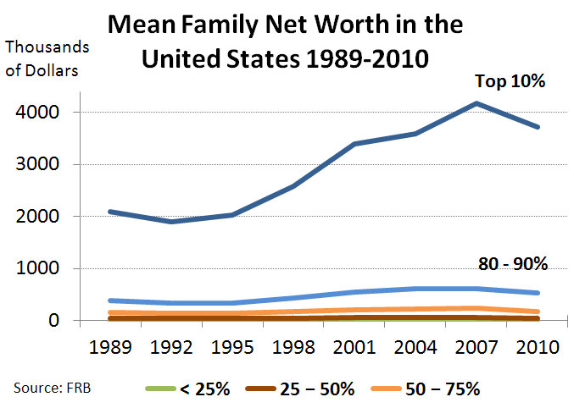
Notes:
What does this chart say about inequality? (Wikipedia)

Slide 11
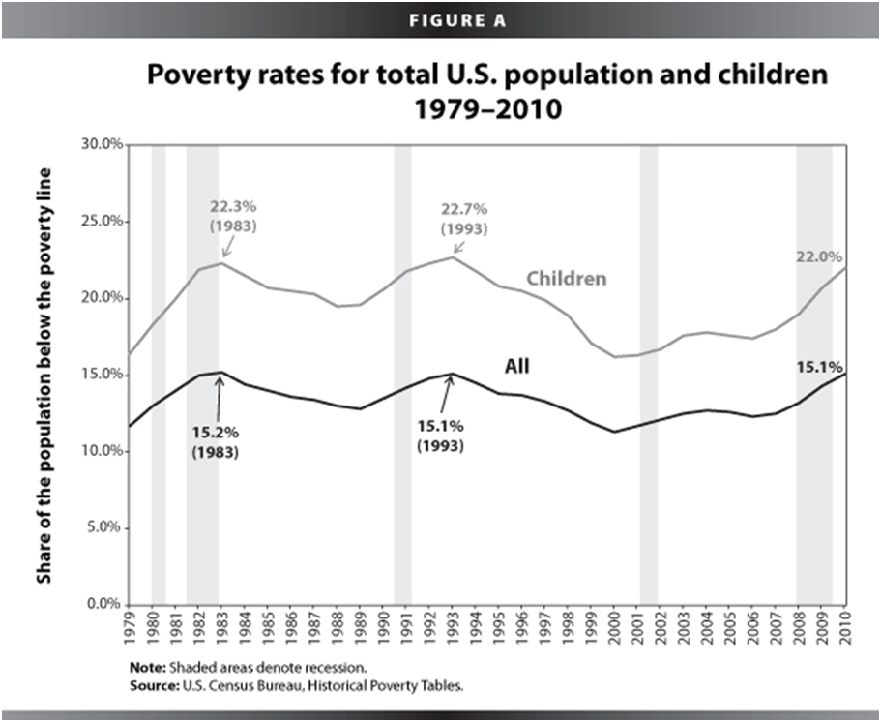
Notes:
Why were poverty rates lower before 1979? (Wikipedia)

Slide 12
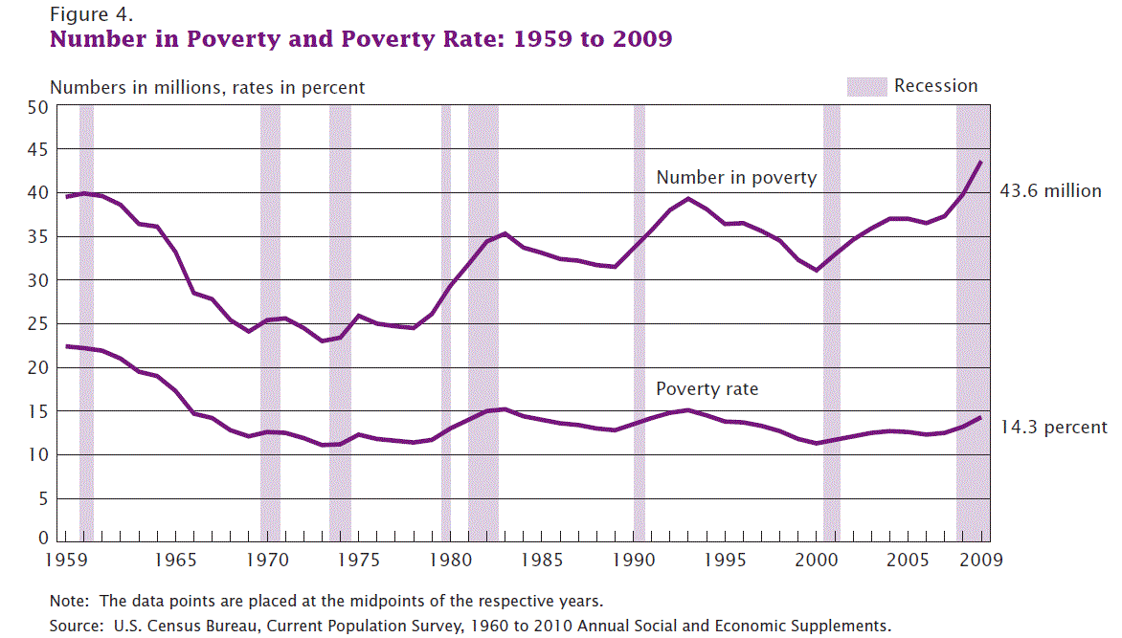
Notes:
Why is their poverty in a wealthy country like the U.S.?

Slide 13
Education
Notes:
School children sitting in the shade of an orchard in Bamozai, near Gardez, Paktya Province, Afghanistan. (Wikipedia)

Slide 14
Education, Rwanda Students
Notes:
Students in Kagugu Primary School of Rwanda. (Wikipedia)

Slide 15
Participatory Democracy
Elite Democracy

Slide 16
Global Organizations, United Nations
Notes:
The U.N. s an intergovernmental organization whose stated aims include promoting and facilitating cooperation in international law, international security, economic development, social progress, human rights, civil rights, civil liberties, political freedoms, democracy, and the achievement of lasting world peace. Located in New York City. (Wikipedia)

Slide 17
Global Organizations, International Court
Notes:
International Court of Justice commonly referred to as the World Court or ICJ is the primary judicial branch of the United Nations. It is based in the Peace Palace in The Hague, Netherlands. Its main functions are to settle legal disputes submitted to it by states and to provide advisory opinions on legal questions submitted to it by duly authorized international branches, agencies, and the UN General Assembly. (Wikipedia)

Slide 18
NGO G r e e n p e a c e
Notes:
The complex governance and management structure of Greenpeace. Based in Amsterdam, Netherlands, and 28 regional offices operating in 45 countries. (Wikipedia)

Slide 19
NGO, International Red Cross
Notes:
The International Red Cross and Red Crescent Movement is an international humanitarian movement with approximately 97 million volunteers, members and staff worldwide which was founded to protect human life and health, to ensure respect for all human beings, and to prevent and alleviate human suffering. (Wikipedia)

Slide 20
United States as Empire?
Notes:
This is a provocative questions to raise. No definitive answer on this one!
The U.S. Joint Service Color Guard on parade. (Wikipedia)

Slide 21
Notes:
U.S. military spending from 1910 to 2007, adjusted for inflation to 2003 dollars. The large spike represents World War II spending. (Wikipedia)

Slide 22
Reasons for Conflict
Conflict over scarce resources.
Religious differences.
Ethnic hatred.
Conflicting worldviews.
Territorial expansion.
Core exploits periphery.
Rapid social disruptions.
Competition for prestige and power.
Economic rivalries
Hostile nationalism.
Disputes over territorial boundaries.

Slide 23
Domestic Terrorism
Notes:
Domestic terrorism in the United States between 1980 and 2000 consisted of incidents confirmed as or suspected to be terrorist acts. These attacks are considered domestic because they were carried out by U.S. citizens. (Wikipedia)
The Oklahoma City bombing was a domestic terrorist bomb attack on the Alfred P. Murrah Federal Building in downtown Oklahoma City on April 19, 1995. It would remain the most destructive act of terrorism in the United States until the September 11 attacks. The bombing claimed 168 lives and injured more than 680 people.

Slide 24
Terrorism, 9/11
Notes:
Terrorism: Terrorism is the systematic use of violence (terror) as a means of coercion for political purposes. (Wikipedia)
Right: United Airlines Flight 175 hits the South Tower of the former World Trade Center on September 11, 2001, in New York City, United States of America.
Left: The remains of 6 World Trade Center, 7 World Trade Center, and 1 World Trade Center on September 17, 2001.

Slide 25
Clean Elections Arizona Maine
Notes:
Arizona Clean Elections Commission and Maine Citizens for Clean Elections. (Wikipedia)

Slide 26
Communication
Notes:
An evolution of mobile phones on the right. (Wikipedia)
Ipad Air on the left.

Slide 27
Consumerism
Notes:
Left: Consumerism worldwide, an electronics store in a shopping mall in Jakarta, Indonesia. Part of the Globalized worldview. (Wikipedia)
Right: McDonalds’ is ubiquitous throughout the world. A Mega Mac burger with a large Coke and fries in Malaysia. (Wikipedia)

Slide 28
Fundamentalist Worldview
Notes:
Trinity Broadcasting Network headquarters in Costa Mesa, California. (Wikipedia)

Slide 29
Fundamentalist Worldview
Notes:
Inside Hillsong Church, Sydney, Australia. Preaches the prosperity gospel. (Wikipedia)

Slide 30
Transformative Worldview
Interdependent Ideals
Community-Focused Social Values
Natural Capitalism
Ecological Awareness
Renewable Energy
Peace and Justice Movements
Sustainable Agriculture
Holistic Health
Spirituality
Holistic Education

Slide 31
Notes:
Wind energy in Germany. Photo Denise Ames

Slide 32
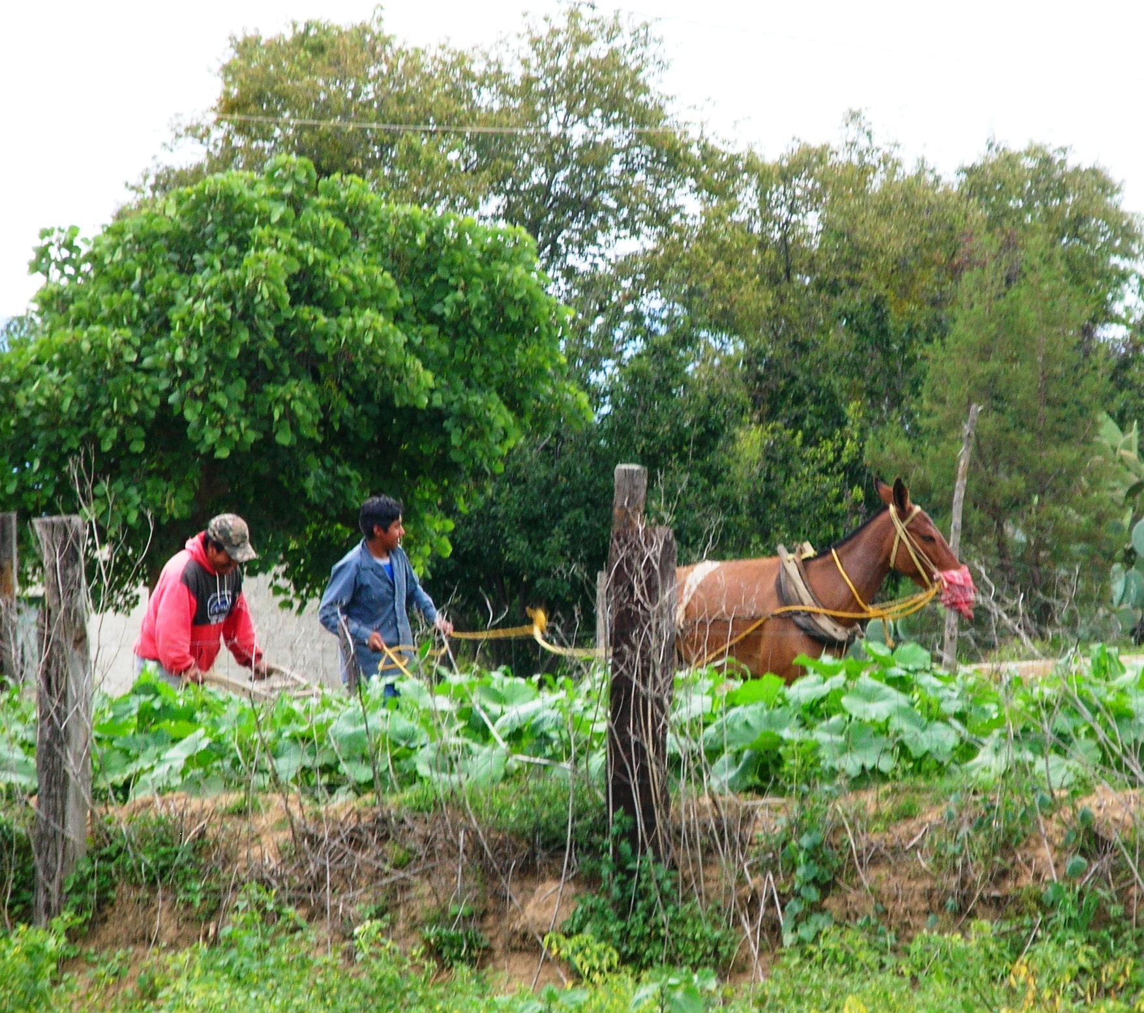
Notes:
Sustainable agriculture in the village of Vincente Guerrero in the state of Tlaxaca, Mexico, 2007. photo Denise Ames

