Slide 1
Chapter 8: The Global Wave
Techno-Economic Currents

Slide 2
The Global Economy
Neoliberalism
Economic Globalization
Financialization

Slide 3
The Philosophy of Neoliberalism
Self Interest Motivation
Benefits of Financial Gains
Competitive Behavior
Materialist Consumption
Free Markets most Efficient
Governments Provide Infrastructure & Laws
Economic Growth Best

Slide 4
Ten Principle of Neoliberalism
Free Trade
Deregulation
Cut Taxes for Wealthy
Money will Trickle down to Poor
Government support for Infrastructure and Subsidies
Privatize
Economic Growth
Commodification
Depress Wages
Economic Globalization is Good

Slide 5
Ronald Reagan and Margaret Thatcher
Notes:
President Ronald Reagan, US, left, Prime Minister Margaret Thatcher, UK, right spouses on left. They helped push a global shift to neoliberalism. (Wikipedia)

Slide 6
Economic Globalization
Increasing expansion of capitalism around the world, integrating non-capitalist economies into a world economic system.

Slide 7
Managed Capitalism
Notes:
Harry Dexter White, U.S. Assistant U.S. Secretary of Treasury, John Maynard Keynes, UK, right. (Wikipedia)

Slide 8
Cochabamba Water Wars
Notes:
Demonstrators demand removal of consortium and end of privatization of water works, February to April 2000. (Wikipedia)

Slide 9
Carlos Slim Helu
Notes:
Carlos Slim Helu is a Mexican business magnate, investor, and philanthropist. From 2010 to 2013, Slim was ranked as the richest person in the world, but that position has been regained by Bill Gates of the U.S. How did he get so wealthy? (Wikipedia)

Slide 10
World Bank
Notes:
The World Bank headquarters in Washington, DC. Does the U.S. have any advantage by having the World Bank headquarters located in Washington D.C.? (Wikipedia)

Slide 11
International Monetary Fund
Notes:
On 28 June 2011, Christine Lagarde was named managing director of the IMF, the first woman to hold the position. The head of the IMF is customarily an European and World Bank president an American. What would be the advantage to the West in continuing this tradition? (Wikipedia)

Slide 12
Notes:
World Trade Organization is an organization that intends to supervise and liberalize international trade. The organization officially commenced on 1 January 1995. (Wikipedia)
Why have so many nations joined the WTO? Who does this benefit?
Green members
Yellow observers
Red nonmembers
Blue represented by the European Union

Slide 13
The World Trade Organization
Notes:
The Chiquita Corporation brought the one of the cases about the banana trade before the World Trade Organization in 1997. What significance was this early case have on the WTO policies? (Wikipedia)

Slide 14
Notes:
The share of the financial sector has grown considerably since the 1980s. What repercussions does this growth of the financial sector have on the economy? (Wikipedia)

Slide 15
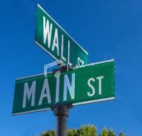
Notes:
The Financial Sector: Increasing bifurcation between Main Street and Wall Street. What does this mean for you? (Wikipedia)

Slide 16
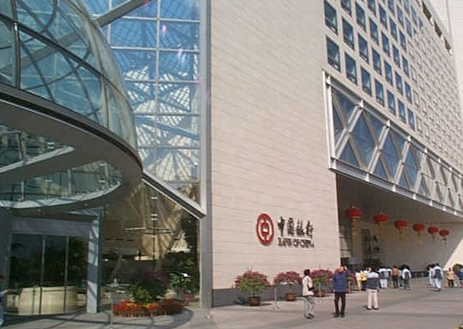
Notes:
Bank of China Headquarters, Beijing, China. Architecture by I. M. Pei. Employees 288,687 (2011), revenue 413.10 billion (2011). What effect does state capitalist enterprises have on a nation’s economy? (Wikipedia)

Slide 17
State Capitalism
Notes:
Petrobas is the largest company in the Southern Hemisphere by market capitalization and the largest in Latin America measured by 2011revenues. Brazilian government owns 64% of the company. How would it be difference if the company was owned by private investors? (Wikipedia)

Slide 18
Damascus, Syria, Souk
Notes:
Alternative forms of the economy are evident in this Damascus, Syria souk or marketplace. Photo Denise Ames
How is the economy different in a souk rather than a chain store such as Walmart?

Slide 19
The Core
Notes:
Indian tycoon Mukesh Ambani is about to move into his new house, the world's largest: a 27-story skyscraper in Mumbai. It has three helipads, a parking garage and 600 staff members. It's worth £630 million, or about $9 billion.
How can core individuals gain so much wealth? (Wikipedia)

Slide 20
Slum
Notes:
The periphery. Kibera slum in Nairobi, Kenya, the second largest slum in Africa and third largest in the world.
Why are people in the periphery, such as the very poor who live in slums? (Wikipedia)

Slide 21
S l u m
Notes:
A slum in Brazil. Rocinha favela is next to skyscrapers and wealthier parts of the city, a location that provides jobs and easy commute to those who live in the slums. Why is Brazil one of the most unequal nations in the world? (Wikipedia)

Slide 22
S l um
Notes:
An integrated slum dwelling and informal economy inside Dharavi of Mumbai. Dharavi slum started in 1887 with industrial and segregationist policies of the British colonial era. The slum housing, tanneries, pottery and other economy established inside and around Dharavi during the British rule of India. What would be the advantages of having enterprises in the slums? What would be the disadvantages? (Wikipedia)

Slide 23
Slum
Notes:
Makoko - One of the oldest slums of Africa built on stilts on a lagoon, home to about quarter of million people of Lagos, Nigeria. Starting 2012, it is being dismantled by the city government, amidst controversy, to accommodate infrastructure for 20+ million poor Nigerians in urban Lagos area. (Wikipedia)

Slide 24
Slum
Notes:
Substandard housing in a slum near Jakarta, Indonesia in the 2000s. (Wikipedia)

Slide 25
Advantages for Core Nations
Technological Advantage
Influence on World Bank, WTO and IMF
Access to Natural Resources and Markets
Media and Communication Monopolies
Controls National and International Policies
Military Advantage

Slide 26
North American Free Trade Association NAFTA
Notes:
Three world leaders: (background, left to right) Mexican President Carlos Salinas de Gortari, U.S. President George H. W. Bush, and Canadian Prime Minister Brian Mulroney, observe the signing of the North American Free Trade Agreement. Commenced in San Antonio, Texas on December 17, 1992. (Wikipedia)
What affect has NAFTA had on all three countries?

Slide 27
Walmart: “every day low prices.”
Notes:
Externalizing costs. The company is the world's second largest public corporation, according to the Fortune Global 500 list in 2013, the biggest private employer in the world with over two million employees, and is the largest retailer in the world. Walmart remains a family-owned business, as the company is controlled by the Walton family, who own over 50 percent of Walmart. It is also one of the world's most valuable companies. (Wikipedia)
What advantages does Walmart have when it externalizes costs? How does this strategy affect you as a consumer?

Slide 28
Wal-Mart's Externalized Costs
Health Care Cost
Low Wages
Overtime
Loss of Local Tax Revenue
Subsidies and Tax Abatements
Infrastructure Subsidies
Loss of U.S. Manufacturing Jobs

Slide 29
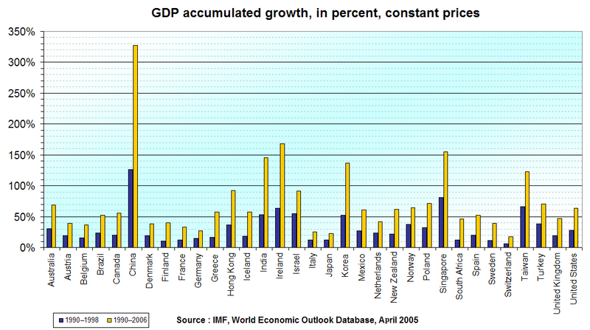
Notes:
GDP real growth rates, 1990–1998 and 1990–2006, in selected countries. (Wikipedia)
What countries have the highest growth raths? What countries the lowest?

Slide 30
Eat Some Peanuts!
Notes:
What is the point of the peanuts story? (Wikipedia)

Slide 31
Questions About Growth
Growth of what?
Growth for whom?
Who pays for growth?
At what cost is growth?
What is the real need?
What is the most direct and efficient way for those who have that need to be able to satisfy it?
How much is enough?
What are the obligations to share?

Slide 32
Patterns of Labor Service Workers and Manufacturing Workers
Notes:
Nurse, a service worker on the left. Manufacturing workers on right. (Wikipedia)

Slide 33
U.S. Manufacturing Worker
Notes:
This woman operating the potato chip machine is now competing with Chinese manufacturing workers in the previous slide because of the economic globalization. What do you think are happening to her wages? Is he going to be able to enjoy a middle class status. (Wikipedia)

Slide 34
A Maquila in Mexico
Notes:
is the Mexican name for manufacturing operations in a free trade zone (FTZ), where factories import material and equipment on a duty-free and tariff-free basis for assembly, processing, or manufacturing and then export the assembled, processed and/or manufactured products, sometimes back to the raw materials' country of origin.
Currently about 1.3 million Mexicans are employed in one or more of approximately 3,000 maquiladoras. (Wikipedia) How does this operation affect wages in the U.S.? (Wikipedia)

Slide 35
Local Capitalism
Notes:
Farmers or growers markets are part of the shift to local capitalism that many people are promoting. What are the advantages of local capitalism? What are the disadvantages? (Wikipedia)

Slide 36
Local Capitalism, Artisans
Notes:
Artisans in Iran making vases. Photo Denise Ames

