Slide 1
Chapter 8: People Creating a Future: The Global Wave
Ecosystem Currents

Slide 2
Ten Areas of Global Change
1. Integrated
Global
Environment
Nations
English
Consumer Culture
Democracy
Human Rights
Population Growth
Globalized Conflict

Slide 3
The Earth is an Island
Notes:
Wikipedia

Slide 4
Environmental Issues
Desertification
Deforestation
Fresh Water
Climate Change
Sea Levels
Soil Depletion
Carrying Capacity
Human Populations
Natural Populations
Notes:
Anti-sand shields protect agricultural plots in north Sahara, Tunisia, Africa.

Slide 5
Desertification
Notes:
Global Desertification Vulnerability Map. Wikipedia

Slide 6
Desertification
Notes:
Vegetation barriers to keep the prowling desert at bay. Wikipedia

Slide 7
Desertification
Notes:
Loess soil near Hunyan, Shanxi province, China. Wikipedia

Slide 8
Desertification
Notes:
A herd of goats in Norte Chico, Chile. Overgrazing of drylands is one of the primary causes of desertification. Wikipedia

Slide 9
Desertification
Notes:
A shepherd guiding his sheep through the high desert outside of Marrakech, Morocco. Wikipedia

Slide 10
Deforestation
Notes:
Slash-and-burn farming in the state of Rondônia, western Brazil. Wikipedia

Slide 11
Deforestation
Notes:
Illegal slash and burn practice in Madagascar, 2010. Wikipedia

Slide 12
Desertification
Notes:
Nouakchott Sand Dunes encroaching upon Nouakchott, the capital and largest city in Mauritania. Wikipedia

Slide 13
Deforestation
Notes:
Deforested land over Oaxaca, southern Mexico. Photo Denise Ames

Slide 14
Deforestation
Notes:
Satellite image of Haiti’s border with the Dominican Republic (right) shows the amount of deforestation on the Haitian side. (Wikipedia)

Slide 15
Deforestation
Notes:
Jungle burned for agriculture in southern Mexico. (Wikipedia)

Slide 16
Fresh Water and Irrigation
Notes:
Irrigation of land in Punjab, Pakistan. (Wikipedia)

Slide 17
Fresh Water and Irrigation
Notes:
Center pivot with drop sprinklers, Yuma County, Colorado. (Wikipedia)

Slide 18
Climate Change
Notes:
Increase in atmospheric CO₂ levels. (Wikipedia)

Slide 19
Climate Change
Notes:
A petrochemical refinery in Grangemouth, Scotland, UK contributes to climate change. (Wikipedia)

Slide 20
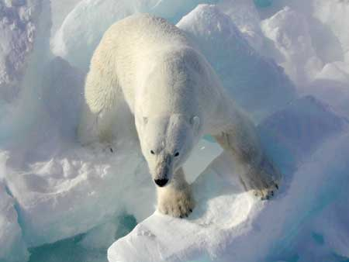
Notes:
Polar bears depend on diminishing sea ice as a platform for hunting seals. (Wikipedia)

Slide 21
Soil Depletion
Notes:
Linxia, China, a farmer is gradually losing his land as the edge of the loess plateau is eroded away. (Wikipedia)

Slide 22
Soil Depletion
Notes:
Reclaimed terraced community farm in Vincente Geuerrero in the state of Tlaxaca, Mexico. Photo Denise Ames

Slide 23
Soil Deple-tion
Notes:
Intensive tillage result in soil degradation. (Wikipedia)

Slide 24
World Map according to Ecological Footprint
Notes:
World map of countries shaded according to their ecological footprint in 2007 (published on 13 October 2010 by the Global Footprint Network). It is measured by the amount of global hectares that are affected by humans per capita of the country. Lighter shades denote countries with a lower ecological footprint per capita and darker shaded for countries with a higher ecological footprint per capita. The total ecological footprint (global hectares affected by humans) is measured as a total of six factors: cropland footprint, grazing footprint, forest footprint, fishing ground footprint, carbon footprint and built-up land. Wikipedia http://en.wikipedia.org/wiki/File:World_map_of_countries_by_ecological_footprint_(2007).svg

Slide 25
World Population Map
Notes:
Map showing urban areas with at least one million inhabitants in 2006. Only 3% of the world's population lived in cities in 1800; this proportion had risen to 47% by 2000, and reached 50.5% by 2010. By 2050, the proportion may reach 70%. Source: Wikipedia http://en.wikipedia.org/wiki/World_population

Slide 26
Notes:
Chart showing geographic distribution of the world population in 2005. Wikipedia: http://en.wikipedia.org/wiki/World_population

Slide 27
Notes:
The Siberian tiger is a subspecies of tiger that is endangered; three subspecies of tiger are already extinct. (Wikipedia)

Slide 28
Notes:
The most endangered Asiatic top predator, the dhole, is on the edge of extinction. (Wikipedia)

