Slide 1
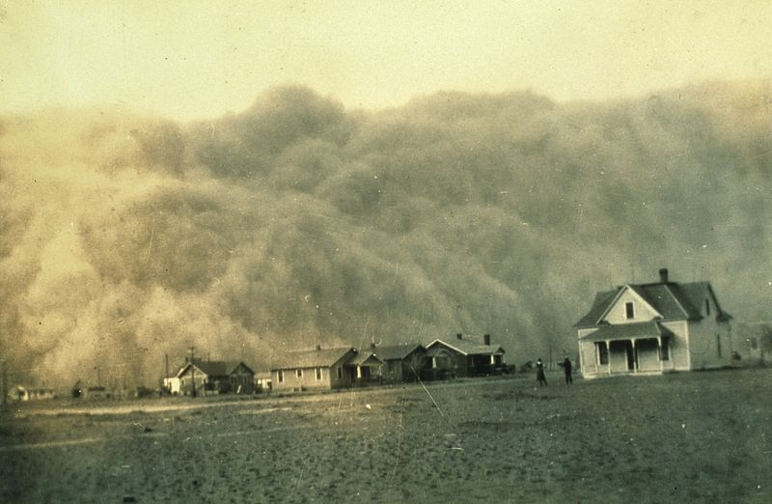
Dust Bowl, U.S. 1935
Notes:
The Dust Bowl dust storm approaches Stratford, Texas, in 1935.

Slide 2
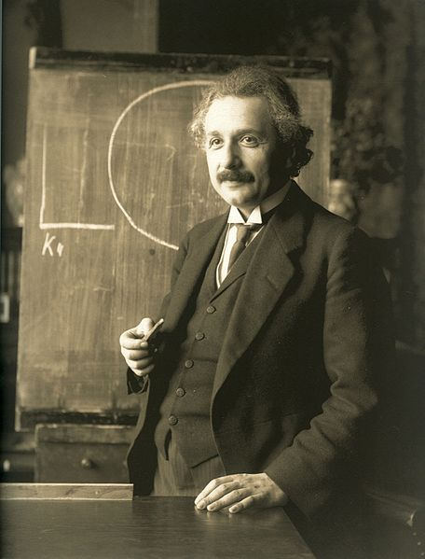
Cultural, A Changing Worldview
Notes:
Albert Einstein, 1921. He was awarded the Nobel Prize for Physics the same year.

Slide 3
Techno-Economic Currents to 1950

Slide 4
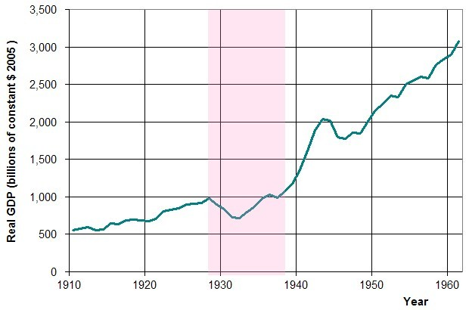
Real U.S. GDP Rates
Notes:
USA annual real GDP from 1910–60, with the years of the Great Depression (1929–1939) highlighted. (Wikipedia)

Slide 5
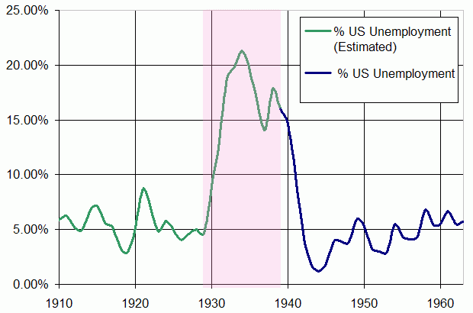
U.S. Unemployment Rates
Notes:
The unemployment rate in the US 1910–1960, with the years of the Great Depression (1929–1939) highlighted.

Slide 6
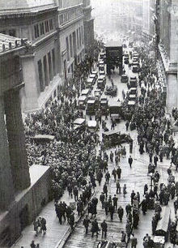
Great Depression, Stock Market Crash
Notes:
Crowd gathering at the intersection of Wall Street and Broad Street after the 1929 crash.

Slide 7
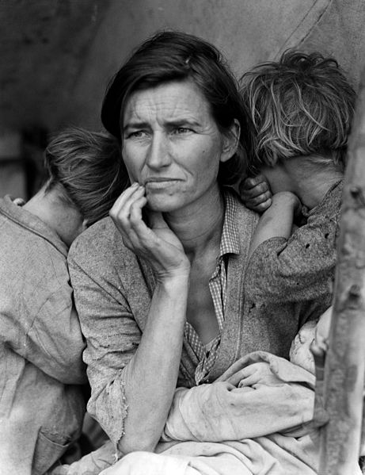
Great Depression United States
Notes:
Face of the Depression. Dorothea Lange's Migrant Mother depicts destitute pea pickers inCalifornia, centering on Florence Owens Thompson, age 32, a mother of seven children, in Nipomo, California, March 1936.

Slide 8
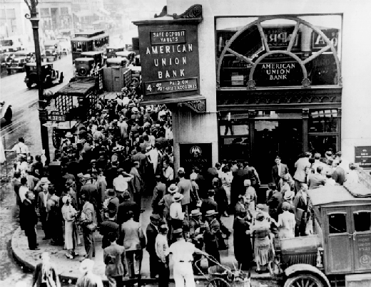
Economy, Great Depression
Notes:
Crowd at New York's American Union Bank during a bank run early in the Great Depression.

Slide 9
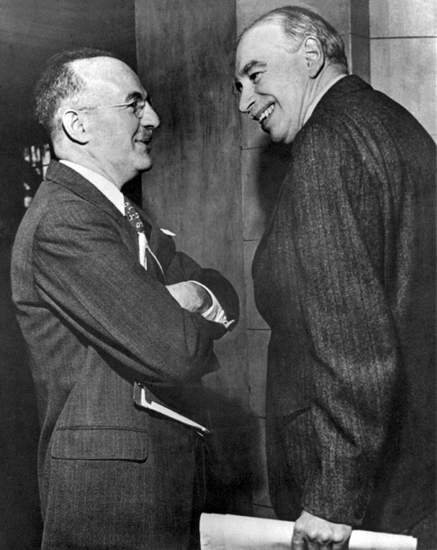
Economy, Managed Capitalism
Notes:
John Maynard Keynes (right) and Harry Dexter White at the Bretton Woods Conference in 1945. Keynes ushered in what was known as managed capitalism.

Slide 10
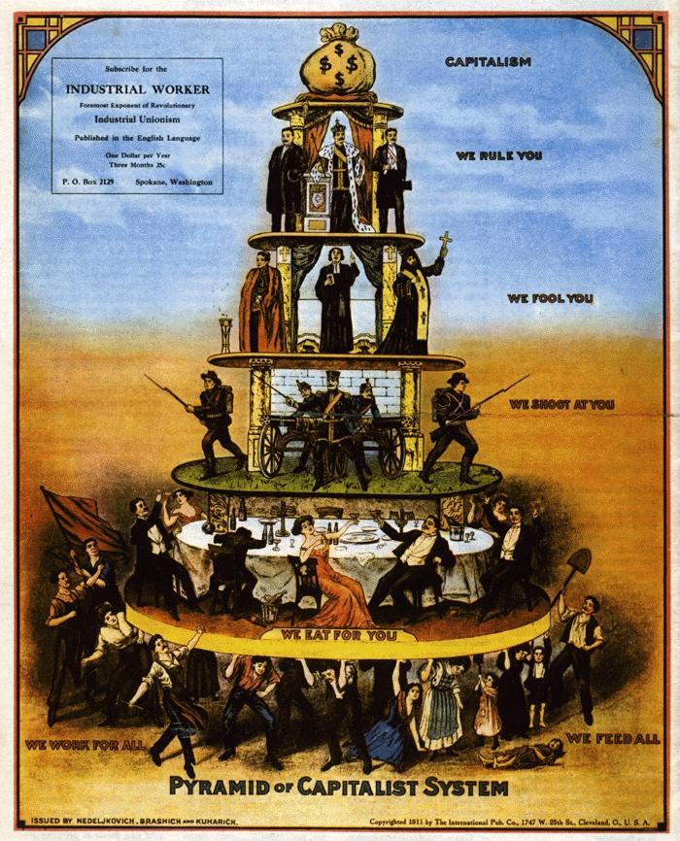
A View of Capitalism
Notes:
What is the interpretation of capitalism according to industrial workers.

Slide 11
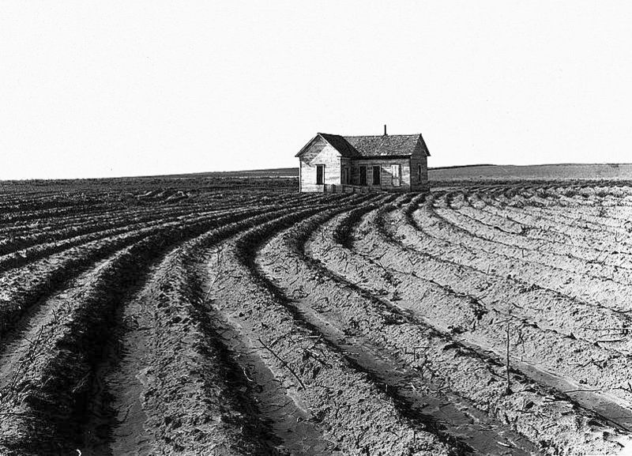
Great Depres-sion
Notes:
Power farming displaces tenants from the land in the western dry cotton area. Childress County, Texas, 1938. (Wikipedia)

Slide 12
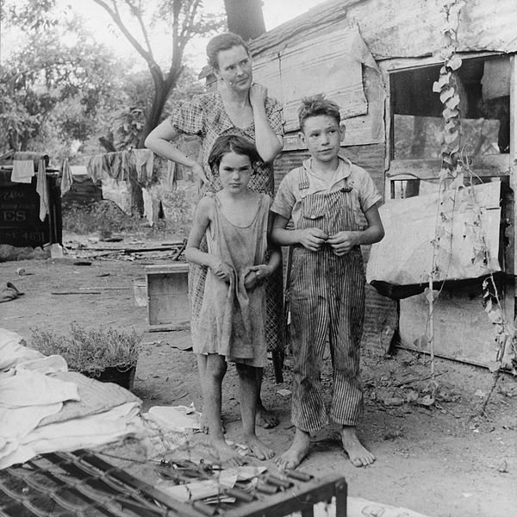
Great Depres-sion
Notes:
An impoverished American family living in a shanty, about 1936. photo by Dorthea Lange

Slide 13
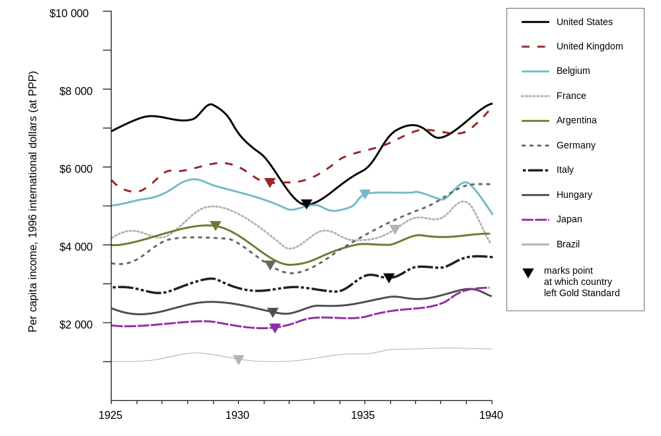
Notes:
The Depression in international perspective. (Wikipedia)

Slide 14
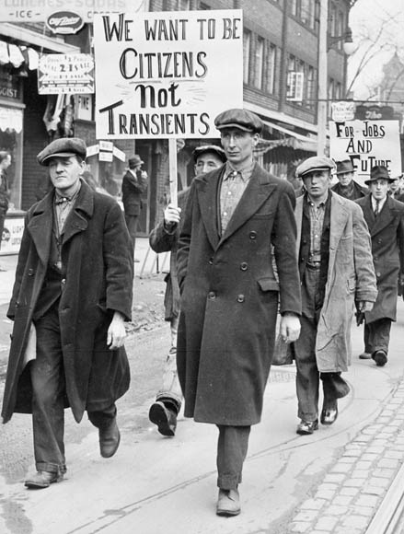
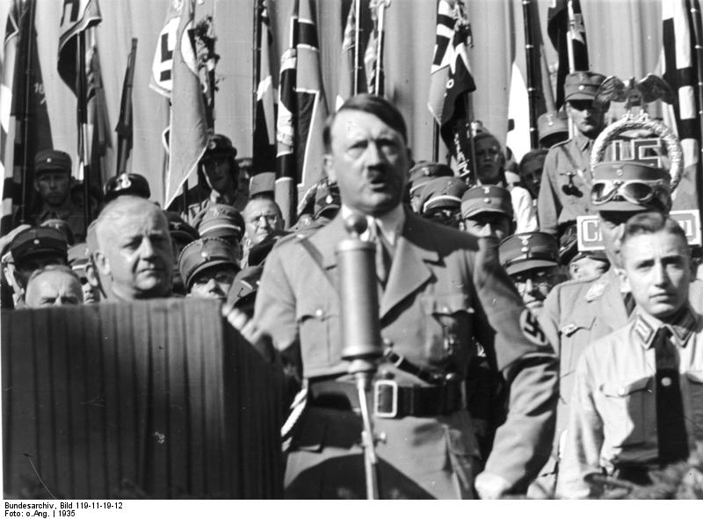
International Great Depression
Notes:
Unemployed men march in Toronto,Ontario, Canada. (left)
Adolph Hitler speaking in 1935, Germany was hard hit by the depression.

Slide 15
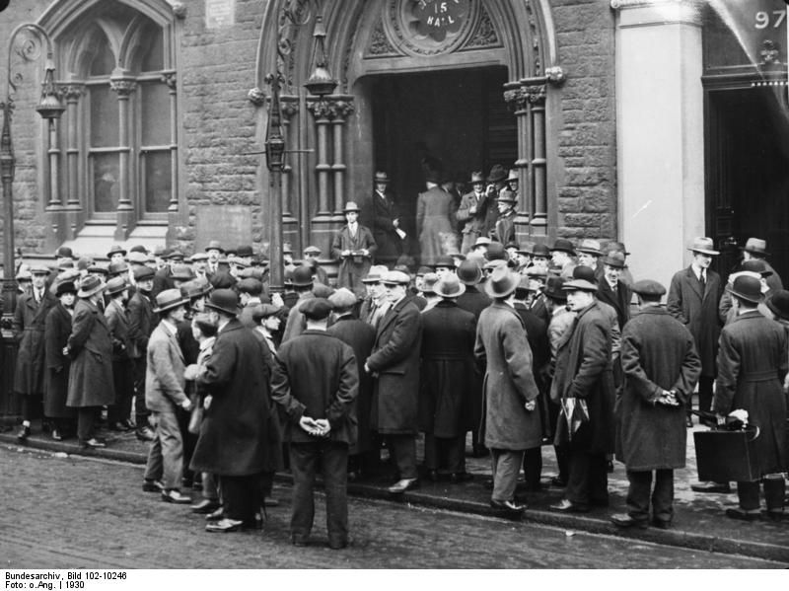
Great Depression, London
Notes:
Unemployed people in front of a workhouse in London, 1930. (Wikipedia)

Slide 16
Political Currents to 1950

Slide 17
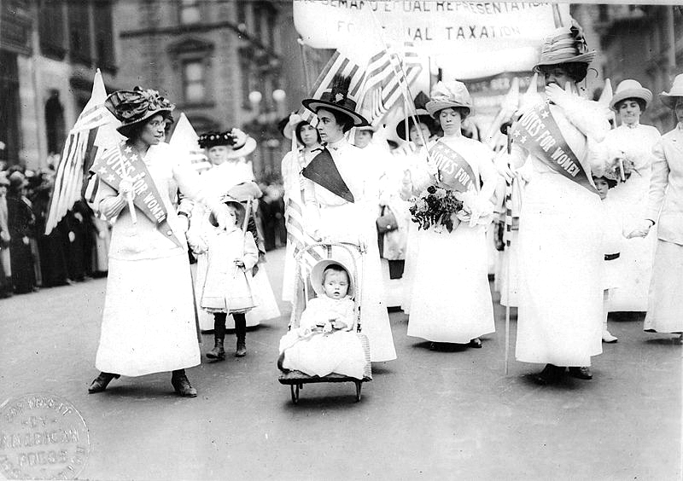
Political, Women’s Suffrage
Notes:
Feminist suffrage parade in New York City, May 6, 1912. Women gained the right to vote in the U.S. in 1920.

Slide 18
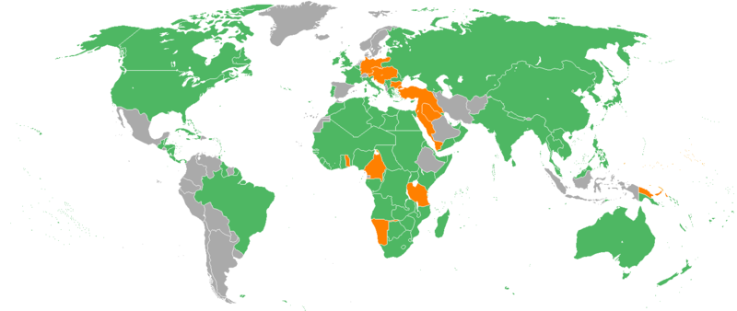
World War I Participants
Notes:
Map of the participants in World War I: Allied Powers in green, Central Powers in orange, and neutral countries in grey.

Slide 19
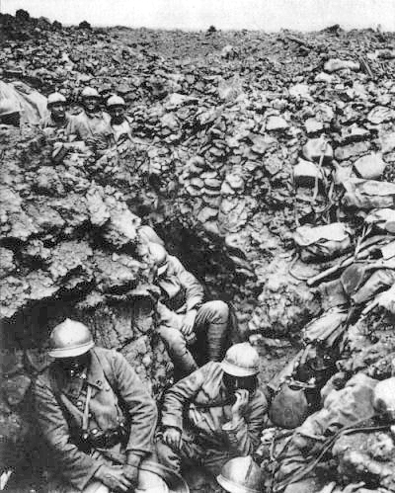
World War I Trench Warfare
Notes:
French 87th regiment in trench at Hill 34 outside Verdun.

Slide 20
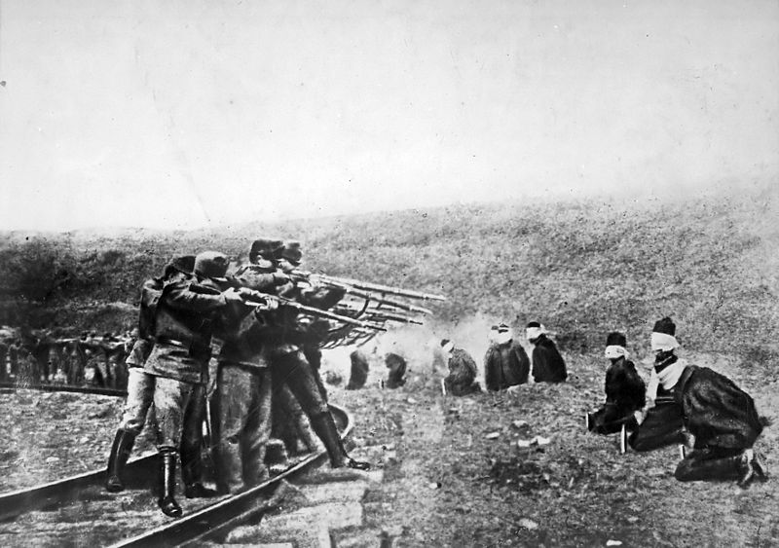
World War I Massacre
Notes:
Austro-Hungarian troops executing captured Serbians. Serbia lost about 850,000 people during the war, a quarter of its pre-war population. (Wikipedia)

Slide 21
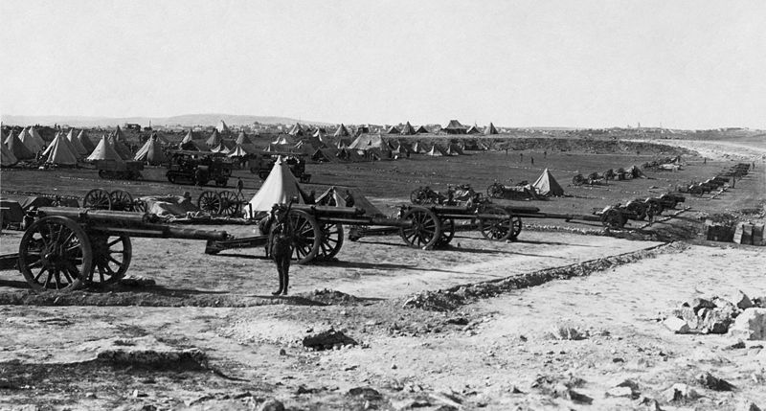
World War I, Middle East
Notes:
A British artillery battery emplaced on Mount Scopus in the Battle of Jerusalem during the Middle East campaign of World War I. (Wikipedia)

Slide 22
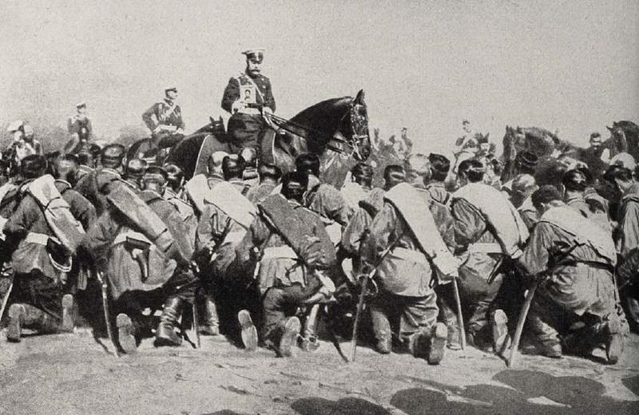
World War I, Russia
Notes:
Tsar Nicholas II among his troops during World War I, Russia, ill-prepared for the war, lost millions. Tsar Nicolas II and his royal family were assassinated by the Bolsheviks during the Russian Revolution.

Slide 23
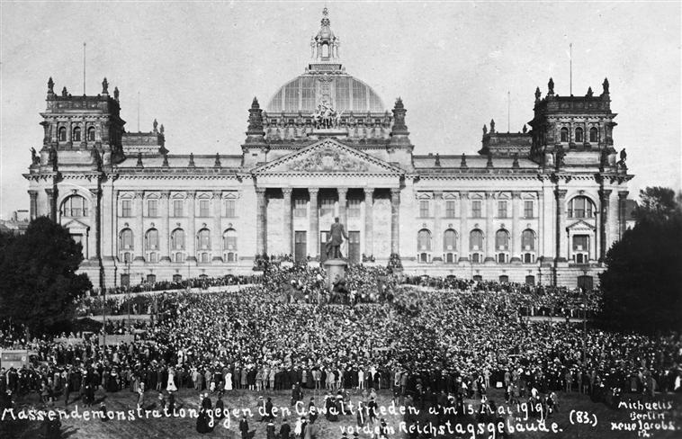
Political, Treaty of Versailles
Notes:
Demonstration against the Treaty of Versailles in front of the Reichstag building in Berlin, Germany.

Slide 24
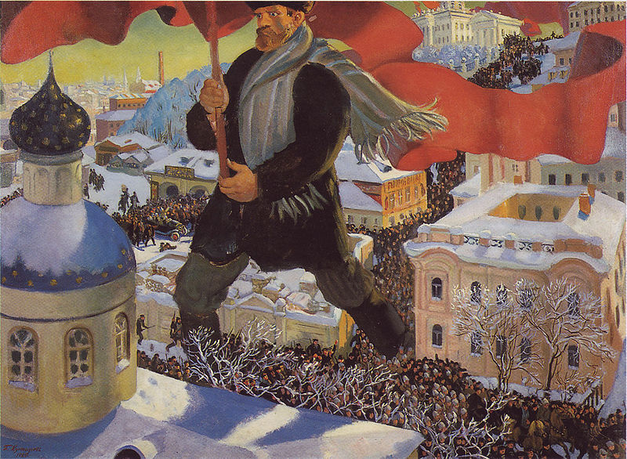
Political, Communist Revolution
Notes:
Painting of the 1917 Bolshevik Revolution, painter Boris Kustodiev, 1920 painting,

Slide 25
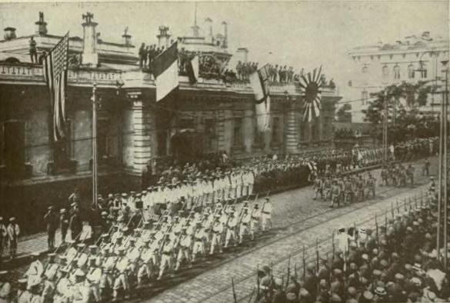
Russian Revolution, White Russians
Notes:
American, British, and Japanese Troops parade through Vladivostok in armed support to the White Army, circa 1917. (Wikipedia)

Slide 26
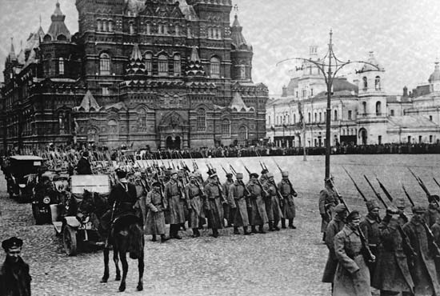
Communist Revolution, Russia
Notes:
Bolshevik forces marching on Red Square, 1917.

Slide 27
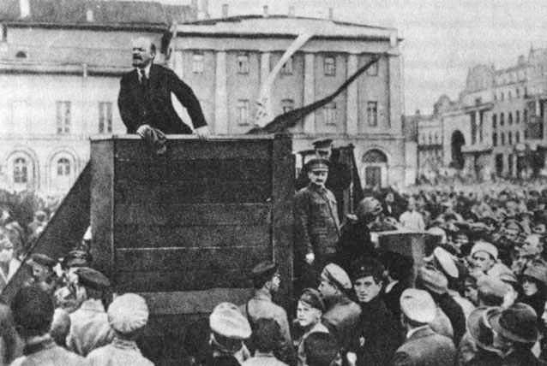
Russian Revolution, Lenin
Notes:
Vladimir Lenin, leader of the Bolsheviks, speaking at a meeting in Sverdlov Square in Moscow, with Leon Trotsky and Lev Kamenev adjacent to the right of the podium. (Wikipedia)

Slide 28
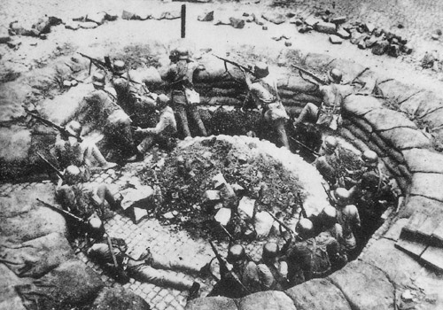
Japanese Invasion of China, 1937
Notes:
A Chinese machine gun nest in the Battle of Shanghai, 1937. Japan invaded China in 1937.

Slide 29
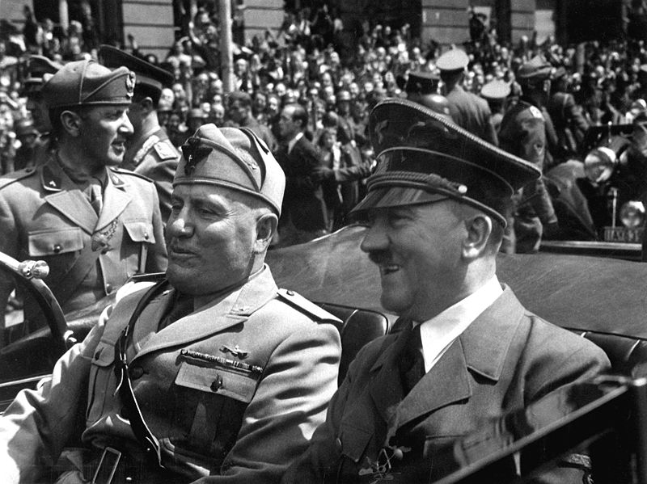
Political, Fascist Leaders
Notes:
Two fascist leaders Benito Mussolini of Italy and Adolf Hitler of Germany in 1940.

Slide 30
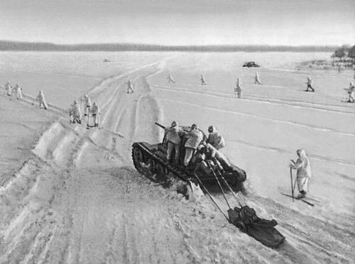
Soviet Union Counterattacks Germany
Notes:
Soviet counter-attack against the Germans during the battle of Moscow, December 1941. (Wikipedia)

Slide 31
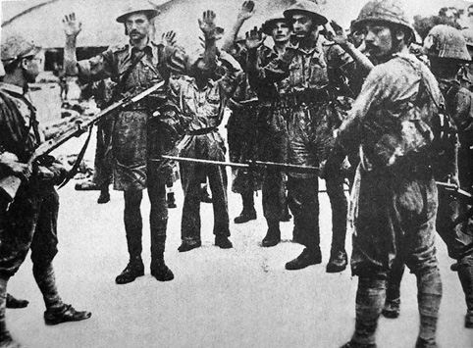
Fall of Singapore to Japanese
Notes:
The February 1942 Fall of Singapore saw 80,000 Allied soldiers captured by the Japanese. (Wikipedia)

Slide 32
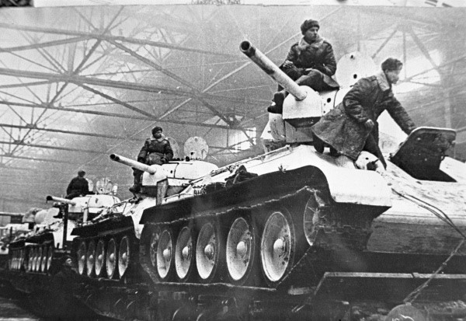
Soviet Union Tanks
Notes:
Soviet T-34, the most-produced tank of the war. Over 57,000 were built by 1945. (Wikipedia)

Slide 33
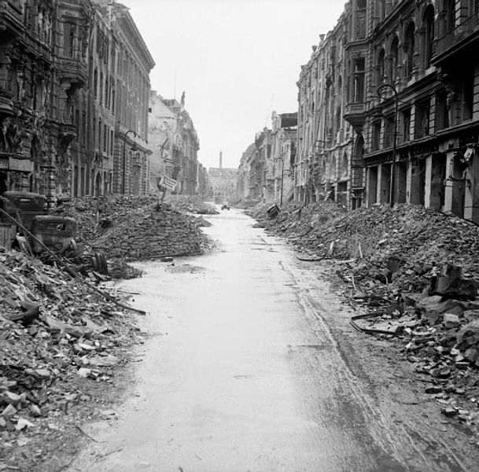
Battle of Berlin, 1945
Notes:
A devastated Berlin street in the city centre after the Battle of Berlin, 3 July 1945.

Slide 34
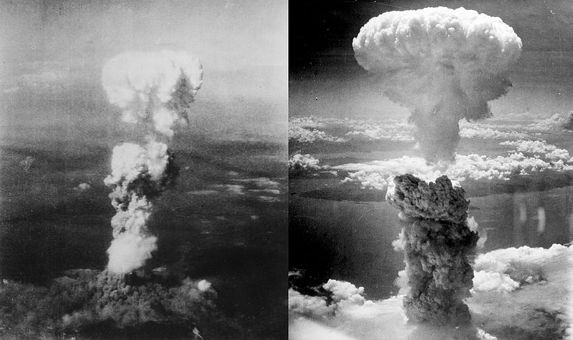
Political, Atomic Bombs
Notes:
Atomic bomb mushroom clouds over Hiroshima (left) and Nagasaki (right), August 6 and 9, 1945.

Slide 35
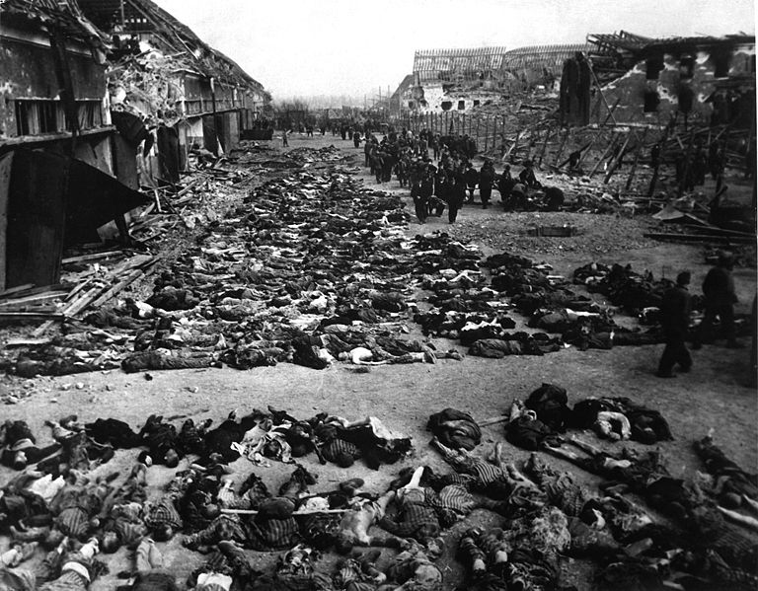
Political, The Holocaust
Notes:
German concentration camp, Lager Nordhausen, 1945, 6 million Jews were killed by the Nazis.

