Slide 1
The World Around 1500
Ottoman Empire ( 1453-1918), Middle East
Safavid Dynasty (1501-1722), Iran
Mughal Empire (1526-1739), India
Ming (1368-1644) and Qing (1644-1911) Dynasty, China
Tokugawa Japan (1603-1868)
Russian Empire (1480-1917)
Decline of kingdoms in Africa
Decline of Inca, Aztec, and Maya in Western hemisphere
Notes:
The Urban Wave continued past 1500 with the above empires and dynasties strong in their regions. However, the Western hemisphere was the first to feel the effects of Westernization with the invasion of the Spanish around 1500. Deadly disease brought from the Europe was the main weapon in bringing about decline in the region.

Slide 2
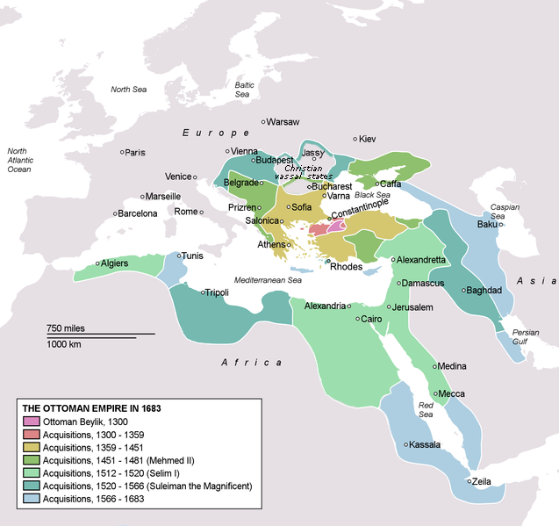
Notes:
Ottoman Empire in 1683, at the height of its empire. Map exercise: Identify the present-day countries that were part of the Ottoman Empire.

Slide 3
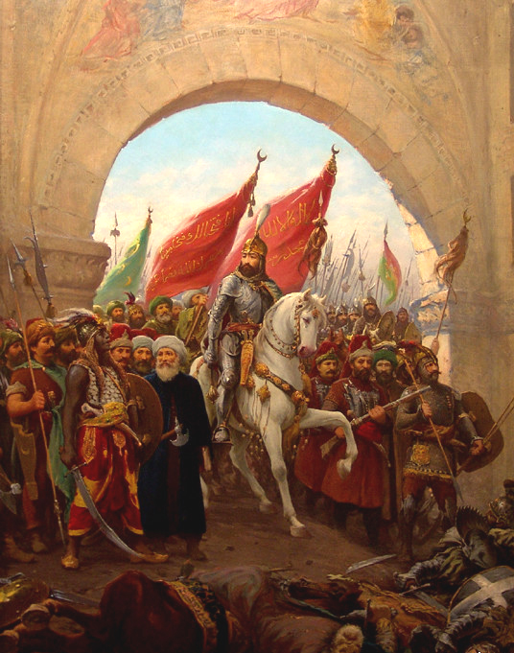
Otto-man Empire
Notes:
Mehmed II enters Constantinople in 1453, signaling the conquest of the Byzantine Empire by the Ottoman Turks painting, by Fausto Zonaro (title) Wikimedia Commons.

Slide 4
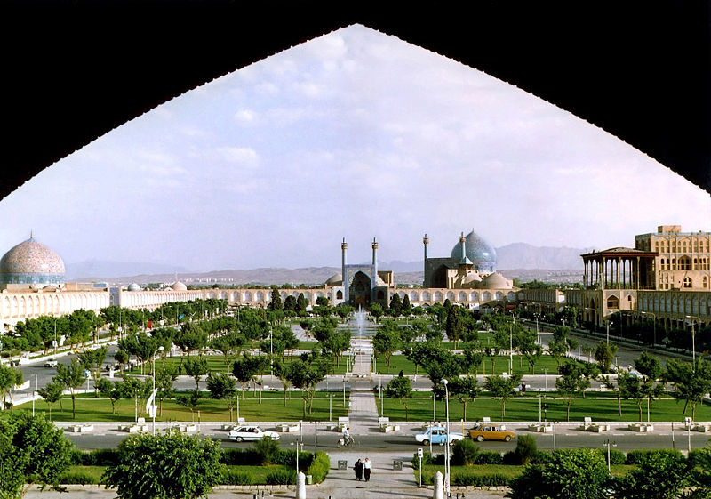
Safavid Dynasty, Iran
Notes:
Naghsh-i Jahan Square, Isfahan, Iran Capital of the Safavid Dynasty 1501-1722.

Slide 5
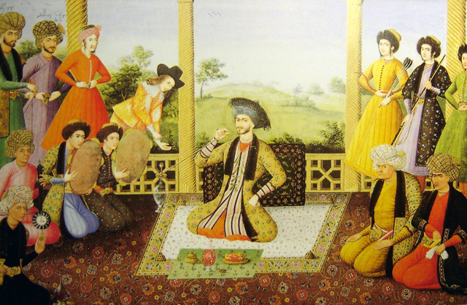
Safavid Dynasty
Notes:
Shah Suleiman I and his courtiers, Isfahan, 1670. Painter is Aliquli Jabbadar, and is kept at The St. Petersburg Institute of Oriental Studies in Russia, ever since it was acquired by Tsar Nicholas II.

Slide 6
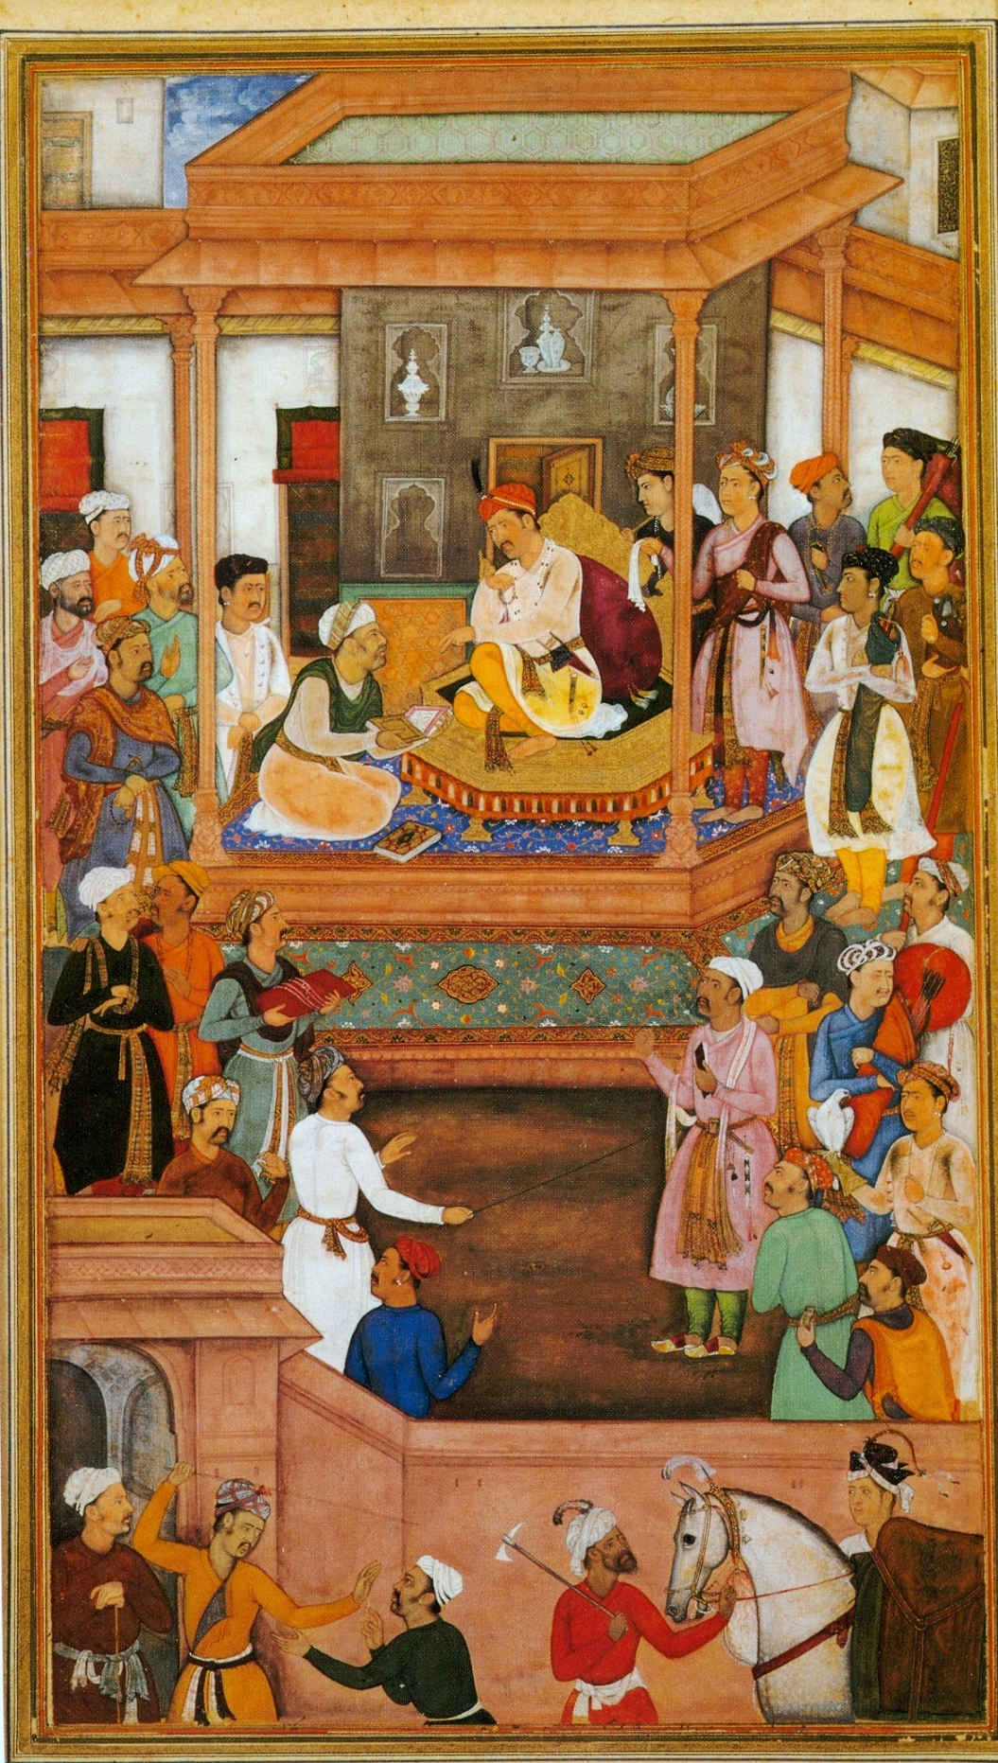
Mughal Empire, India
Notes:
Abu'l-Fazl ibn Mubarak presenting Akbarnama to Akbar, Mughal miniature. Akbar, widely considered the greatest of the Mughalemperors (1556-1605).

Slide 7
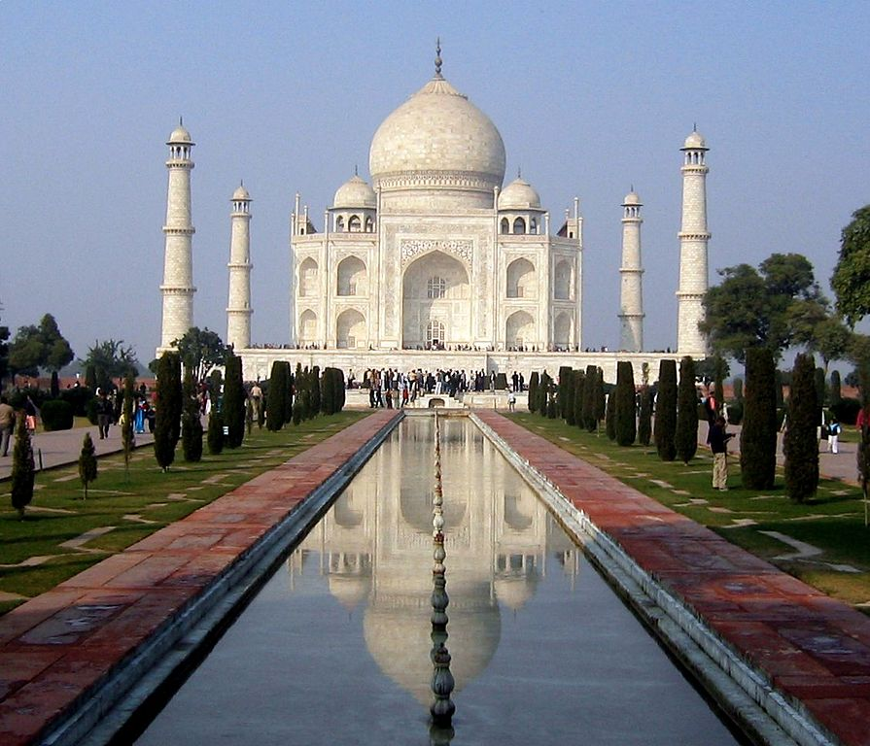
Mughal Empire, India
Notes:
Taj Mahal is the finest example of Mughal architecture, a style that combines elements from Persian, Turkish and Indian architectural styles. It is a white marble mausoleum located in Agra, India. It was built by Mughal emperor Shah Jahan in memory of his third wife, Mumtaz Mahal. Build 1632-1653.

Slide 8
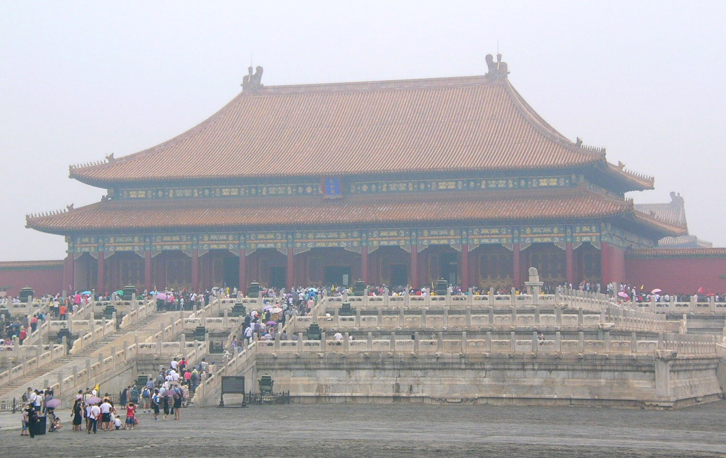
Ming Dynasty, China
Notes:
The Hall of Supreme Harmony in the Forbidden City, Beijing, China. The official imperial household of the Ming and Qing dynasties from 1420 until 1924, when the Republic of China evicted Puyi from the Inner Court. Today pollution blankets a smoky haze over the city. Photo Denise Ames

Slide 9
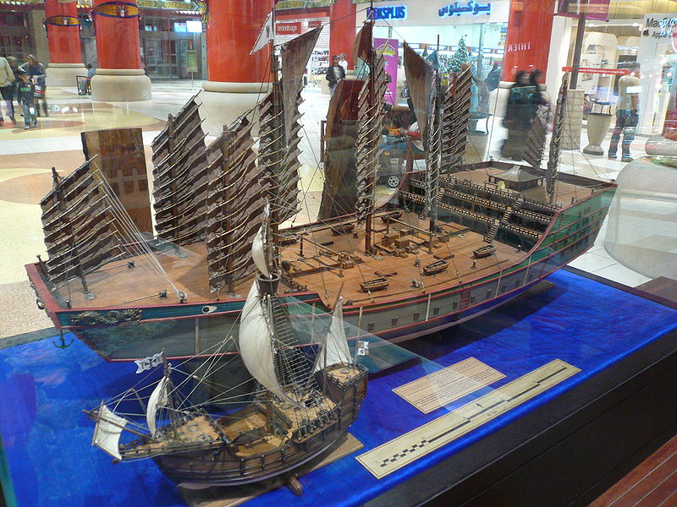
Ming Dynasty, China
Notes:
A display at the Ibn Battuta Mall in Dubai purports to compare the size of ships used by Zheng He and Christopher Columbus.

Slide 10
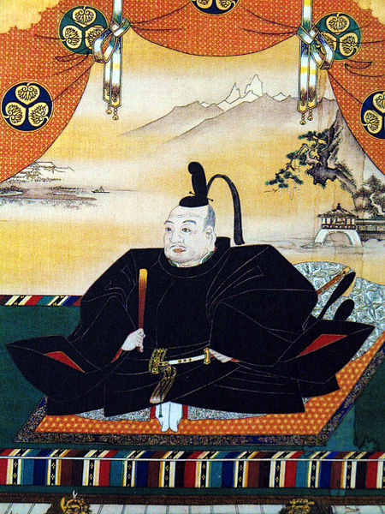
Tokugawa Ieyasu, Japan
Notes:
Tokugawa Ieyasu was the founder and first shogun of the Tokugawa shogunate of Japan, which ruled from the Battle of Sekigahara in 1600 until the Meiji Restoration in 1868.

Slide 11
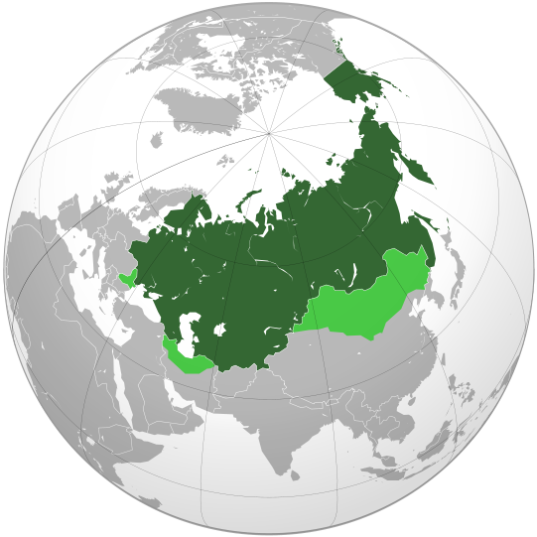
Russian Empire
1914
Notes:
1480-1917, Asynchronous map of the Russian Empire. Dark green empire, light green spheres of influence.

Slide 12
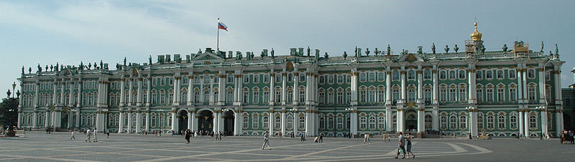
Russian Empire
Notes:
The Winter Palace in Saint Petersburg, Russia, was, from 1732 to 1917, the official residence of the Russian monarchs. The storming of the palace in 1917 became an iconic symbol of the Russian Revolution.

Slide 13
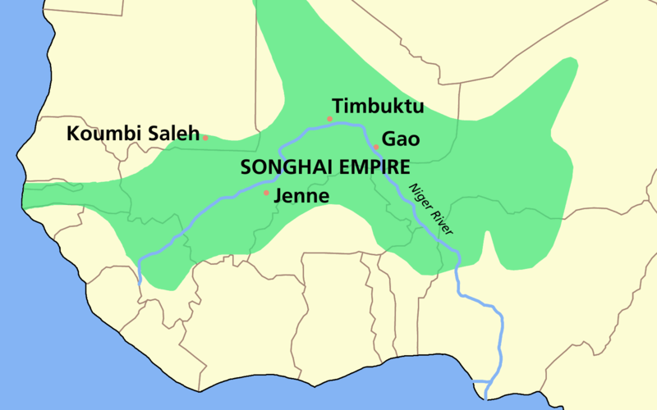
Notes:
The Songhai Empire (1340-1591), also known as the Songhay Empire, was a state located in western Africa. From the early 15th to the late 16th century, Songhai was one of the largest Islamic empires in history. This empire bore the same name as its leading ethnic group, the Songhai. Its capital was the city of Gao, where a Songhai state had existed since the 11th century. Its base of power was on the bend of the Niger River in present day Niger and Burkina Faso. A civil war of succession weakened the Empire.

Slide 14
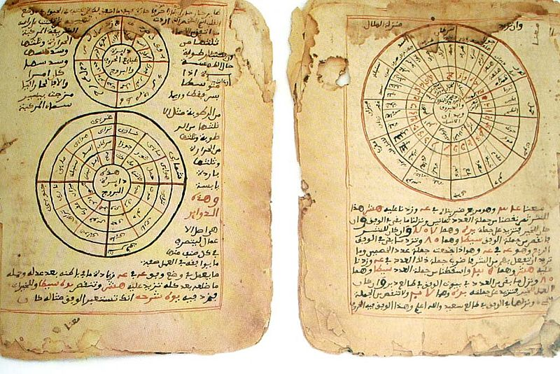
Songhay Empire, Africa
Notes:
Askia the Great (ca. 1443 – 1538, also Muhammad Toure, Askia (ass-key-a)) was an emperor of the Songhai Empire in the late 15th century, the successor of Sunni Ali Ber. Askia Muhammad strengthened his country and made it the largest country in West Africa's history. At its peak under Muhammad, the Songhai Empire encompassed the Hausa states as far as Kano (in present-day Nigeria) and much of the territory that had belonged to the Mali Empire in the west. His policies resulted in a rapid expansion of trade with Europe and Asia, the creation of many schools, and made Islam an integral part of the empire.
The Timbuktu Manuscripts showing both mathematics and astronomy, many Malian rulers including Askia Mohammad I promoted the publications of such manuscripts.
See slide in Urban Wave of Askia’s tomb.

Slide 15
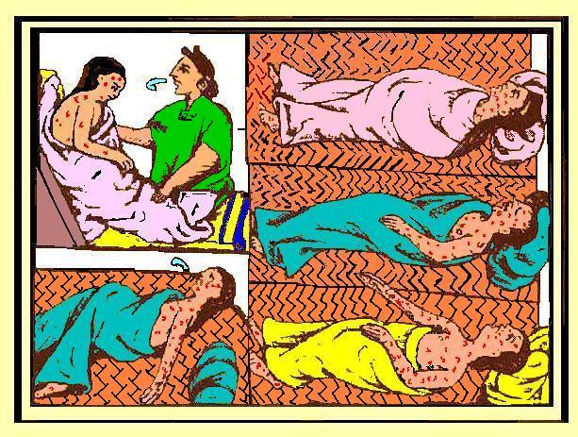
Aztec Empire, Western Hemisphere
Notes:
Aztecs dying of smallpox, “The Florentine Codex” 1540–85. Deadly diseases brought from Europe, native people had to immunity to them.

Slide 16
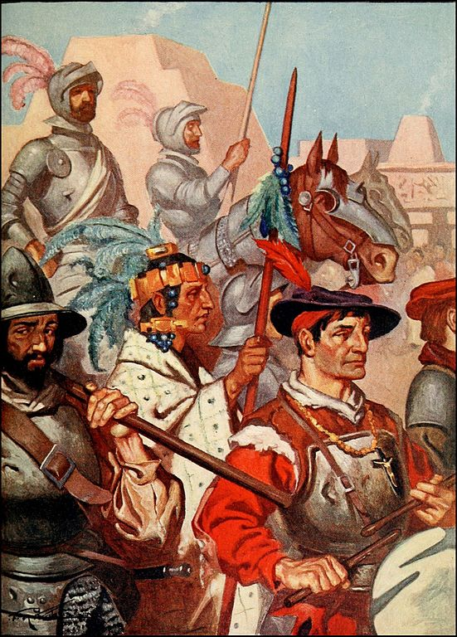
Western Hemi-sphere
Notes:
Conquistadors and their Tlaxcalan allies enter Tenochtitlan in present day Mexico.

Slide 17
Europe Around 1500
Renaissance
Exploration
Protestant Reformation
Sea-Faring Trade
The Scientific Revolution
Wealth from the Western Hemisphere

Slide 18
Three Eras in the Modern Wave
Early Modern Era 1500-1750
The Modern Industrial Era
1750-1900
3. The Twentieth Century 1900-2000

Slide 19
The Early Modern Era 1500-1750
Relationship with Nature: Ecosystem Currents
Ways of Living Techno-Economic Currents
Human Networks: Social Currents
Establishing Order: Political Currents
Human Expression: Cultural Currents

Slide 20
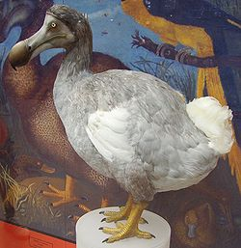
Early Modern Era:
Eco-system Currents
Notes:
A reconstructed dodo bird, which has been extinct since the mid-to-late 17th century. Stood about one meter tall. Extinction directly attributable to human activity. With the Modern Wave nature suffered from increased exploitation.

Slide 21
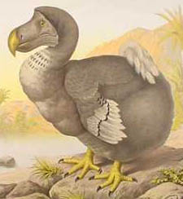
Early Modern Era:
Eco-system Currents
Notes:
The dodo, a bird of Mauritius, became extinct during the mid-late seventeenth century after humans destroyed the forests where the birds made their homes and introduced mammals that ate their eggs.

Slide 22
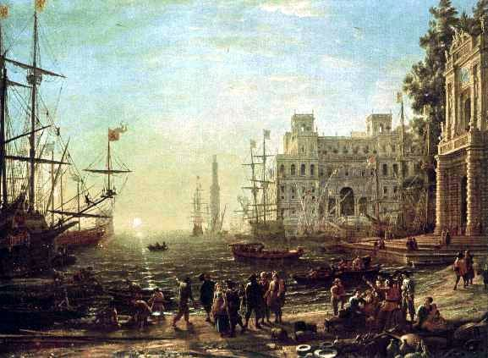
Early Modern Era, Economy
Notes:
An imaginary seaport with a transposed Villa Medici, painted by Claude Lorrain around 1637, at the height of mercantilism.

Slide 23
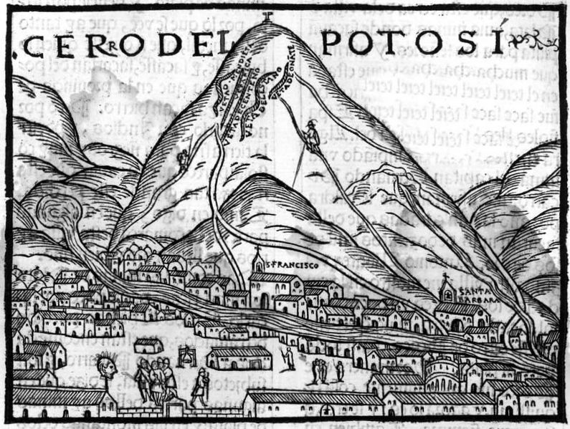
Early Modern Era: Economy
Notes:
The famed Potosi silver mines in Bolivia. Shows the first image of the mines in Europe in 1553.

Slide 24
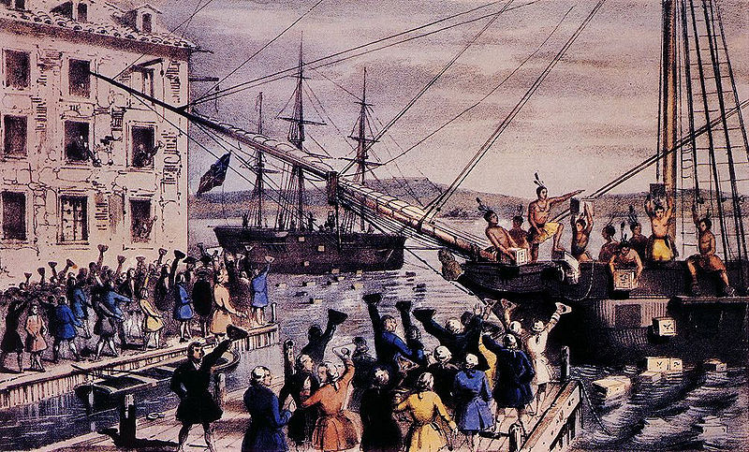
Early Modern Era: Economy
Notes:
Monopolistic activity by the British East India Company triggered the Boston Tea Party in 1773.

Slide 25
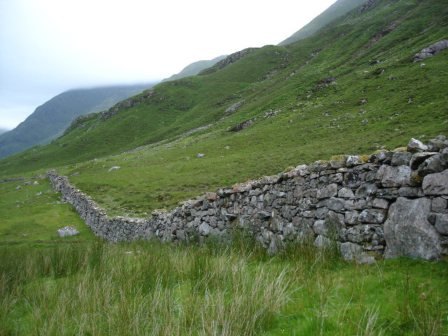
Early Modern Era: Economy
Notes:
Stone fences, such as this one in Glean Lichd, UK, define property boundaries making private property a vital ingredient in commercial capitalism.

Slide 26
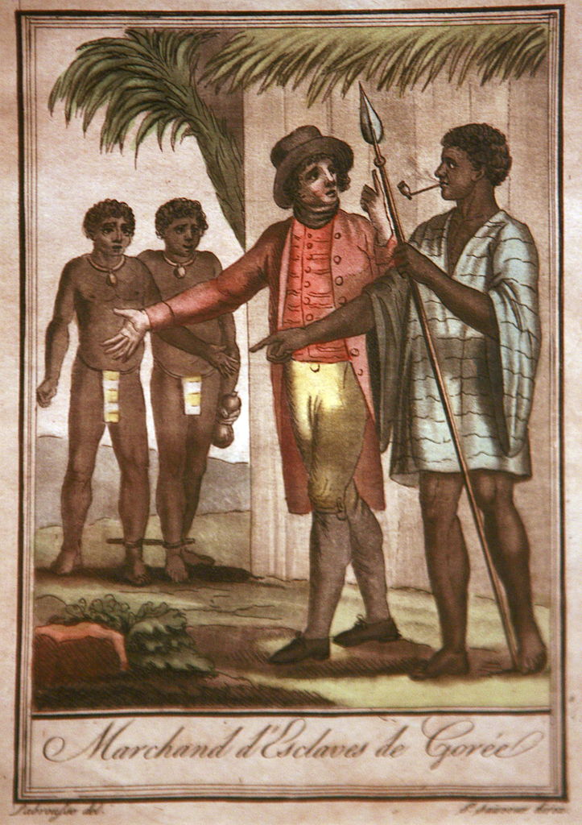
Early Modern Era: Slavery
Notes:
Slave traders in Senegal. For centuries Africans had sold other Africans to the Arabs and Europeans as slaves.

Slide 27
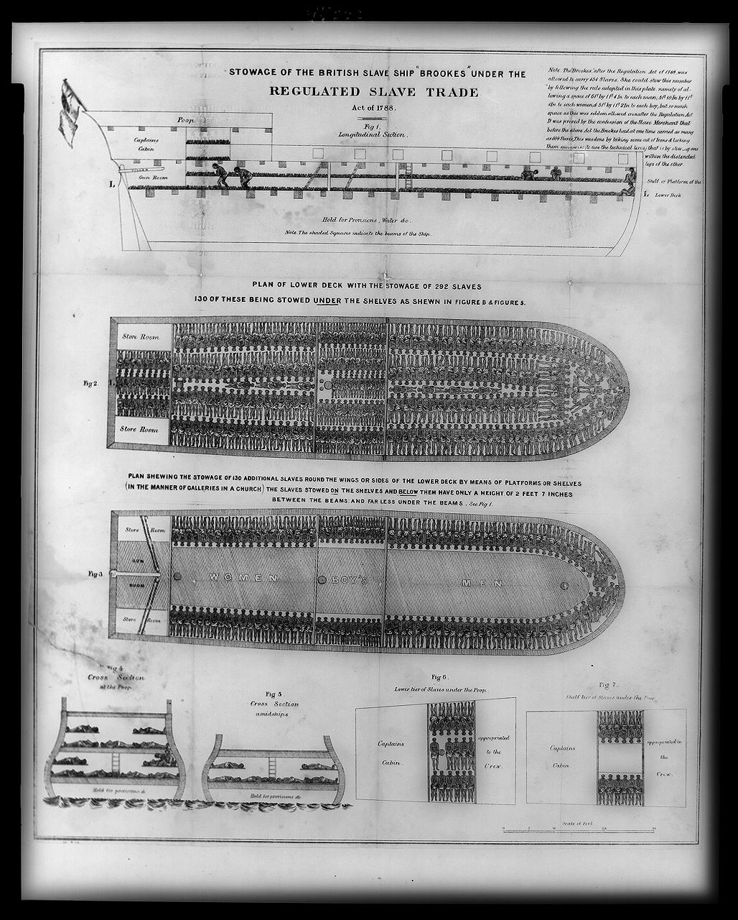
Early Modern Era: Slavery
Notes:
Stowage of African slaves on a British slave ship.

Slide 28
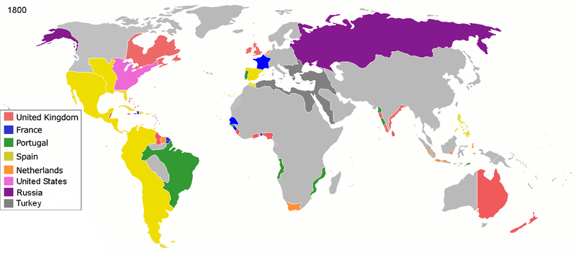
Early Modern Era: Colonialism

Slide 29
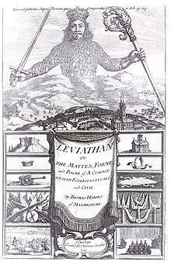
Early Modern Era: Political
Notes:
Frontpiece of the Leviathan, by Thomas Hobbes. He argued that absolute monarchy was a necessity to curb the natural state of chaos among humans.

Slide 30
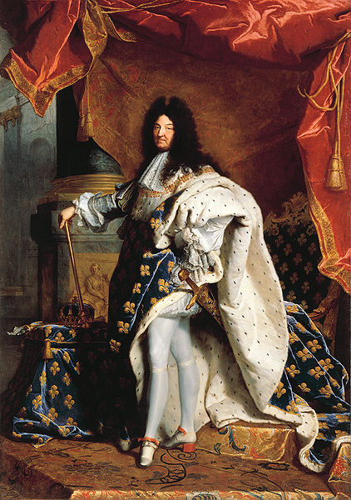
Early Modern Era: Political
Notes:
King Louis XIV (1638–1715) of France known as the Sun King, exemplified absolutism. Painting by Hyacinthe Rigaud (1701)

Slide 31
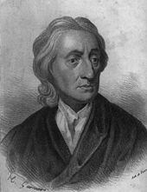
Early Modern Era: Political
Notes:
John Locke, English political philosopher, wrote about liberalism.

Slide 32
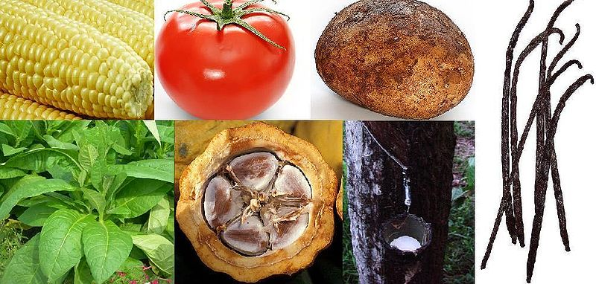
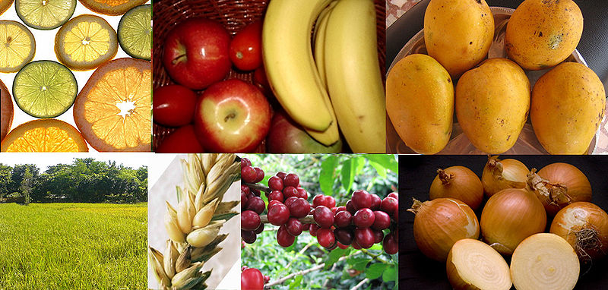
Early Modern Era: Interaction and Exchange
Notes:
Western hemisphere native plants. Clockwise, from top left: 1. Maize 2. Tomato 3. Potato 4. Vanilla 5. Rubber Tree 6. Cacao 7. Tobacco
Eastern hemisphere native plants. Clockwise, from top left: 1. Citrus 2. Apple 3. Banana 4. Mango 5. Onion 6. Coffee 7. Wheat 8. Rice

Slide 33
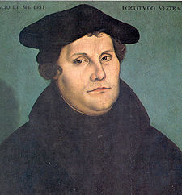
Early Modern Era:
Protestant Reforma-tion
Notes:
Martin Luther, initiated the Protestant Reformation .

Slide 34
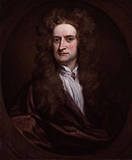
Early Modern Era: Scientific
Revolution
Notes:
Sir Issac Newton, considered by many to be one of the most influential people in human history. His theories advanced the Scientific Revolution.

