Slide 1
Post-Classical Geographical Regions
Middle East
Africa
Western hemisphere
China
Asia (other than China)
Byzantine Empire and Russia
Europe

Slide 2
Post-Classical Civilization Themes
Influence of the Arabs and Islam
Development of World Trade Network
Institutionalization and Spread of Universal Religions
Expansion of Civilization to Secondary Regions

Slide 3
Umayyad Dynasty

Slide 4
Dome of the Rock
Notes:
Dome of the Rock built by the Umayyad dynasty in Jerusalem on the Temple Mount, completed in 691-692.

Slide 5
Great Mosque, Damascus
Notes:
After the Arab conquest of Damascus in 634, the mosque was built on the site of a Christian basilica dedicated to John the Baptist (Yahya). The mosque holds a shrine which today may still contain the head of John the Baptist, honored as a prophet by both Christians and Muslims alike, and the place where Isa (Jesus) will return at the End of Days.

Slide 6
World 750
Notes:
Map of the world in 750 AD before the Battle of the Zab, which caused the fall of the Umayyad dynasty.

Slide 7
Abbasid Dynasty
Notes:
Abbasid Caliphate (light and dark green) at its greatest extent, c. 850. Territories in dark green were lost early on.

Slide 8
Ibn Khaldun and Avicenna
Notes:
L. Ibn Khaldun, May 27, 1332 AD/732 AH – March 19, 1406 AD/808 AH) was a Muslim historiographer and historian who is often viewed as one of the forerunners of modern historiography, sociology, and economics.
R. Avicenna (980-1037) regarded as the father of modern medicine, 150 of his surviving treatises concentrate on philosophy and 40 of them concentrate on medicine. A drawing of Avicenna from 1271.

Slide 9
Art of Arabesque
Notes:
Art of arabesque, tile work on the wall of mosque, Yazd, Iran. Photo Denise Ames

Slide 10
One Thousand and One Arabian Nights
Notes:
A girl with Parrot, scene from the One Thousand and One Nights. It is a collection of Middle Eastern and South Asian stories and folk tales compiled in Arabic during the Islamic Golden Age.

Slide 11
Bantu
Notes:
Approximate distribution of Bantu peoples divided into zones according to the Guthrie classification of Bantu languages. Bantu is used as a general label for 300-600 ethnic groups in Africa who speak Bantu languages.

Slide 12
Trade Routes of West Africa
Notes:
Trade routes of the Western Sahara c. 1000-1500. Goldfields are indicated by light brown shading.

Slide 13
Extent of Ancient Ghana
Notes:
Ancient Ghana before c. 830–c. 1235.

Slide 15
Almoravids
Notes:
L. Coin of the Almoravids, Sevilla, Spain, 1116.
R. Depiction of Almoravid general Abu Bakr, riding a camel with a whip of knotted cords, from the 1413 chart of Mecia de Viladestes.

Slide 16
Mansa Musa, Mali
Notes:
Musa depicted holding a gold nugget from the 1375 Catalan. Reign 1312 - 1337 Born ca. 1280

Slide 17
Songhay
Notes:
The, also known as the Songhay Empire, was a state located in western Africa. From the early 15th to the late 16thSonghai Empire century, Songhai was one of the largest Islamic empires in history.This empire bore the same name as its leading ethnic group, the Songhai. Its capital was the city of Gao, where a Songhai state had existed since the 11th century. Its base of power was on the bend of the Niger River in present day Niger and Burkina Faso.

Slide 18
Tomb of Askia, Mali
Notes:
The Tomb of Askia, in Gao, Mali, is believed to be the burial place of Askia Mohammad I, one of the Songhai Empire's most prolific emperors. It was built at the end of the 15th century and is designated as a UNESCO World Heritage Site.

Slide 19
Great Zimbabwe
Notes:
Exterior wall of the Great Enclosure. Picture taken by David Randall-MacIver in 1906. Great Zimbabwe is a ruined city that was once the capital of the Kingdom of Zimbabwe, which existed from approximately 1100 to 1400. The monument, which first began to be constructed in the 11th century and which continued to be built until the 14th century, spanned an area of 722 hectares (1,784 acres) and at its peak could have housed up to 18,000 people.

Slide 20
Az t ec
Notes:
The Valley of Mexico at the time of the Spanish Conquest.

Slide 21
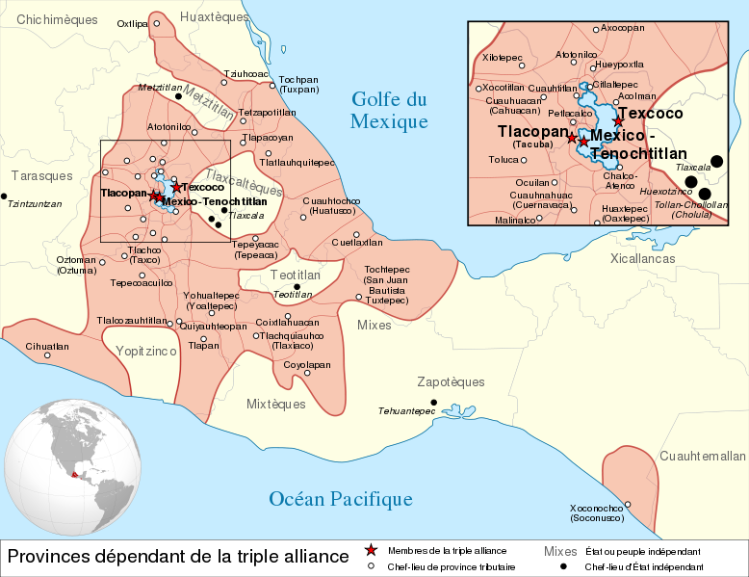
Notes:
The maximal extent of the Aztec Empire.

Slide 22
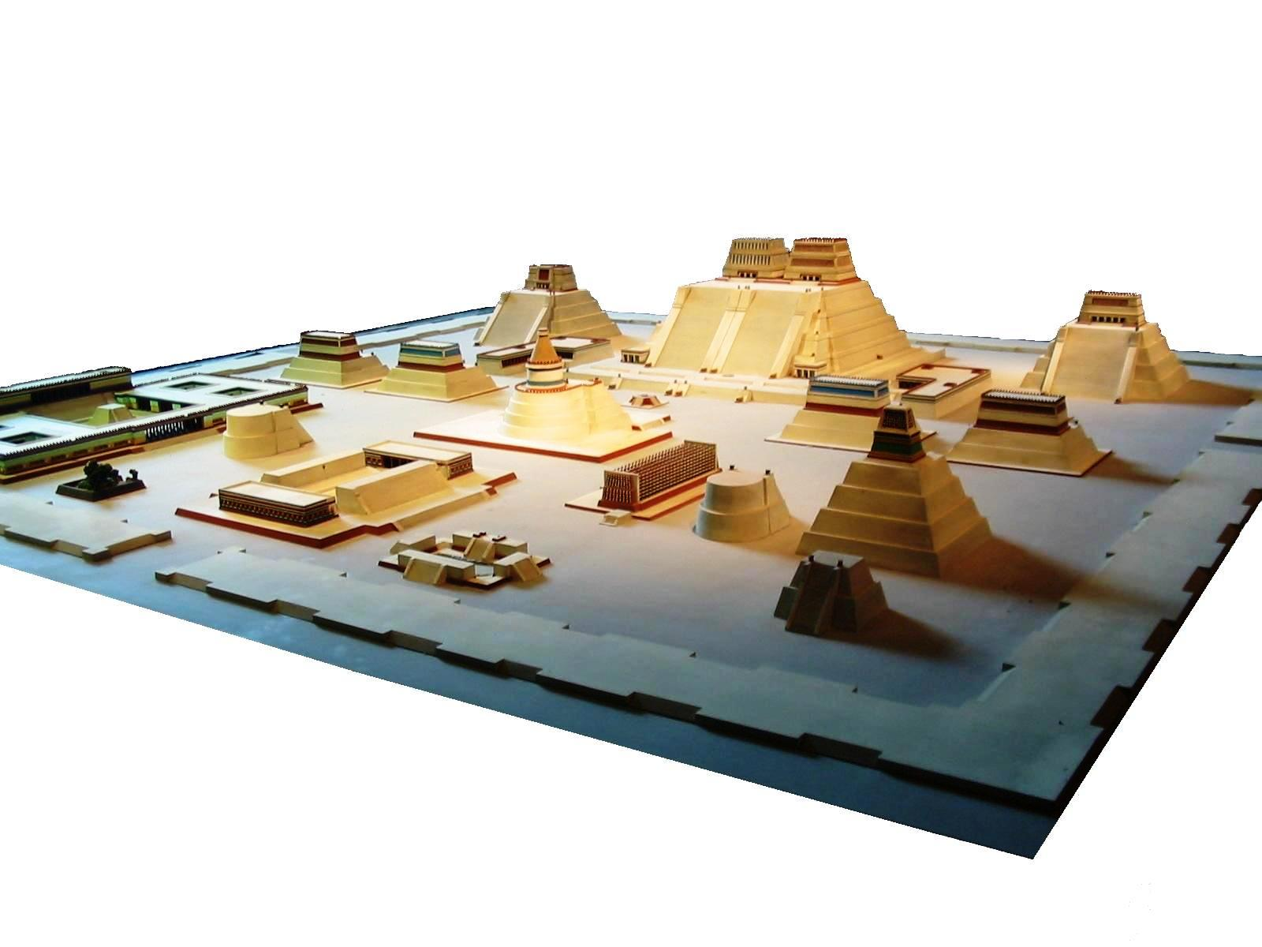
Tenochtitlan, Aztec
Notes:
Model of the temple district of Tenochtitlan, capital of the Aztec Empire.

Slide 23
Human Sacrifice, Aztec
Notes:
Human sacrifice as shown in the Codex Magliabechiano.

Slide 24
Huitzilopochtli, Aztec
Notes:
Huitzilopochtli, as depicted in the Codex Telleriano-Remensis, was the Aztec sun-god, in which sacrifices were made.

Slide 25
Xiuhtecuhtli, Aztec
Notes:
Aztec cosmogram in the pre-Hispanic Codex Fejérváry-Mayer - the fire god Xiuhtecuhtli is in the center.

Slide 26
Az t ec Ca l enda r
Notes:
The Aztec sun calendar is a circular stone with pictures representing how the Aztecs measured days, months, and cosmic cycles.

Slide 27
Aztec Deities
Notes:
L. Centeotl, ancient deity of maize.
R. Jaguar warrior, from the Codex Magliabechiano.

Slide 28
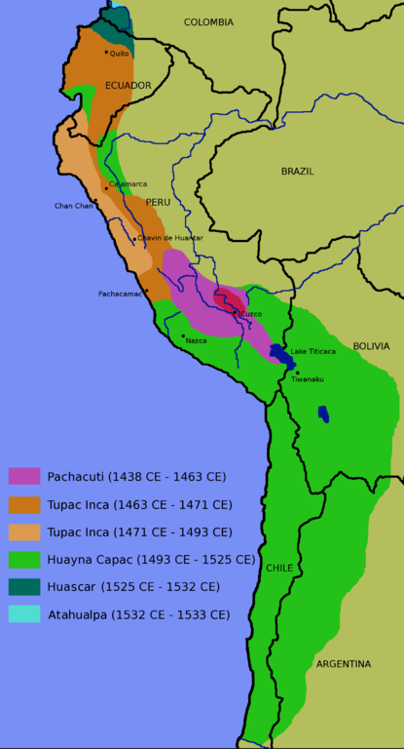
Inca Empire
Notes:
Inca expansion (1438–1533)

Slide 29
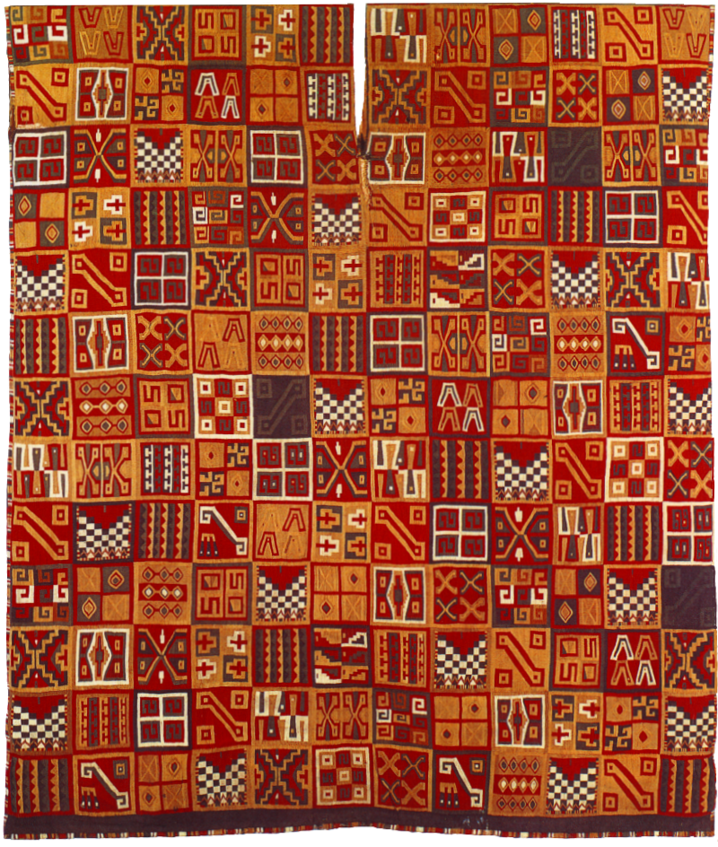
I
n
c
a
T
u
n
i
c
Notes:
Tunic was created around 1550.

Slide 30
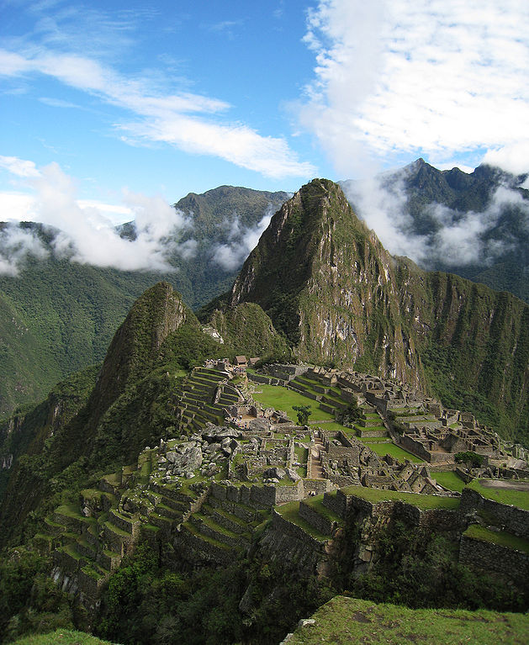
Notes:
Machu Picchu, sacred site of the Inca Empire.

Slide 31
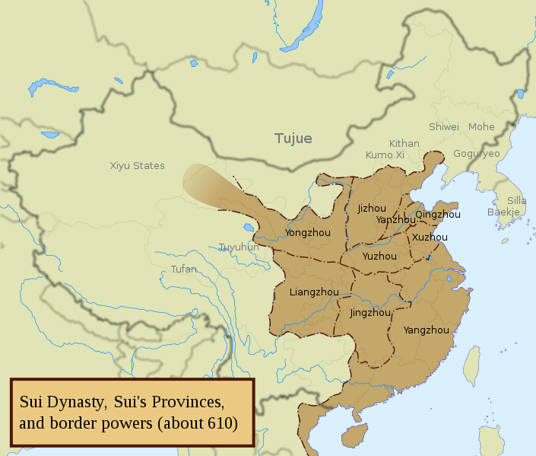
Notes:
Sui Dynasty (581-618) Sui's China, and Sui divisions under Yangdi (western regions not depicted).

Slide 32
Sui Dynasty, China
Notes:
Sui Dynasty Chinese landscape painting, Strolling About in Spring, by Zhan Ziqian, Sui era artist.
Notice small people.

Slide 33
Sui Dynasty, China
Notes:
A Chinese Sui Dynasty (581–618 AD) cart figurine pulled by a bull.

Slide 34
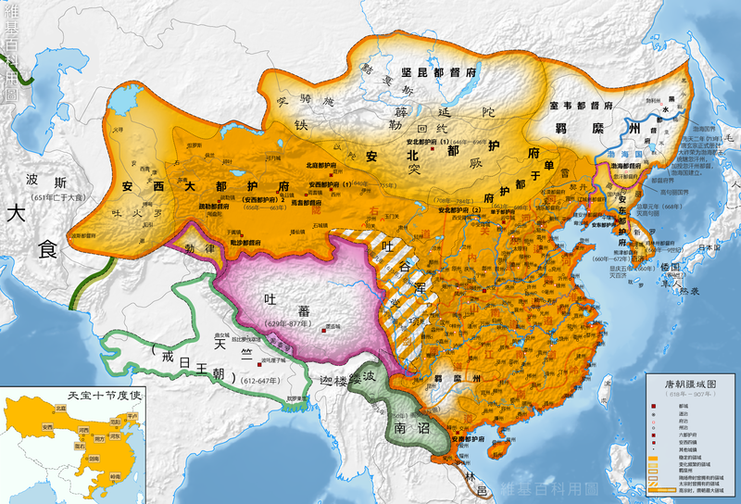
Tang Dynasty
Notes:
Tang 618-907, China under the Tang Dynasty (orange) circa 663 CE. It was founded by the Li family, who seized power during the decline and collapse of the Sui Empire. The dynasty was interrupted briefly by the Second Zhou Dynasty (October 8, 690 – March 3, 705) when Empress Wu Zetian seized the throne, becoming the first and only Chinese empress regnant, ruling in her own right.
The Tang Dynasty, with its capital at Chang'an (present-day Xi'an), which at the time was the most populous city in the world, is generally regarded as a high point in Chinese civilization—equal to, or surpassing that of, the earlier Han Dynasty—a golden age of cosmopolitan culture.

Slide 35
Empress Wu Zeitan, China
Notes:
The Official Imperial Portrait of Tang Dynasty's Empresses. (17 February 624 – 16 December 705)
Only woman in the history of China to assume the title of Empress Regnant. As de facto ruler of China first through her husband and her sons from 665 to 690, not unprecedented in Chinese history, she then broke all precedents when she founded her own dynasty in 690, the Zhou, (interrupting the Tang Dynasty), and ruled personally under the name Sacred and Divine Empress Regnant and variations thereof from 690 to 705.

Slide 36
Tang Dynasty, Emperor Yang of Sui
Notes:
Portrait painting of Emperor Yang of Sui, commissioned in 643 by Taizong, painted by Yan Liben (600–673).

Slide 37
Tang, Civil Servant
Notes:
Tang statue of a civil official dressed in Hanfu, made of sancai glazed earthenware; he wears a tall hat, wide-sleeved outer garment tied at the waist with a wide belt, and rectangular "kerchief" in front. A white inner gown hangs over his square shoes. He holds a tablet to his chest, preparing to provide a report to his superiors

Slide 38
Tang Emperor Xuanzong
Notes:
Emperor Xuanzong of the Tang Dynasty, wearing the robes and the hat of a scholar.
(r. 712–56) invited monks and clerics of Buddhism and Daoism to his court.

Slide 39
T a n g D y n a s t y
Notes:
A Man Herding Horses, by Han Gan (706–783), a court artist under Emperor Xuanzong.

Slide 40
Notes:
A mural painting from Cave 61 at the Mogao Caves, Dunhuang, Gansu province, China, dated to the 10th century and depicting Tang Dynasty monastic architecture from Mount Wutai, Shanxi province. Showing monastic architecture from Mount Wutai, Tang Dynasty; Japanese architecture of this period was influenced by Tang Chinese architecture

Slide 41
Wild Goose Pagoda, Xian, Tang Dynasty
Notes:
The Giant Wild Goose Pagoda, Chang'an (modern-day Xi'an), built in 652, repaired by Empress Wu Zetian in 704. Photo Denise Ames

Slide 42
Tang
Notes:
The Leshan Giant Buddha, 71 m (233 ft) high; begun in 713, completed in 803. It is carved out of a cliff face that lies at the confluence of the Minjiang, Dadu and Qingyi rivers in the southern part of Sichuan province in China, near the city of Leshan. The stone sculpture faces Mount Emei, with the rivers flowing below his feet. It is the largest carved stone Buddha in the world and it is by far the tallest pre-modern statue in the world.

Slide 43
Tang Dyn-asty
Notes:
Palace ladies in a garden from a mural of Prince Li Xian's tomb in the Qianling Mausoleum, where Wu Zetian was also buried in 706

Slide 44
Landscape Painting, Tang Dnyasty
Notes:
Poet on a Mountain , notice the small human figure.

Slide 45
Tang Dynasty Wall Scroll
Notes:
Wall scroll painted by Ma Lin in 1246. Ink on silk, notice the small human figure.

Slide 46
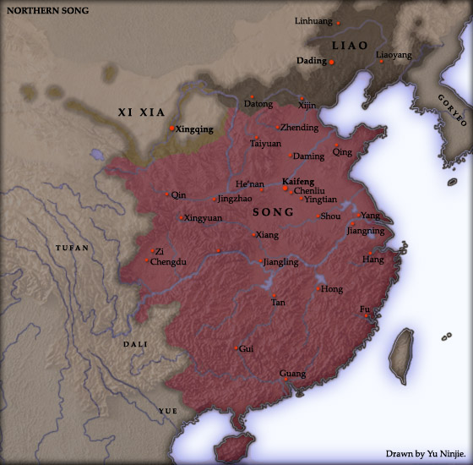
Notes:
Song Dynasty 960-1279.

Slide 47
The Golden Age, Movable Type
Notes:
A page from bronze movable-type book by Hua Sui, printed in 1490. In the beginning of twelfth century, movable type was used in large scale for the printing of paper money issued by the Northern Song Dynasty.

Slide 48
The Golden Age, Civil Service Exams
Notes:
The civil service exams hit a high mark during the Song Dynasty. Civil service exam candidates gather around the wall where results had been posted. Artwork by Qiu Ying c.1540). painted this image of candidates who had taken the civil service exams as the waited at the wall where officials would post the scores.

Slide 49
Song Dynasty, Scholar
Notes:
Scholar in a Meadow, Chinese painting of the 11th century by an anonymous Song artist. Scholar Gentry important during this time.

Slide 50
Song Dynasty, Catapult
Notes:
An illustration of a trebuchet catapult from the Wujing Zongyao manuscript of 1044. Trebuchets like this were used to launch the earliest type of explosive bombs

Slide 51
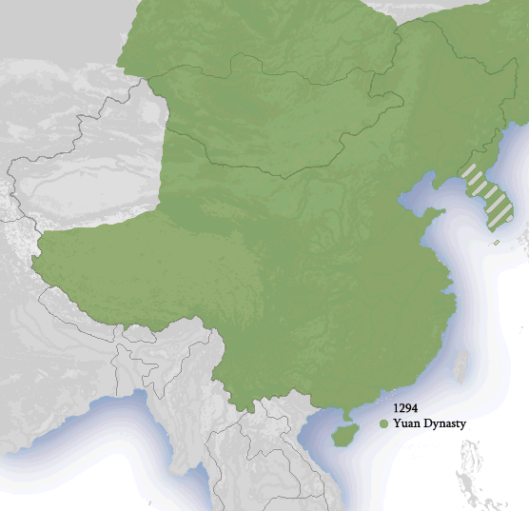
Notes:
Yuan Dynasty 1279-1368, Mongols overthrew the Song Dynasty in 1279. It was the Chinese branch of Mongol Borjigin dynasty established by Genghis Khan. Although the Mongolians had ruled northern China for decades, it was not until 1271 that Kublai Khan (grandson of Genghis Khan) officially proclaimed the dynasty in the traditional Chinese style.

Slide 52
Yuan Dynasty, Pagoda
Notes:
The Bailin Temple Pagoda of Zhaoxian County, Hebei Province, built in 1330 during the Yuan Dynasty.

Slide 53
Japan, Nara Period
Notes:
The Great Buddha at Nara, 752. The Nara period of the 8th century marked the emergence of a strong Japanese state and is often portrayed as a golden age. In 710, the capital city of Japan was moved from Asuka to Nara. The Nara period covers the years from 710 to 794 CE.

Slide 54
Heian Period, Japan
Notes:
Byōdō-in Phoenix Hall, a temple of Pure Land Buddhism, built in the 11th century during the Heian period of Japan. The Heian period, lasting from 794 to 1185, is the final period of classical Japanese history. It is considered the peak of the Japanese imperial court and noted for its art, especially its poetry and literature.

Slide 55
Tale of the Genji, Japan
Notes:
A handscroll painting dated circa 1130, illustrating a scene from the ale of Genji. A scene of the Chapter "Yadori Gi“ (mistletoe ) of Illustrated handscroll of Tale of Genji (written by Murasaki Shikibu. The handscroll was made in about 1130 and stored in Tokugawa Museum, Japan. The handscroll were separated to each sections and mounted to frame for conservation. Height about 21.5cm.

Slide 56
Feudal Japan
Notes:
The Kamakura period, 1185 to 1333, is a period that marks the governance of the Kamakura shogunate and the transition to the Japanese "medieval" era, a nearly 700-year period in which the emperor, the court, and the traditional central government were left intact but largely relegated to ceremonial functions.

Slide 57
Japanese Samurai
Notes:
Samurai on horseback, wearing Ō-yoroi armour, carrying bow and arrows. Samurai’s were the military during feudal era.

Slide 58
Japanese Samurai
Notes:
Samurai warriors 1860s.

Slide 59
Shinto Shrine, Japan
Notes:
Fushimi Inari—Main Gate, one of the oldest Shinto shrines in Japan. is the indigenous spirituality of Japan and the people of Japan. It is a set of practices, to be carried out diligently, to establish a connection between present day Japan and its ancient past.

Slide 60
Delhi Sultanate
Notes:
Delhi Sultanate under various dynasties. Capital Delhi (1206-1327), Daulatabad (1327-1347), Delhi (1347-1506) Agra (1506-1526). Historical era established 1206 - disestablished 1527. Religion, Sunni Islam.

Slide 61
Delhi Sultanate

Slide 62
Mamluk Dynasty, India
Notes:
The Mamluk Dynasty, one of the dynasties of the Delhi Sultanate.
The Qutub Minar, an example of the Mamluk dynasty's works.

Slide 63
K hme r E m p I r e
Notes:
Khmer Empire 802-1431. 900 CE Red: Khmer Empire Light Green: Haripunjaya Yellow: Champa
The Khmer Empire was one of the most powerful empires in Southeast Asia. At times ruled over and/or vassalized parts of modern-day Laos, Thailand, Vietnam, Burma, and Malaysia.

Slide 64
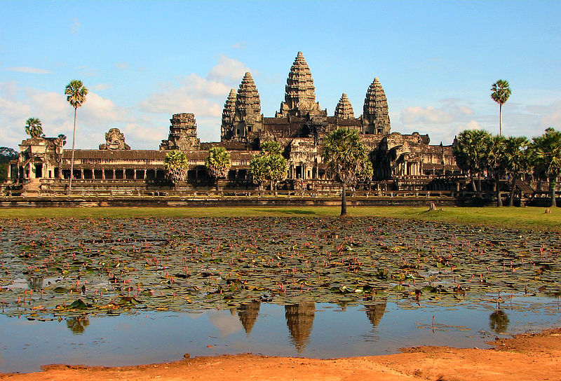
Notes:
Angkor is a region of Cambodia that served as the seat of the Khmer Empire, which flourished from approximately the 9th to 15th centuries. The ruins of Angkor are located amid forests and farmland. The temples of the Angkor area number over one thousand, ranging in scale from nondescript piles of brick rubble scattered through rice fields to the magnificent Angkor Wat, said to be the world's largest single religious monument. Fell in 1431.

Slide 65
Bagan (Pagan) Burma
Notes:
Bagan (Pagan) is an ancient city located in the Mandalay Region of Burma (Myanmar). From the 9th to 13th centuries, the city was the capital of the Kingdom of Pagan, the first kingdom to unify the regions that would later constitute modern Myanmar. During the kingdom's height between the 11th and 13th centuries, over 10,000 Buddhist temples, pagodas and monasteries were constructed in the Bagan plains alone, of which the remains of over 2200 temples and pagodas still survive to the present day.
Bagan is not yet a UNESCO World Heritage Site.

Slide 66
Mongo l Ar che r
Notes:
With the help of their mounted archers, as depicted here, the Mongols conquered most of Eurasia.

Slide 67
Hagia Sophia, Byzantine Empire
Notes:
A former Orthodox patriarchal basilica, later a mosque, now a museum in Istanbul, Turkey. From the date of its dedication in 360 until 1453, it served as the cathedral of Constantinople. It was a mosque from 1453 until 1934, when it was opened as a museum. Photo Denise Ames

Slide 68
Justinian of Byzantine Empire
Notes:
Mosaic showing Justinian with the bishop who ruled Byzantine Ravenna, bodyguards and courtiers.

Slide 69
Baptism of Saint Prince Vladimir
Notes:
In 989, he brought Christianity to Russia.

Slide 70
Kiev, Mongol Invasion
Notes:
Occupation of Kiev in 1240 by the Mongols. Illustration of a Russian annal. The Siege of Kyiv by the Mongols took place between November 28 and December 6, 1240, and resulted in a Mongol victory

Slide 71
E u r op e 4 5 0

Slide 72
Europe, A German Knight
Notes:
A German knight in armor plate.

Slide 73
Europe, Aachen
Notes:
Charlemagne's palace chapel at Aachen, completed in 805

Slide 74
Europe, peasant, clergy, and knights
Notes:
Medieval manuscript illustration of the three classes of medieval society: clergy, knights, and the peasantry.

Slide 75
Europe, a Monk
Notes:
A medieval European scholar making precise measurements in a 14th-century manuscript illustration.
Miniature of Richard of Wallingford, Abbot of St. Albans, mathematician and inventor of a mechanical astronomical clock. He is shown seated at his desk measuring with a pair of compasses.

