Slide 1
Chapter 6: The Urban Wave Classical Civilizations
Six Classical Regions
India
China
Persia
Greece
Rome
Maya

Slide 2
Five Themes in Classical Civilization
Formation of Large Cities
Human Migrations
Technological Innovations
Long-distance Trade Expands
The Axial Age Expands

Slide 3
Notes:
Maurya Empire at its maximum extent (Dark Blue), including its vassals (Light Blue). Mauryan dynasty ruled from 321 to 185 BCE

Slide 4
Asoka, Maurya Empire, India
Notes:
L. Original sandstone sculpted Lion Capital of Ashoka preserved at Sarnath Museum which was originally erected around 250 BC atop an Ashoka Pillar at Sarnath. The wheel "Ashoka Chakra" from its base has been placed onto the center of the National Flag of India.
R. Front view of the single lion capital in Vaishali. Bihar, India. Build by Emperor Asoka in about 250 BC, and still standing.

Slide 5
A Pillar of Asoka, India
Notes:
View of the Ashokan Pillar at Vaishali, India. The pillars of Ashoka are a series of columns dispersed throughout the northern Indian subcontinent, erected or at least inscribed with edicts by the Mauryan king Ashoka during his reign in the 3rd century BC. Originally, there must have been many pillars but only nineteen survive with inscriptions. Many are preserved in a fragmentary state.

Slide 6
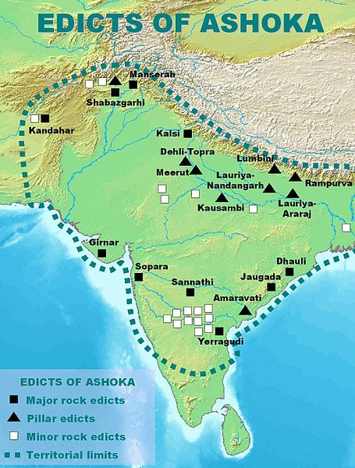
Notes:
The Edicts of Ashoka are a collection of 33 inscriptions on the Pillars of Ashoka, as well as boulders and cave walls, made by the Emperor Ashoka of the Mauryan dynasty during his reign from 269 BCE to 231 BCE. The edicts describe in detail the first wide expansion of Buddhism through the sponsorship of one of the most powerful kings of Indian history. According to the edicts, the extent of Buddhist proselytism during this period reached as far as the Mediterranean, and many Buddhist monuments were created.

Slide 7
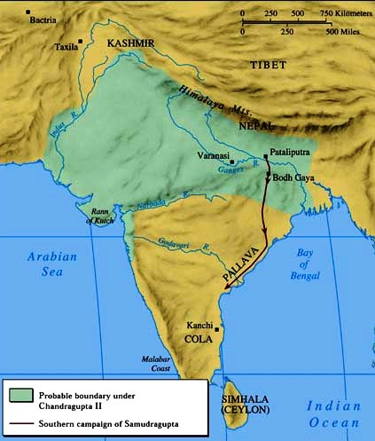
Gupta Empire
Notes:
The Gupta Empire - approximately from 320 to 550 CE and covered much of the Indian Subcontinent. Founded by Maharaja Sri-Gupta, the dynasty was the model of a classical civilization.

Slide 8
Gupta Empire, India
Notes:
L. Gold coin of Gupta era, depicting a Gupta king holding a bow.
R. A Terracotta relief panel of a meditating Buddha from the Gupta era.

Slide 9
Zhou Dynasty, Classical Era, China
Notes:
The Zhou Dynasty (1046–256 BCE). During the Zhou Dynasty, the use of iron was introduced to China.

Slide 10
Zhou Dynasty, China
Notes:
A Western Zhou ceremonial bronze of cooking-vessel form inscribed to record that the King of Zhou gave a fiefdom to Shi You, ordering that he inherit the title as well as the land and people living there.

Slide 12
The Grand Canal, China
Notes:
The Grand Canal of China is the world's oldest and longest canal. Construction began in 486 BCE and continued onward. The canal is 1,795 Km (1,114 miles) long with 24 locks and some 60 bridges. This is the Jiangnan section of the canal.

Slide 13
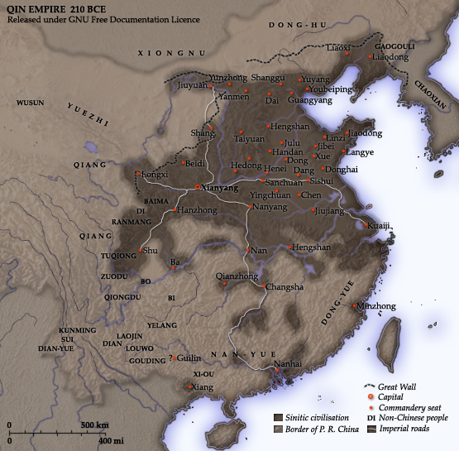
Notes:
The Qin Dynasty circa. 210 BCE, ruled 221 BCE–206 BCE

Slide 14
Qin Dynasty, Terra Cotta Warriors
Notes:
The Terracotta Army or the "Terra Cotta Warriors and Horses", is a collection of terracotta sculptures depicting the armies of Qin Shi Huang, the first Emperor of China. It is a form of funerary art buried with the emperor in 210–209 BC and whose purpose was to protect the emperor in his afterlife, and to make sure that he had people to rule over.

Slide 15
Terra Cotta Army
Notes:
Mausoleum of the First Qin Emperor

Slide 16
Terra Cotta Warriors
Notes:
Photo Denise Ames

Slide 17
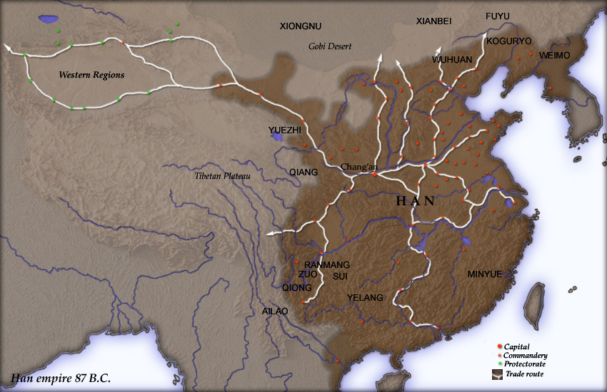
Notes:
The Han Dynasty in 87 BCE (brown), with commanderies (red dots) and protectorates (green dots) shown. (206 BCE – 220 CE. The Han Empire was divided into areas directly controlled by the central government, known as commanderies, and a number of semi-autonomous kingdoms.

Slide 18
Filial Piety
Notes:
A scene of historic paragons of filial piety conversing with one another, Chinese painted artwork on a lacquered basketwork box, excavated from an Eastern-Han tomb of what was the Chinese Lelang Commandery in modern North Korea.

Slide 19
Watchtower along the Silk Road
Notes:
The ruins of a Han-dynasty watchtower made of rammed earth at Dunhuang, Gansu province, the eastern edge of the Silk Road

Slide 20
Pottery, Han Dynasty
Notes:
A pottery dog found in a Han tomb wearing a decorative dog collar, indicating their domestication as pets, while it is known from written sources that the emperor's imperial parks had kennels for hunting dogs.
R. A Han pottery female servant in silk robes.

Slide 21
Notes:
Topography of Iran

Slide 22
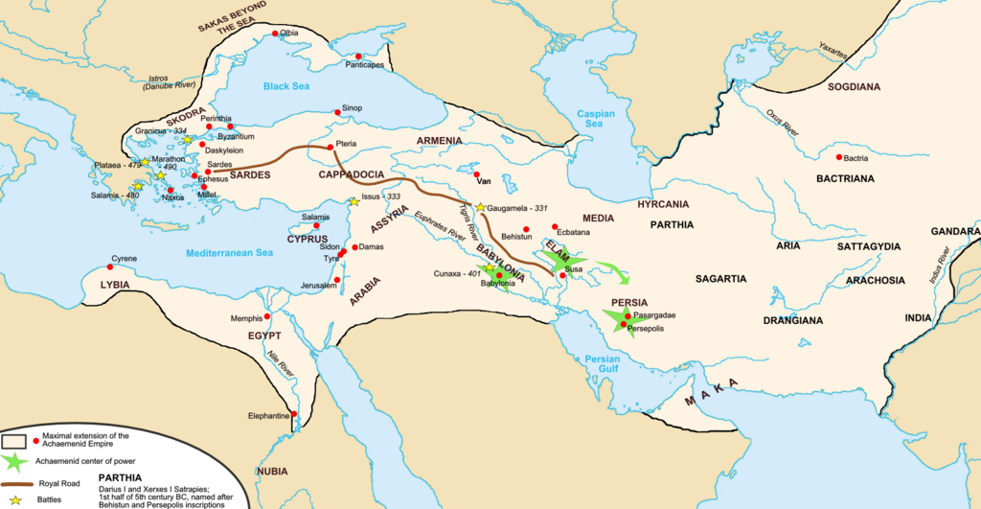
Notes:
Achaemenid Empire (Persian Empire) ca. 550 BCE–336 BCE around the time of Darius the Great and Xerxes.

Slide 23
Persian Kings
Notes:
R. Winged sphinx from the palace of Darius the Great at Susa, Louvre.
L. A depiction of Cyrus the Great.

Slide 24
Cyrus, Persia
Notes:
Painting, Cyrus (559-530 BCE) liberated the Hebrew exiles to resettle and rebuild Jerusalem, earning him an honored place in Judaism.

Slide 25
Persepolis, Persia
Notes:
Ruins of Persepolis in Iran, built by Darius I and completed by his son Xerxes I. photo Denise Ames

Slide 26
Notes:
Political geography of ancient Greece in the Archaic and Classical periods

Slide 27
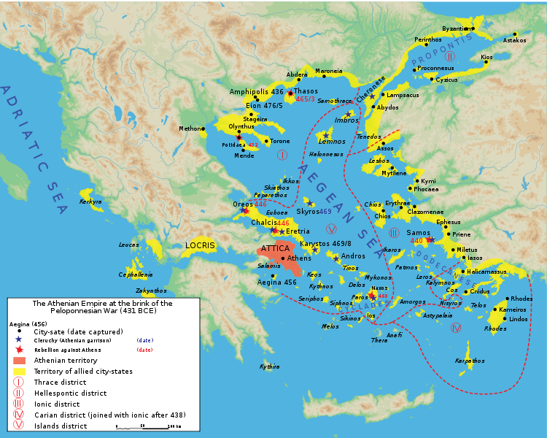
Notes:
Map of the Delian League ("Athenian Empire") in 431 B.C.E., just prior to the Peloponnesian War.

Slide 28
Notes:
The Parthenon, a temple dedicated to Athena, located on the Acropolis in Athens, is one of the most representative symbols of the culture and sophistication of the ancient Greeks

Slide 29
Ancient Greece
Notes:
Greek hoplite and Persian warrior depicted fighting, on an ancient kylix, 5th century BCE

Slide 30
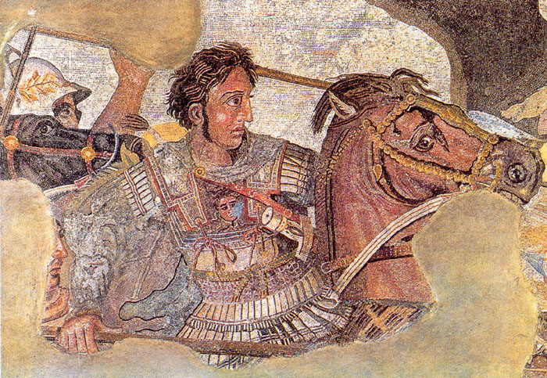
Alexander of Macedonia
Notes:
Alexander fighting the Persian king Darius III. From Alexander Mosaic, Naples National Archaeological Reign 336–323 BC

Slide 31
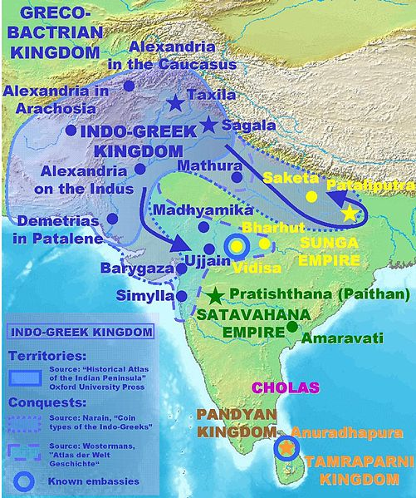
Notes:
Territories and expansion of the Indo-Greeks

Slide 32
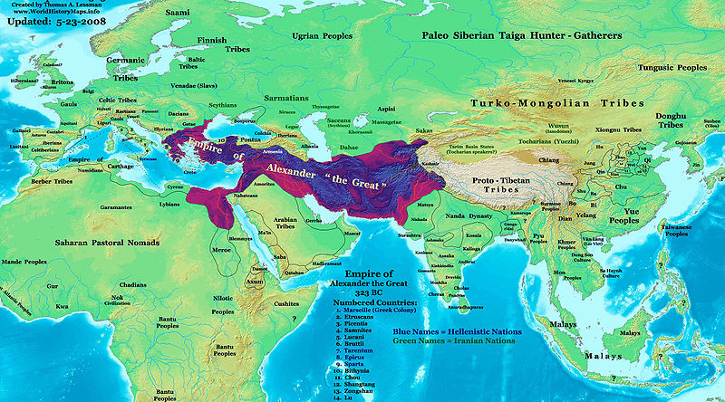
Notes:
Alexander's empire was the largest state of its time, covering approximately 5.2 million square km

Slide 33
Roman Republic, The Forum
Notes:
The Roman Forum, the commercial, cultural, and political center of the city and the Republic which housed the various offices and meeting places of the government

Slide 34
Roman Republic Prior to Punic Wars
Notes:
Theatre of Punic Wars (264–146 BCE), 1923 map.

Slide 35
Notes:
Roman Republic to death of Julius Caesar.
Source http://www.usu.edu/markdamen/ClasDram/images/12/10map04romanrepublic.jpg

Slide 36
Augustus Caesar
Notes:
R. A statue of Augustus as a younger Octavian, dated ca. 30 BCE
L. The statue known as the Augustus of Prima Porta, 1st century. 16 January 27 BC – 19 August AD 14 (40 years, 215 days)

Slide 37
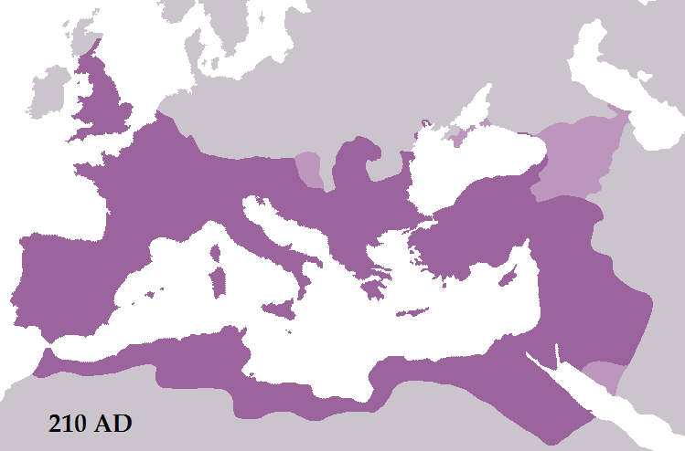
Notes:
The Roman Empire in 210 AD during the reign of Septimius Severus

Slide 38
Roman Coliseum
Notes:
The Roman Coliseum, as it stands now stands, the Coliseum is an iconic symbol of Imperial Rome. Capable of seating 50,000 spectators. Completed in 80 and used for entertainment such as gladiatorial contests. Thousands died a tortuous death, including Christians, in the coliseum.

Slide 39
Christian Martyrs
Notes:
The Christian Martyrs' Last Prayer, by Jean-Léon Gérôme (1883). Roman Colosseum.

Slide 40
Roman Aqueducts
Notes:
The Roman aqueduct bridge to Tarraco in the province of Hispania Tarraconensis, modern-day Spain

Slide 41
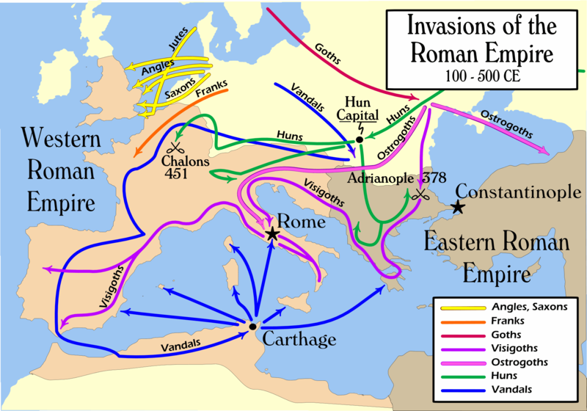
Notes:
Nomadic invasions of the Roman Empire (simplified), showing the Battle of Adrianople.

Slide 42
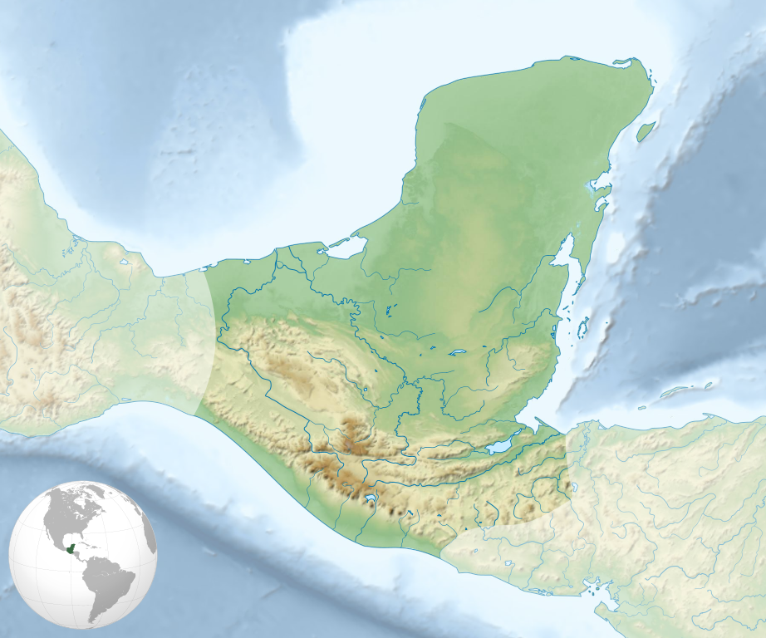
Notes:
Extension of Classic and Post-Classic Maya civilization.

Slide 43
Maya, Palenque
Notes:
Mayan ruins at Palenque in central America.

Slide 44
Maya, Tikal
Notes:
Tikal is one of the largest archaeological sites and urban centres of the Maya civilization. It is located in the archaeological region of the Petén Basin in what is now northern Guatemala.

Slide 45
Maya, New Year’s Ritual
Notes:
New year ritual, Dresden Codex

Slide 46
Maya, Chichen Itza
Notes:
Chichen Itza was a major focal point in the northern Maya lowlands from the Late Classic (c.600–900 AD) through the Terminal Classic (c.800–900) and into the early portion of the Early Postclassic period (c.900–1200).

