Slide 1
Ancient Civilizations
Mesopotamia
Egypt
India
China
Olmec

Slide 2
Mesopotamia
Notes:
Map showing the extent of Mesopotamia. Wikimedia Commons

Slide 3
Mesopotamia: Metal Production
Notes:
Mining areas of the ancient West Asia. Boxes colors: arsenic is in brown, copper in red, tin in grey, iron in reddish brown, gold in yellow, silver in white and lead in black. Yellow area stands for arsenic bronze, while grey area stands for tin bronze.

Slide 4
Cities of ancient Sumer
Notes:
Sumer was a civilization and historical region in southern Mesopotamia.

Slide 5
Mesopotamia
Notes:
The reconstructed facade of the 4100 year old Great Ziggurat of Ur, near Nasiriyah, Iraq . Wikimedia Commons

Slide 6
Sargon, Akkadian ruler
Notes:
Bust of an Akkadian ruler, probably Sargon, Nineveh, ca 2200 BCE.

Slide 7
Akkadian Empire
Notes:
Map of the Akkadian Empire (brown) and the directions in which military campaigns were conducted (yellow arrows)

Slide 8
Egypt
Notes:
Map of Egypt's territorial control during the New Kingdom, the maximum territorial extent of Ancient Egypt (15th century BCE

Slide 9
Ancient Egypt
Notes:
L. Statue of the Egyptian female pharaoh Hatshepsut (1508–1458 BC)
R. Khafre Enthroned

Slide 10
Ancient Egypt
Notes:
Great Sphinix It is the largest monolith statue in the world, standing 73.5 metres (241 ft) long, 6 metres (20 ft) wide, and 20.22 m (66.34 ft) high. It is the oldest known monumental sculpture, and is commonly believed to have been built by ancient Egyptians of the Old Kingdom during the reign of the pharaoh Khafra (c. 2558–2532 BC).

Slide 11
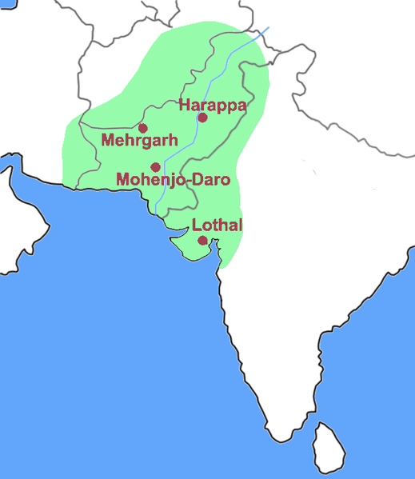
Ancient India
Notes:
Location of Harappa and other cities in the Indus Valley and extent of Indus Valley Civilization (green).

Slide 12
Ancient India
Notes:
Excavated ruins of Mohenjo Daro Indus Valley civilization 2600 BCE, in present day Pakistan. Wikimedia Commons

Slide 13
Ancient India
Notes:
L. Replica of 'Dancing Girl' of Mohenjo-daro, 4,500 years old.
R. Indus Priest/King Statue found Mohenjo Daro

Slide 14
Ancient India
Notes:
Harappa Pakistan Indus Valley Civilization . A large well and bathing platforms from Harappa occupation around 2200–1900 BCE

Slide 15
Ancient China: Xia Dynasty
Notes:
The first dynasty in China to be described in ancient historical chronicles. ca. 2070 BC–ca. 1600 BC

Slide 16
Ancient China: Shang Dynasty
Notes:
Remnants of advanced, stratified societies dating back to the Shang period have been found in the Yellow River Valley. Shang Dynasty1600–1046 BCE

Slide 17
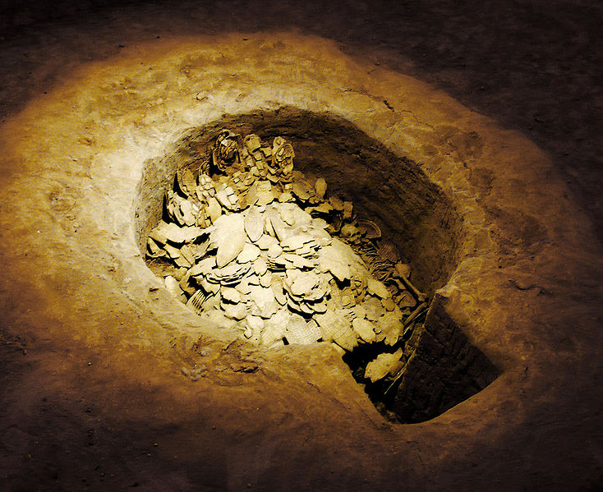
Ancient China
Notes:
An oracle bone during the Shang Dynasty. A diviner asks the Shang king if there would be misfortune over the next ten days; the king replied that he had consulted the ancestor Xiaojia in a worship ceremony. Wikimedia Commons
R. Pit of oracle bones (甲骨) at Anyang Yinxu. The oracle bones are pieces of bone or turtle plastron bearing the answers to divination during the late Shang Dynasty (1766-1050 BC). They were heated and cracked, then typically inscribed using a bronze pin in what is known as the Oracle Bone Script (甲骨文), the earliest known significant corpus of ancient Chinese writing. The bones contain important historical information such as the complete royal genealogy of the Shang Dynasty. Yinxu is the ruins of the last capital of Shang Dynasty . The capital served 255 years for 12 kings in 8 generations.

Slide 18
Olmec
Notes:
The Olmec heartland where the Olmec reigned from 1400 - 400 BCE.

Slide 19
Notes:
The major Formative Period (Pre-Classic Era) sites in present-day Mexico which show Olmec influences in the archaeological record.

Slide 20
Olmec
Notes:
L. Olmec head in stone, over 9 feet tall, Mesoamerica.
R. "The Wrestler", an Olmec era statuette, 1200 – 800 BCE.

