Slide 1
Part II Pastoral Societies

Slide 2
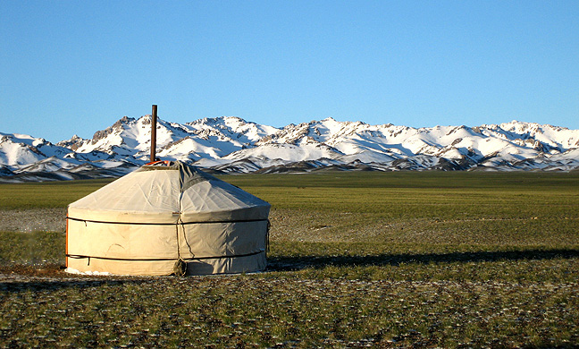
Techno-Economic Currents: Daily Life
Notes:
A yurt in front of the Gurvan Saikhan Mountains. Approximately 30% of the Mongolia's 3 million people are nomadic or semi-nomadic. Wikimedia Commons

Slide 3
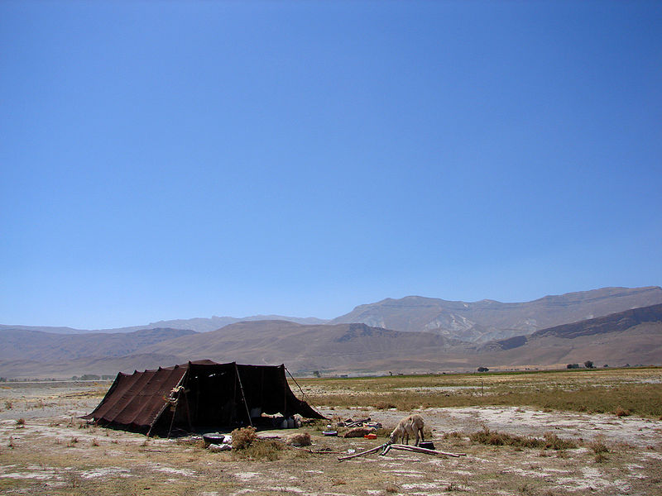
Techno-Economic Currents: Daily Life
Notes:
A campment of the Bakhtiari people, Chaharmahal and Bakhtiari Province, Iran. Wikimedia Commons

Slide 4
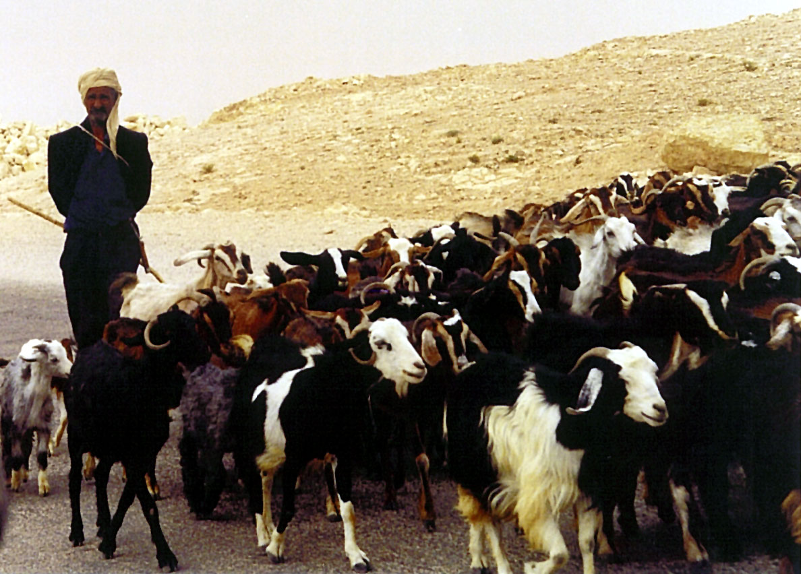
Techno-Economic Currents: Daily Life
Notes:
A man herding goats in Tunisia. Wikimedia Commons

Slide 5
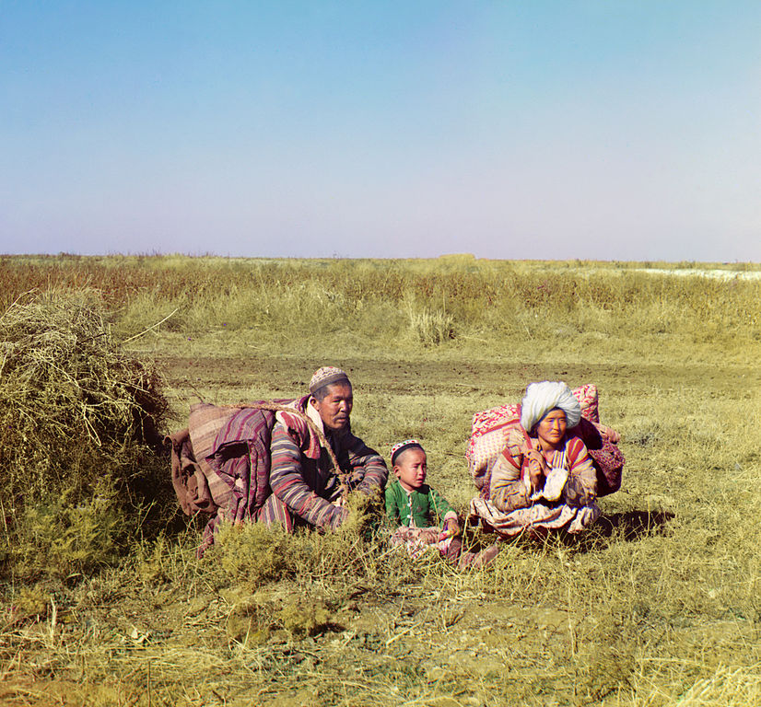
Social Currents: Family
Notes:
Kazakh nomad family in the steppes of the Russian Empire, by pioneer color photographer Sergey Prokudin-Gorsky, ca. 1910. Wikimedia Commons,

Slide 6
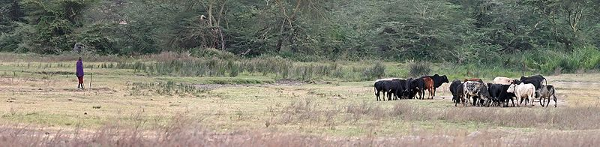
Techno-Economic Currents: Daily Life
Notes:
A Masaai herdsman grazing his cattle, Africa. Wikimedia Commons

Slide 7
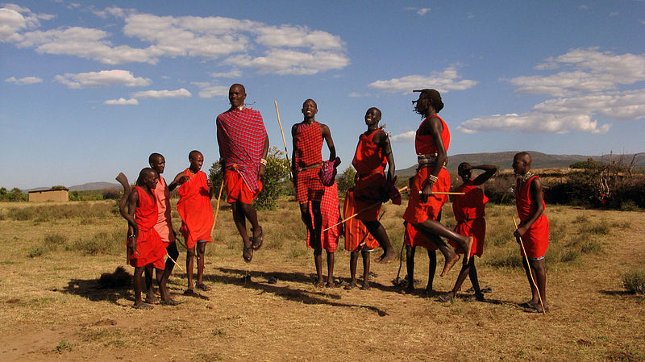
Cultural Currents: Aesthetic Expression
Notes:
Traditional Maasai jumping dance, Africa. Wikimedia Commons,

Slide 8
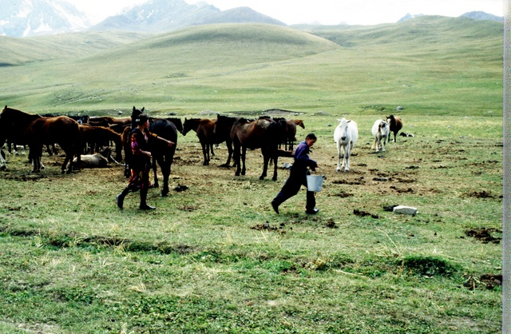
Techno-Economic Currents: Daily Life
Notes:
Horse herding, Kazakhstan, photo Roger Harmon

Slide 9
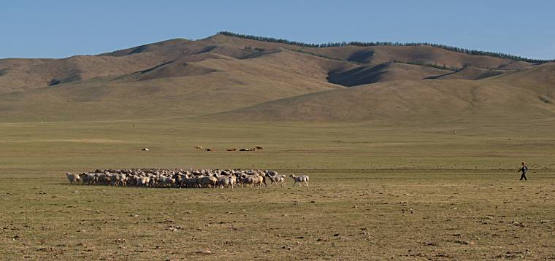
Techno-Economic Currents: Daily Life
Notes:
Mongolia sheep herds,

