Slide 1
Universal Religions and Worldviews of the Urban Wave
The Axial Age
Notes:
The universal religions will be presented in geographic and chronological order.

Slide 2
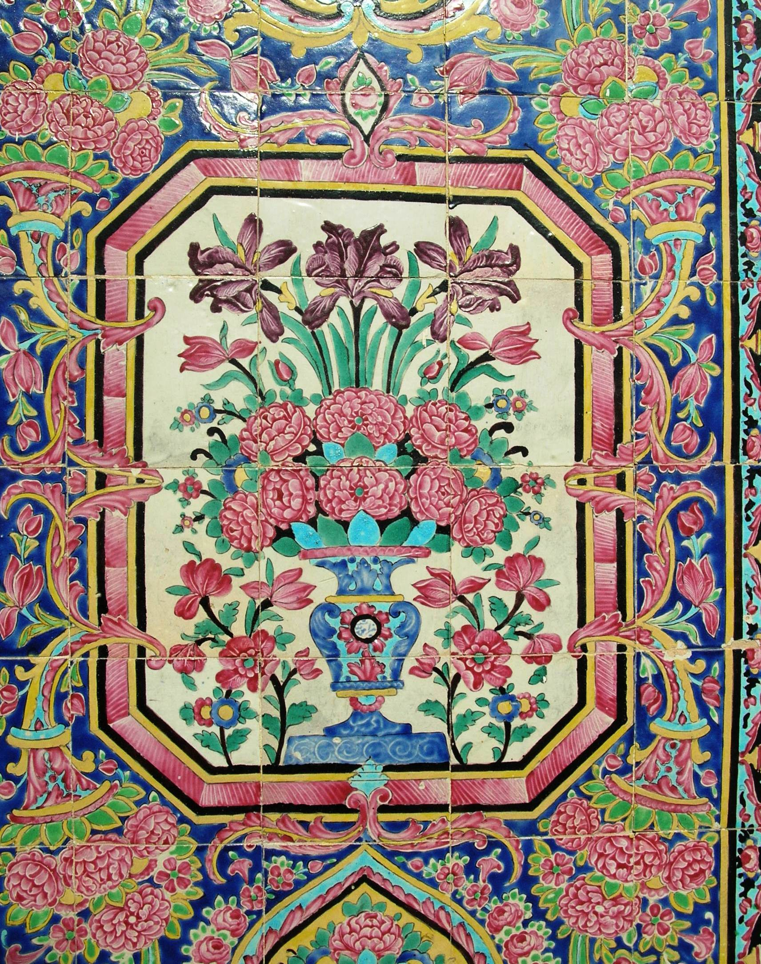
Zoroastrian
Notes:
Zoroastrian symbol of world peace, Iran. Photo Denise Ames

Slide 3
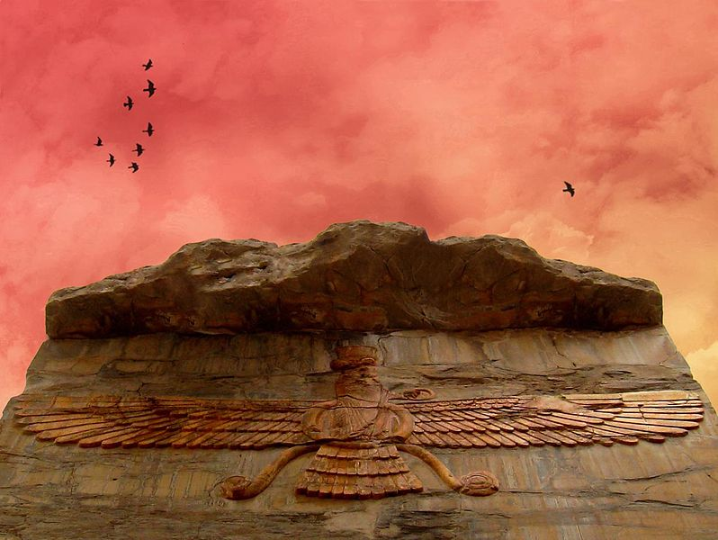
Zoroastrian
Notes:
Farvahar. Persepolis, Iran, fire altar.

Slide 4
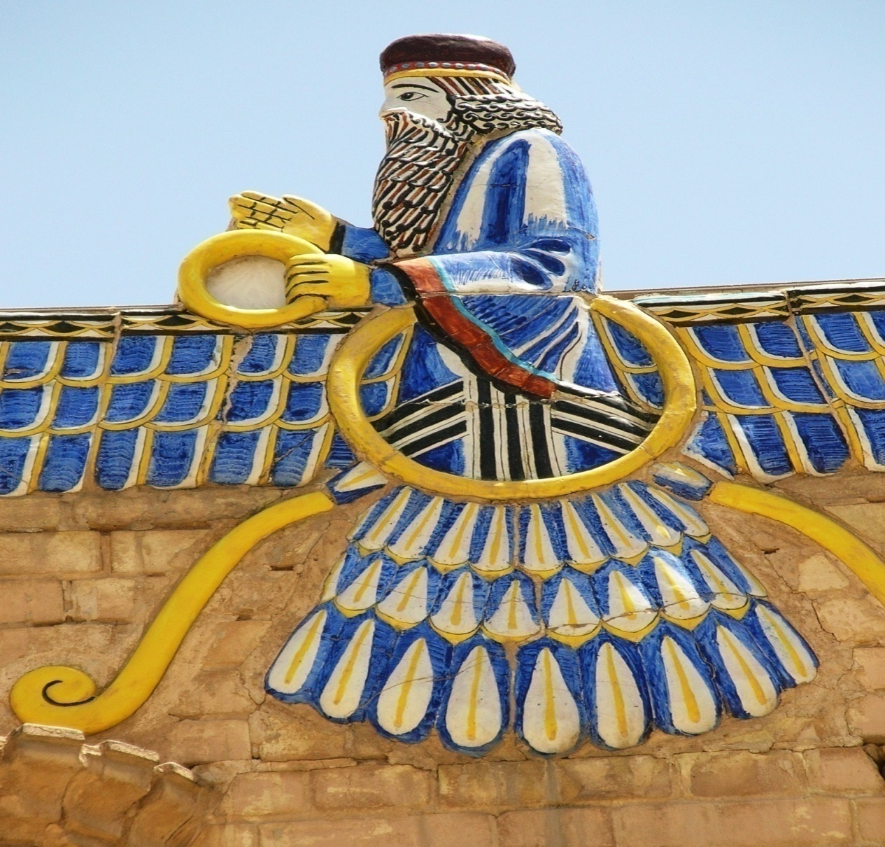
Zoroastrian
Notes:
Faravahar (or Ferohar), one of the primary symbols of Zoroastrianism, believed to be the depiction of a Fravashi guardian spirit. Photo, Zoroastrianism bird man adorning a temple in Yazd, Iran. Denise Ames photo

Slide 5
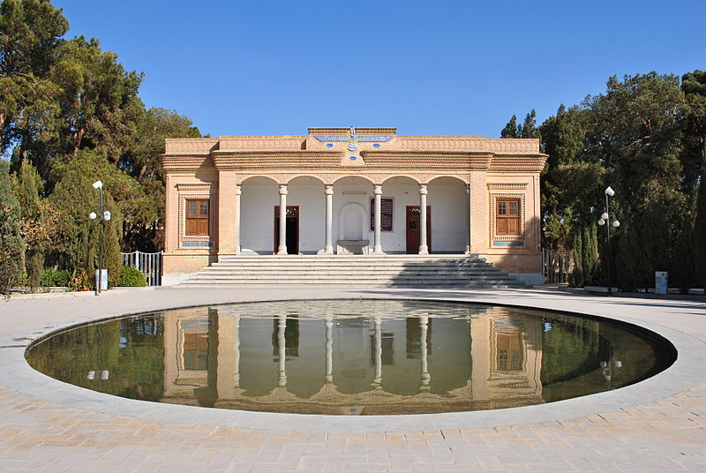
Zoroastrian
Notes:
The Zoroastrian Atash Behram of Yazd, Iran

Slide 6
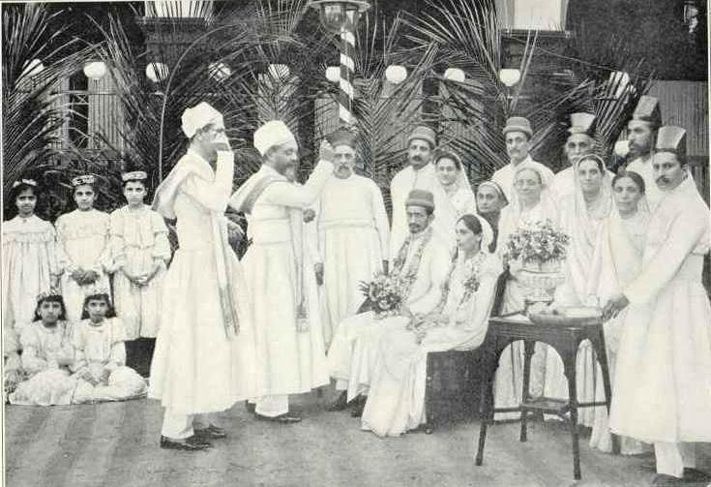
Zoroastrian
Notes:
A Parsi Wedding, 1905

Slide 7
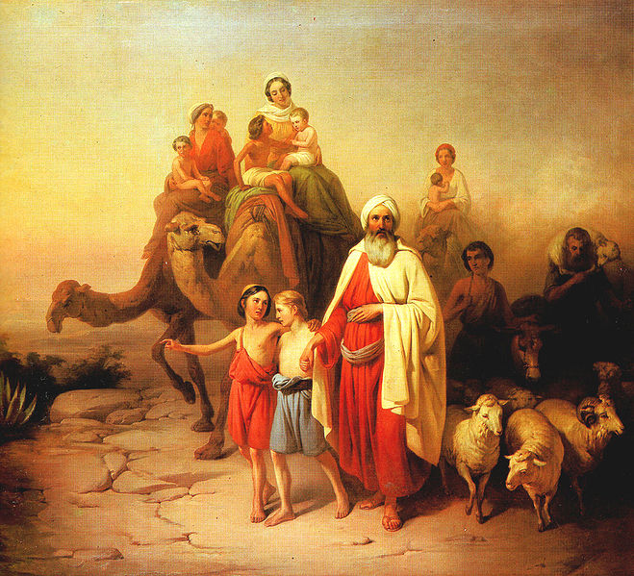
Monotheistic Religions: Judaism, Christianity, and Islam
Notes:
Abraham's Journey from Ur to Canaan (József Molnár, 1850) Patriarch of 3 religions: Judaism, Christianity, and Islam. According to the Bible, God instructs Abraham to travel from his home in Mesopotamia (modern Iraq) to the land of Canaan. There God makes a covenant with Abraham.

Slide 8
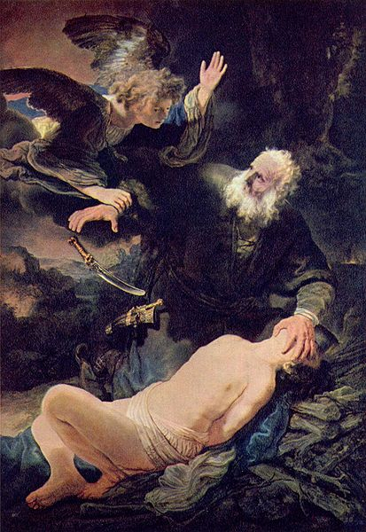
Judaism
Notes:
Abraham, considered the father figure of Christians, Jews, and Muslims—monotheistic religions. An angel prevents Abraham’s sacrifice of Isaac (title) painting by Rembrandt, Wikimedia Commons, higher resolution

Slide 9
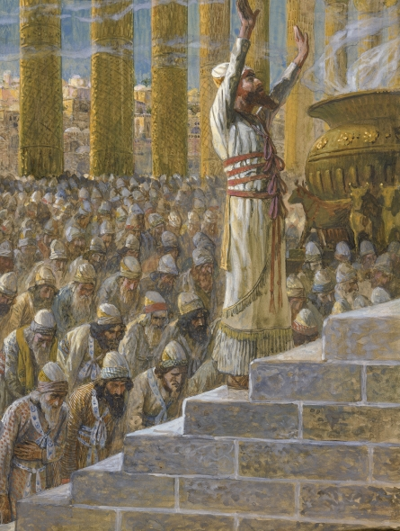
Judaism
Notes:
King Solomon dedicates the Temple at Jerusalem, painting by James Jacques Joseph Tissot (French, 1836–1902) or followers. According to the biblical sources, the temple was constructed under king Solomon during Israel's period of united monarchy. This puts the date of its construction in the mid-10th century BCE.

Slide 10
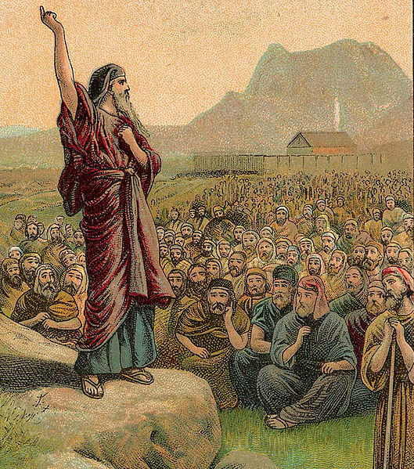
Judaism
Notes:
Moses pleading with the Children of Israel, lithography from a Bible card published in 1907. was, according to the Hebrew Bible and Qur'an, a religious leader, lawgiver and prophet, to whom the authorship of the Torah is traditionally attributed

Slide 11
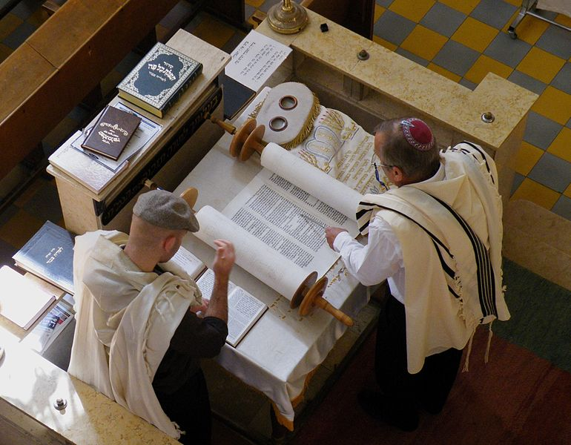
Judaism
Notes:
Reading of the Torah, the Jewish holy book. Aish Synagogue, Tel Aviv, Israel

Slide 12
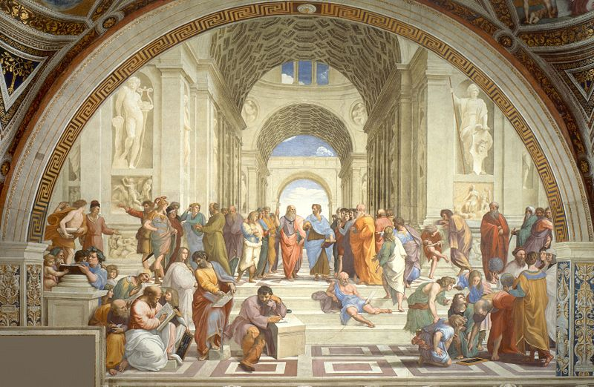
Greek Philosophy
Notes:
Raphael's School of Athens, depicting an array of ancient Greek philosophers engaged in discussion.
Ancient Greek philosophy arose in the 6th century BCE and continued through the Hellenistic period, at which point Ancient Greece was incorporated in the Roman Empire. It dealt with a wide variety of subjects, including political philosophy, ethics, metaphysics, ontology, logic, biology, rhetoric, and aesthetics.

Slide 13
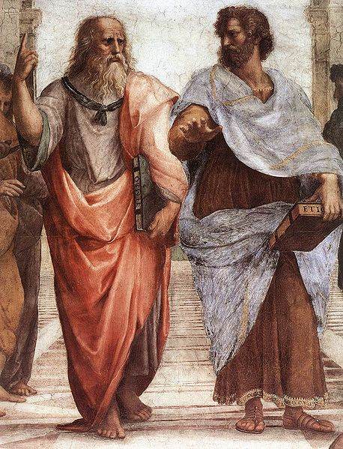
Greek Philosophy
Notes:
Jaspers argued that the axial age gave birth to philosophy as a discipline.
Plato (left) and Aristotle (right), a detail of The School of Athens, a fresco by Raphael. Aristotle gestures to the earth, representing his belief in knowledge through empirical observation and experience, while holding a copy of his Nicomachean Ethics in his hand. Plato holds his Timaeus and gestures to the heavens, representing his belief in The Forms
r. Socrates, credited as one of the founders of Western philosophy/

Slide 14
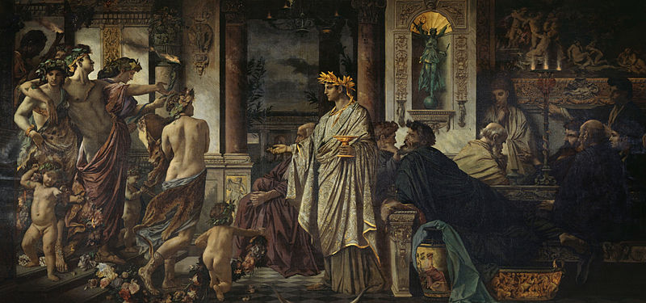
Greek Philosophy
Notes:
Plato's Symposium (Anselm Feuerbach, 1873)

Slide 15
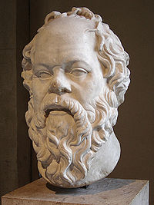
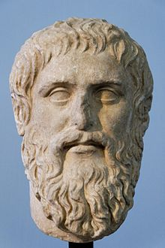
Greek Philosophy
Notes:
R. Plato: copy of portrait bust by Silanion
L. Socrates

Slide 16
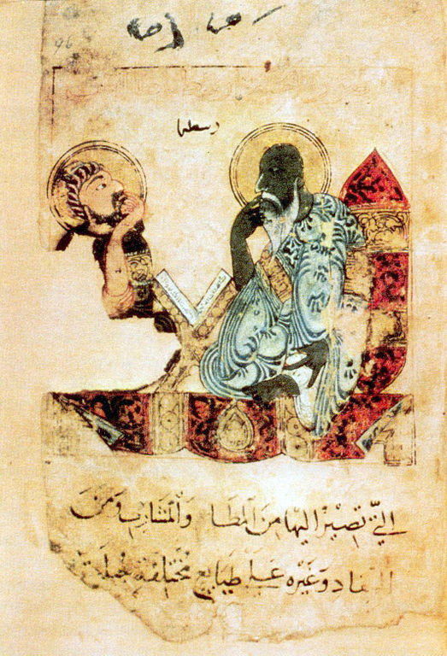
Greek Philosopher
Notes:
Early Islamic portrayal of Aristotle

Slide 17
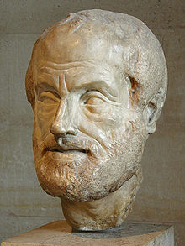
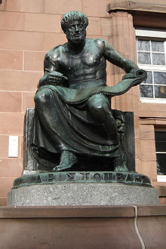
Greek Philosophers
Notes:
R. Statue of Aristotle (1915) by Cipri Adolf Bermann at the University of Freiburg i Breisgau
L. Aristotle: copy of portrait bust by Lysippos

Slide 18
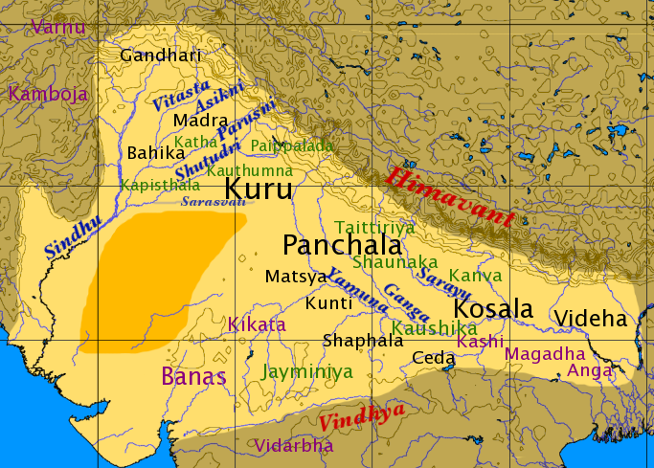
Hinduism
Notes:
Map of northern India showing kingdoms in which the oldest Upanishads – the Brihadaranyaka and Chandogya were composed. River Indus is shown by its Sanskrit name Sindhu

Slide 19
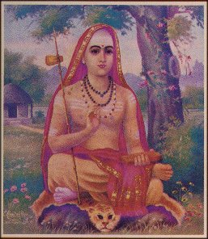
Hinduism
Notes:
Adi Shankara Bhagavadpada, expounder of Advaita Vedanta and commentator (bhashya) on the Upanishads

Slide 20
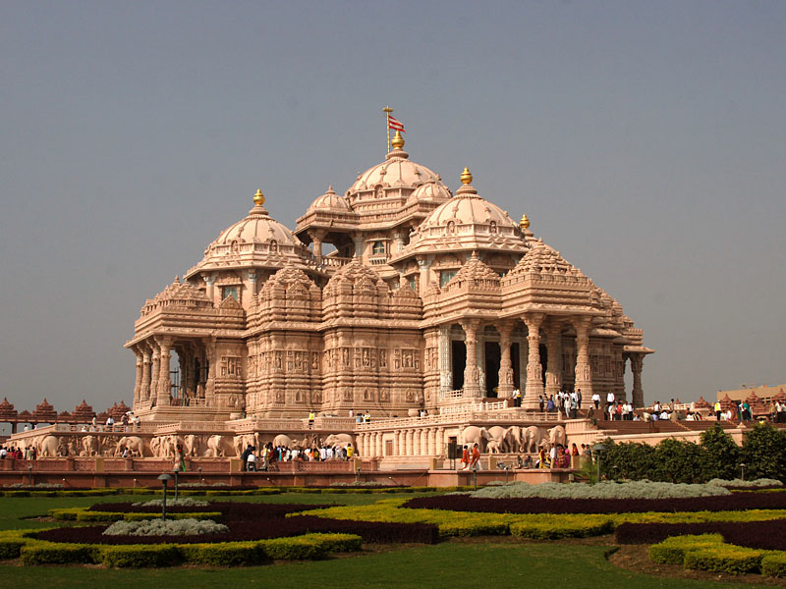
Hinduism
Notes:
The Swaminarayan Akshardham Temple in Delhi, India according the Guinness World Records is the World’s Largest Comprehensive Hindu Temple

Slide 21
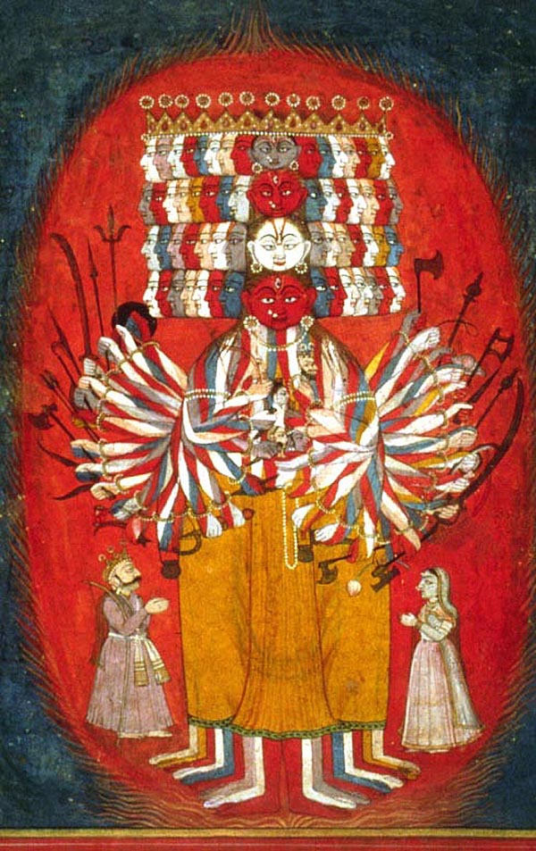
Hinduism
Notes:
Krishna displays his Vishvarupa (Universal Form) to Arjuna on the battlefield of Kurukshetra

Slide 22
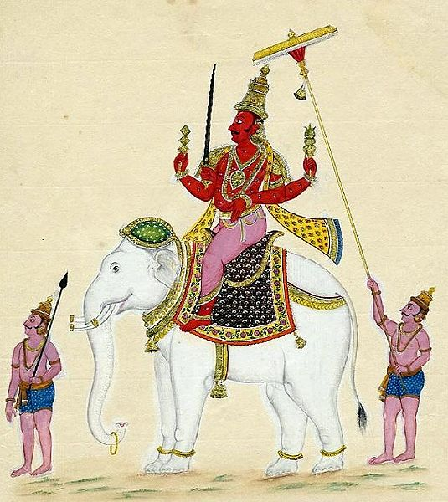
Hinduism
Notes:
Indra, king of gods, in Hinduism; also god of thunder, war, and weather. Wikimedia Commons,

Slide 23
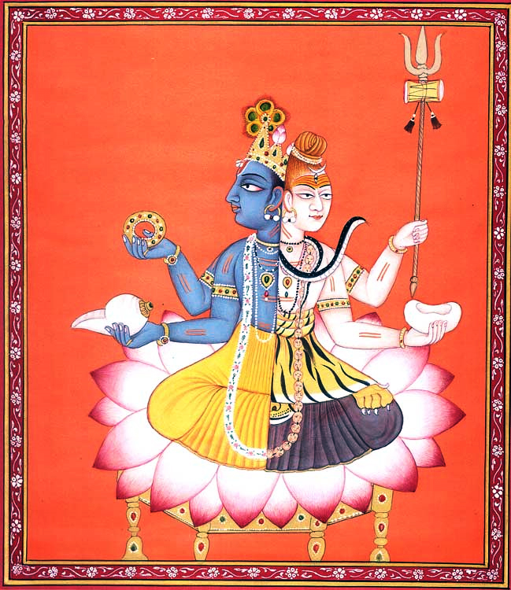
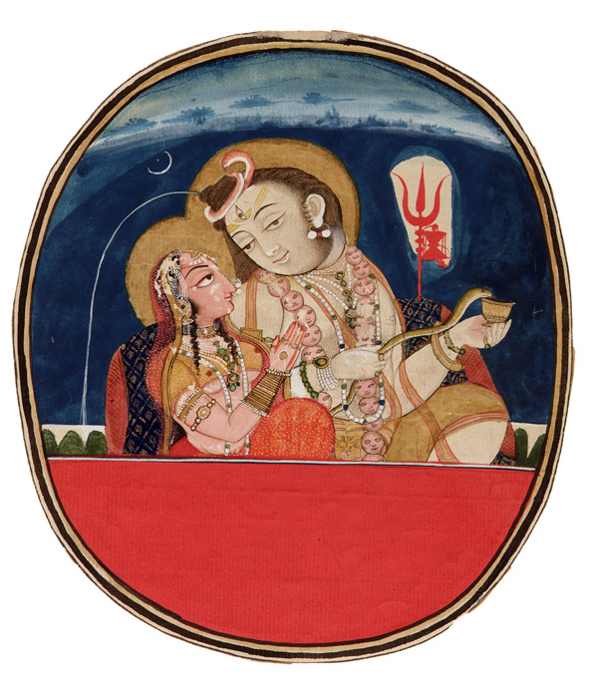
Hinduism
Notes:
Vishnu (left half—blue) and Shiva (right half—white)
R. Shiva with Parvati. Shiva is depicted three-eyed, the Ganges flowing through his matted hair (which are yellowish-white or like molten gold), wearing ornaments of serpents and a skull bracelet, and covered in ashes, and Trisula and Damaru are seen in the background

Slide 24
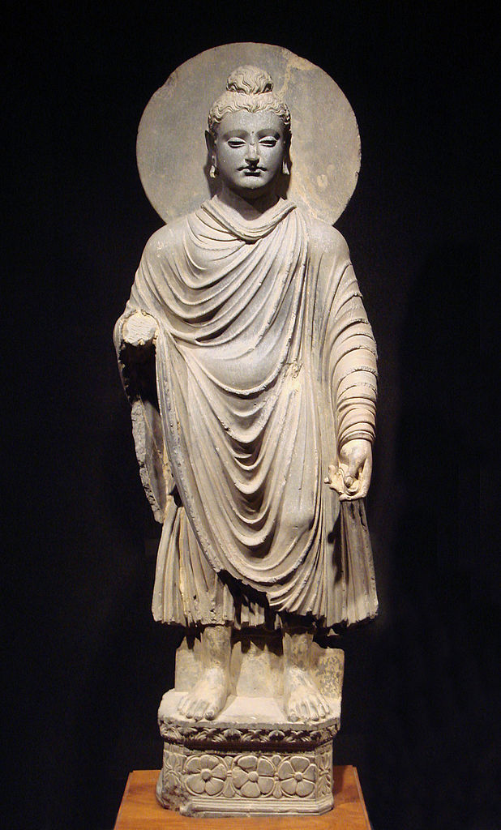
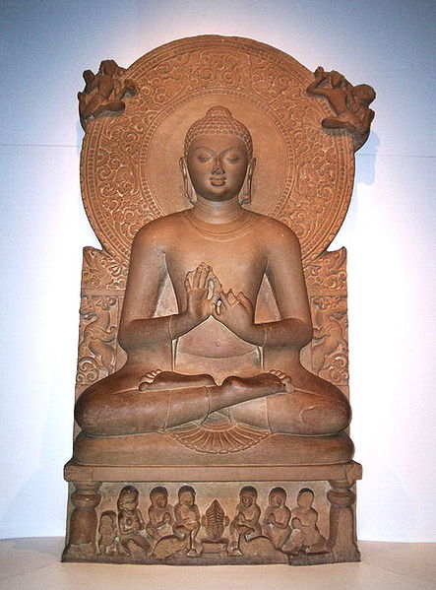
Buddhism
Notes:
L. Standing Buddha. One of the earliest known representations of the Buddha, 1st-2nd century CE, Gandhara (modern Afghanistan).
R. A statue of the Buddha from Sarnath, 4th century CE. Wikimedia Commons

Slide 25
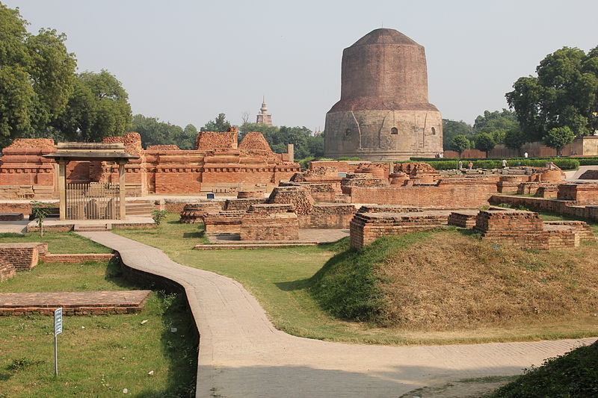
Buddhism
Notes:
Dhamek Stupa in Sarnath, Uttar Pradesh, India, built by King Ashoka, where Buddha gave his first sermon

Slide 26
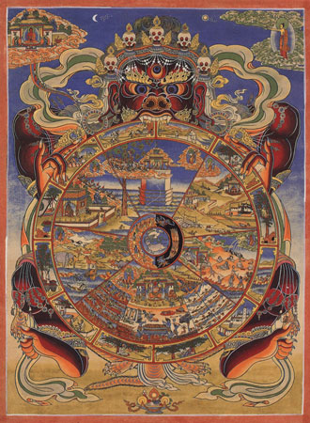
Buddhism
Notes:
Traditional Tibetan Buddhist Thangka depicting the Wheel of Life with its six realms. The Bhavacakra (Sanskrit; Devanagari: भवचक्र; Pali: bhavacakka) or Wheel of Becoming is a symbolic representation of continuous existence proces in the form of a circle, used primarily in Tibetan Buddhism. Wikimedia Commons

Slide 27
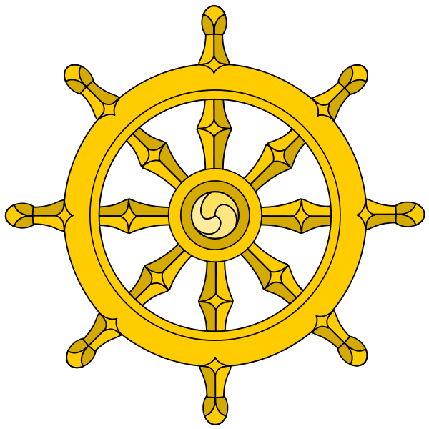
Buddhism
Notes:
The Dharmachakra represents the Noble Eightfold Path.

Slide 28
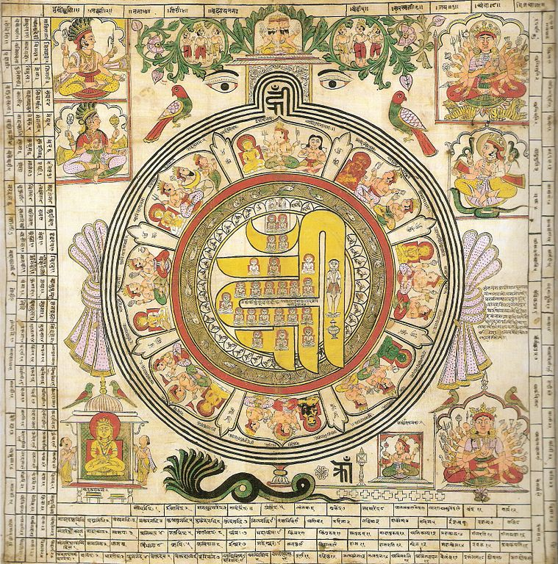
Jainism
Notes:
Painting depicting Om Hrim Siddhi Chakra Mandala 18th Century. Om Hrim Siddhi Chakra used by Jains in dravya puja

Slide 29
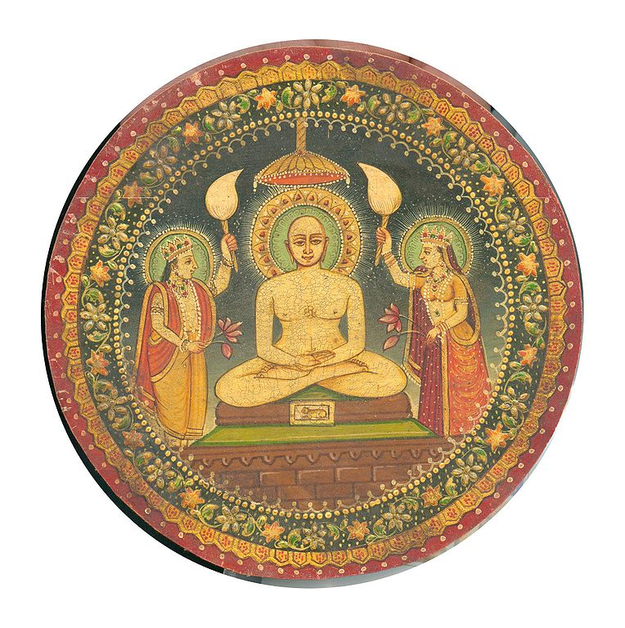
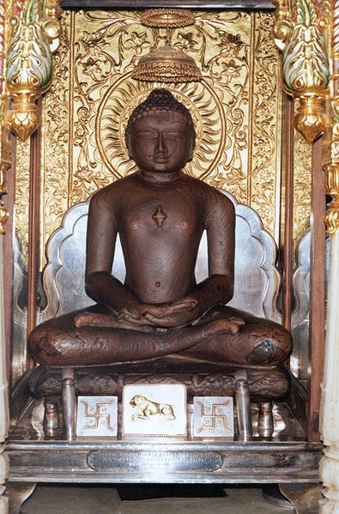
Jainism
Notes:
L. Miniature painting of Mahāvīra
R. Idol of Lord Mahavir. Mahavira is the name most commonly used to refer to the Indian sage Vardhamāna; traditionally 599–527 BCE[ who established what are today considered to be the central tenets of Jainism.

Slide 30
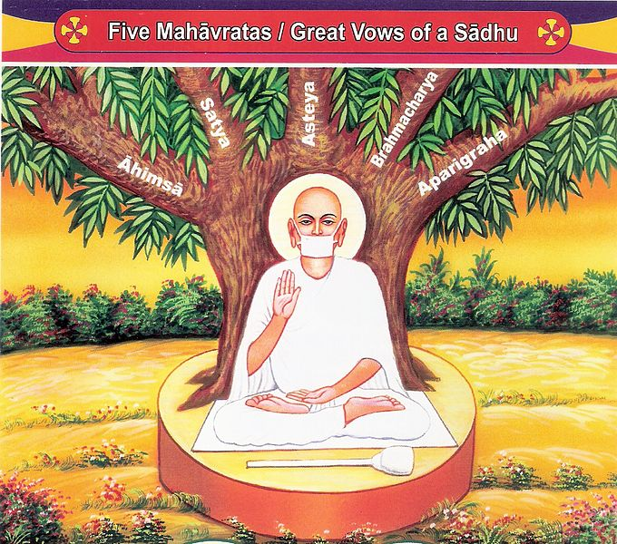
Jainism
Notes:
Five Mahavratas of Jain ascetics

Slide 31
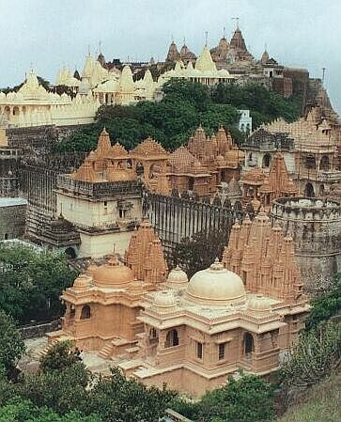
Jainism
Notes:
The Jain temples of Mount Satrunjaya, at Palitana, India.

Slide 32
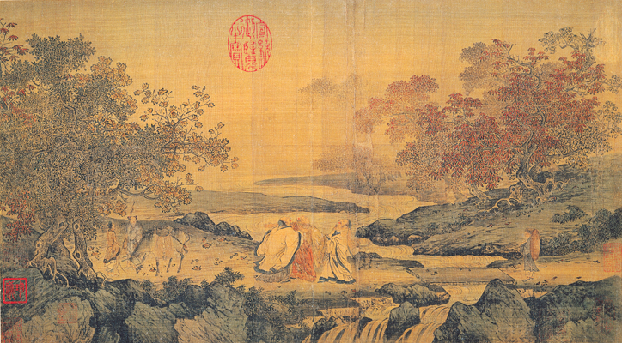
Confucianism, Daoism, Buddhism
Notes:
Song Dynasty painting in the Litang style illustrating the theme "Confucianism, Taoism and Buddhism are one". Depicts Taoist Lu Xiujing (left), official Tao Yuanming (right) and Buddhist monk Huiyuan (center, founder of Pure Land) by the Tiger stream. The stream borders a zone infested by tigers that they just crossed without fear, engrossed as they were in their discussion. Realizing what they just did, they laugh together, hence the name of the picture,Three laughing men by the Tiger stream.

Slide 33
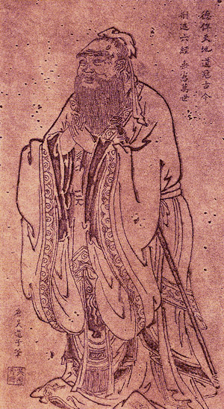
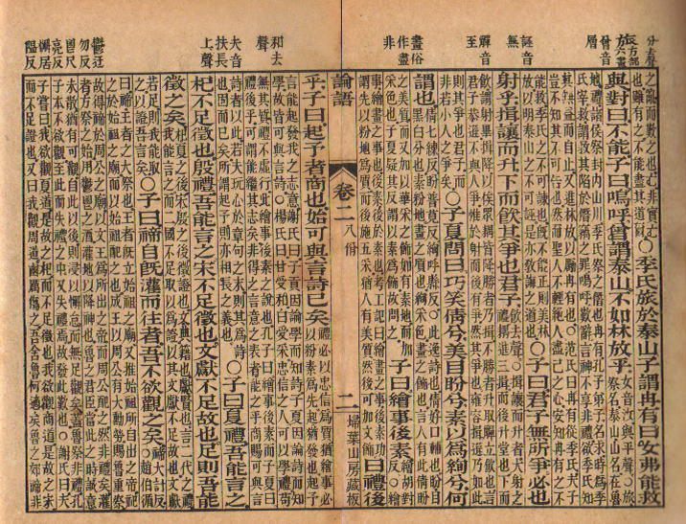
Confucianism
Notes:
L. A portrait of Confucius by the Tang Dynasty artist Wu Daozi (680–740).
R. The Analects of Confucius. Founded 2 century BCE - early 3 century CE

Slide 34
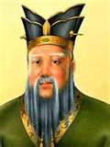
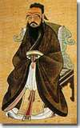
Confucianism
Notes:
Confucius

Slide 35
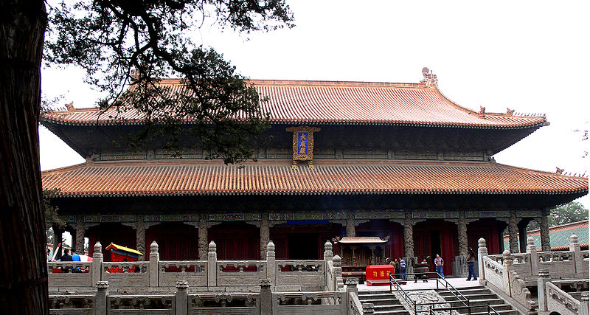
Confucianism
Notes:
The Dacheng Hall, the main hall of the Temple of Confucius in Qufu, China

Slide 36

Daoism
Notes:
The Yin and Yang Symbol with white representing Yang and black representing Yin. The symbol is a visual depiction of the intertwined duality of all things in nature, a common theme in Daoism. It is believed to be derived from the 14th century Tiandi Zhiran Hetu (Heaven and Earth’s Natural Diagram of the River), Hetu (Diagram of River), Luoshu (Chart of Luo), Xiantian tu (Diagram of Preceding Heaven) and Taijitu (太極圖) (Diagram of the Ultimate Power).

Slide 37
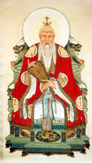
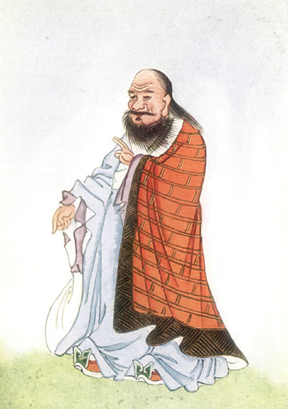
Daoism
Notes:
L. Lao Tzu, depicted as a Daoist god. According to Chinese traditions, he lived in the 6th century BCE.
R. Depiction of Laozi in Edward Theodore Chalmers Wernr's Myths and Legends of China

Slide 38
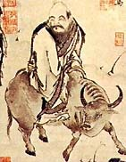
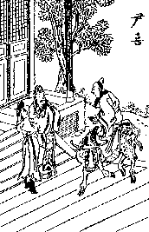
Daoism
Notes:
L. According to legends, Lao Tzu leaves China on his water buffalo.
R. Lao Tzu meets Yin Xi, the Guardian of the Gate of Tibet.

Slide 39
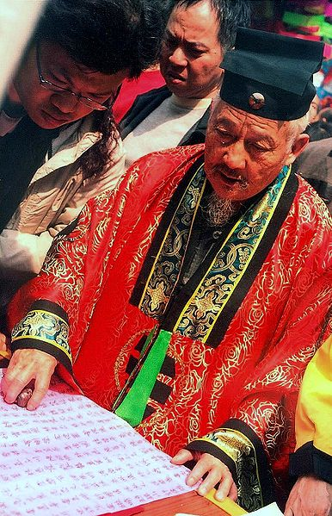
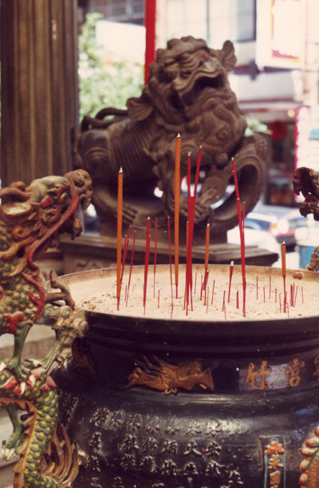
Daoism
Notes:
L. Taoist Priest in Macau, February 2006.
R. Temple incense censer in Taichung, Taiwan with Fu Dog behind.

Slide 40
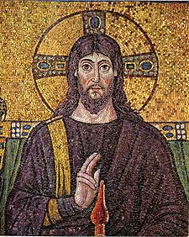
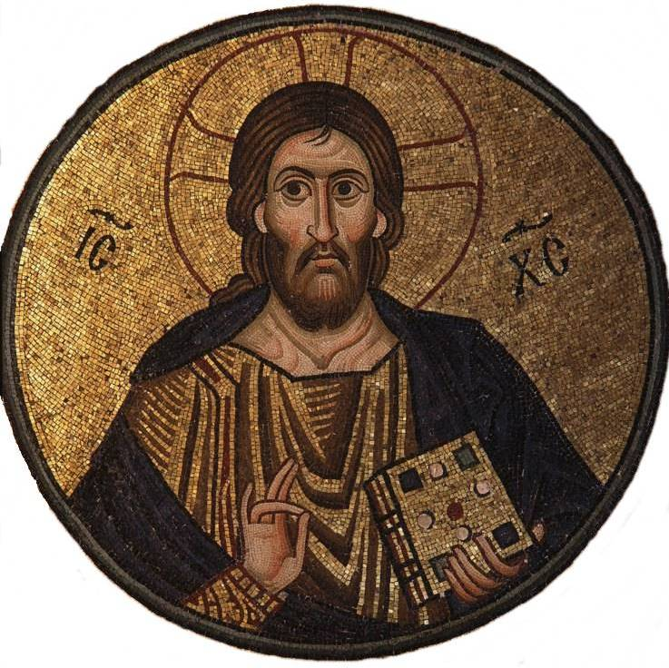
Christianity
Notes:
6th-century mosaic of Jesus at Basilica of Sant'Apollinare Nuovo in Ravenna. Though depictions of Jesus are culturally important, no undisputed record of what Jesus looked like is known to exist. Wikimedia Commons
R. 11th century Icon of Jesus from Greece.

Slide 41
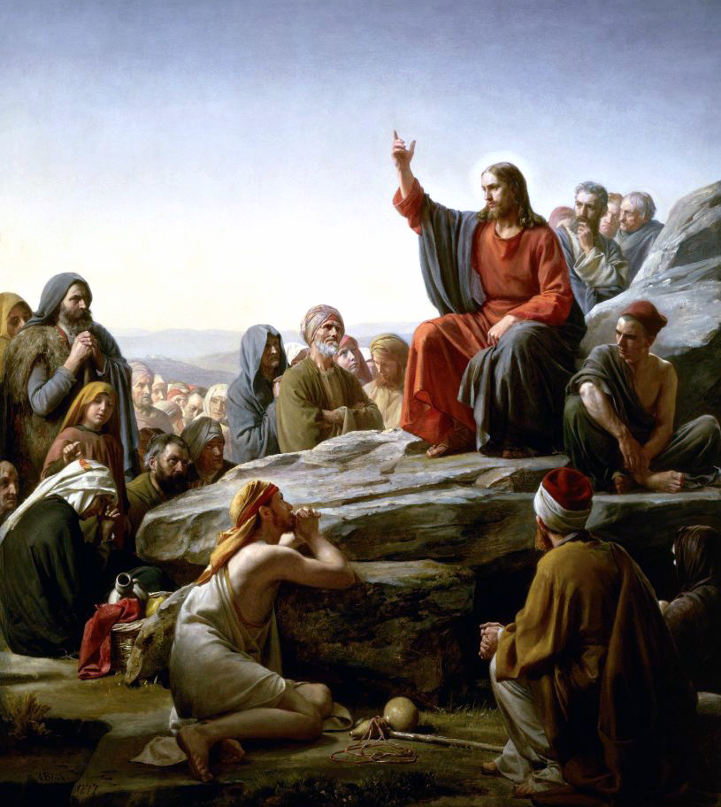
Christianity
Notes:
Jesus, The Sermon On the Mount by Carl Heinrich Bloch, Danish painter, d. 1890

Slide 42

Christianity
Notes:
Icon depicting Emperor Constantine (right) and the Fathers of the First Council of Nicaea (325) as holding the Niceno–Constantinopolitan Creed of 381.

Slide 43


Christianity
Notes:
A depiction of Jesus as a child with his mother, Mary, the Theotokos of Vladimir. 12th century, Russia.
R. Crucifixion, representing the death of Jesus on the Cross, painting by D. Velázquez, 17th c.

Slide 44

Christianity
Notes:
Resurrection of Christ by Noel Coypel, 1700, using a hovering depiction of Jesus.

Slide 45

Christianity
Notes:
Chapel of Saint Ananias, Damascus, Syria, an early example of a Christian house of worship; built in the 1st century CE

Slide 46


Christianity
Notes:
Opening of Luther's 95 Theses
L. European Christian scribe, Bibles were hand-written in this way. Wikimedia Commons

Slide 47

Christianity
Notes:
Samples of Catholic religious objects—The Holy Bible, a Crucifix, and a Rosary.

Slide 48


Islam
Notes:
L. Prophet Muhammad at the Ka'ba, The Life of the Prophet Topkapi Palace Museum, Istanbul. Illustration by Nakkaş Osman c. 1595. Notice, according to tradition, the face of Muhammad is not shown.. Wikimedia Commons
R. The first sura in a Qur'anic manuscript by Hattat Aziz Efend.

Slide 49

Islam
Notes:
Kaaba at the heart of Mecca. As the night goes on pilgrims visiting the Holy House.

Slide 50

Islam
Notes:
Faithful praying towards Makkah; Umayyad Mosque, Damascus.

Slide 51

Islam
Notes:
The Sultan Ahmed Mosque in Istanbul, Turkey.

Slide 52

Islam
Notes:
A folio from an early Quran, written in Kufic script (Abbasid period, 8th–9th century).

Slide 53

Islam
Notes:
The Islamic prophet Muhammad solves a dispute over lifting the black stone into position at al-Kaaba. "The illustrations to the World history of Rashid al-Din / David Talbot Rice ; edited by Basil Gray. Edinburgh : Edinburgh University Press, c1976." - In the center, Prophet Muhammad, with two long hair plaits, places the stone on a carpet held at the four corners by representatives of the four tribes, so that all have the honor of lifting it. The carpet is a kelim from Central Asia. Behind, two other men lift the black curtain which conceals the doors of the sanctuary. This work may be assigned to the Master of the Scenes from the Life of the Prophet.

Slide 54

Islam
Notes:
Mohammed receiving his first revelation from the angel Gabriel. Miniature illustration on vellum from the book Jami' al-Tawarikh (literally "Compendium of Chronicles" but often referred to as The Universal History or History of the World), by Rashid al-Din, published in Tabriz, Persia, 1307 A.D. Now in the collection of the Edinburgh University Library, Scotland.

