Slide 1
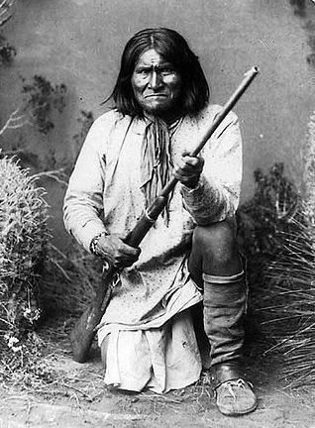
Chiefdoms
Notes:
An example of a chief, Geronimo (1829-1909), Apache chieftain for the Chiricahua tribe of southwestern United States. (title) Wikimedia Commons

Slide 2
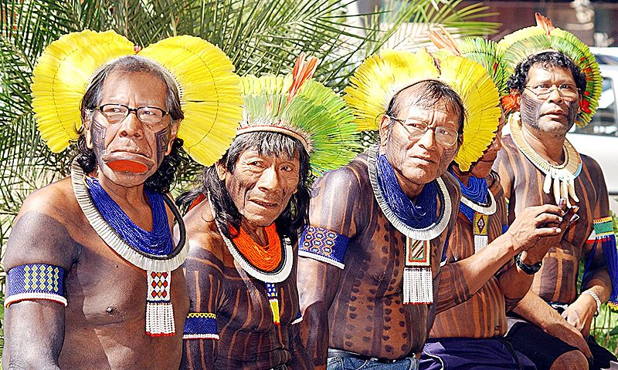
Chiefs
Notes:
Kayapo chiefs. The Kayapo people are indigenous peoples in Brazil, from the plain lands of the south of the Amazon Basin.
In 2010, their population was 8,638. Their villages typically consist of a dozen huts. A centrally located hut serves as a meeting place for village men to discuss community issues. Wikimedia Commons

Slide 3
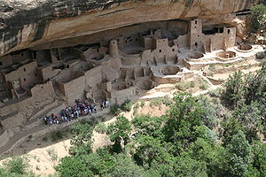
Chiefdoms
Notes:
Former cheifdom, Mesa Verde cliff dwellings, this is a UNESCO World Heritage Site

Slide 4
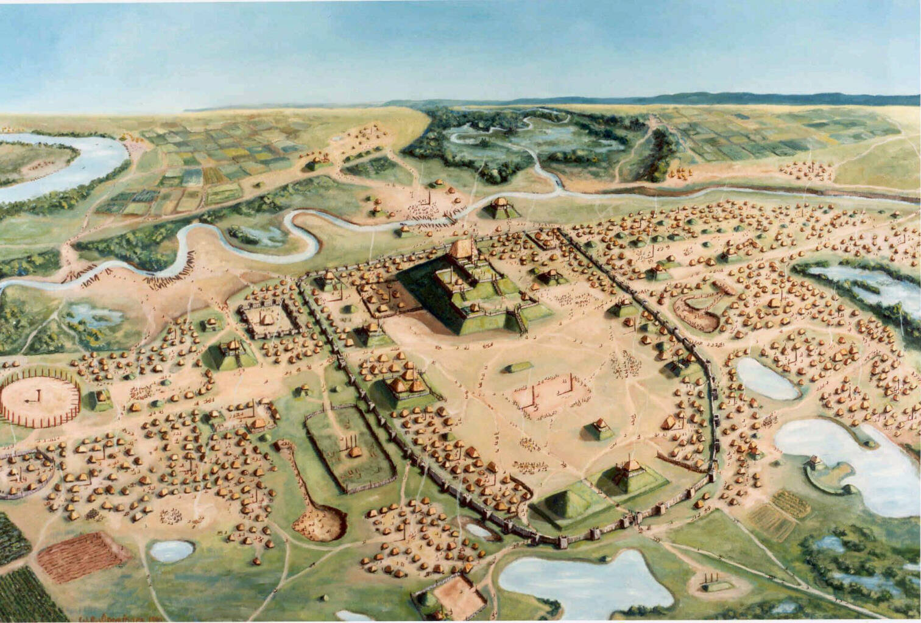
Cahokia
Notes:
Artist rendition of Cahokia, present day southeaster Illinois, USA, permission from the Cahokia State Historical Museum.

Slide 5
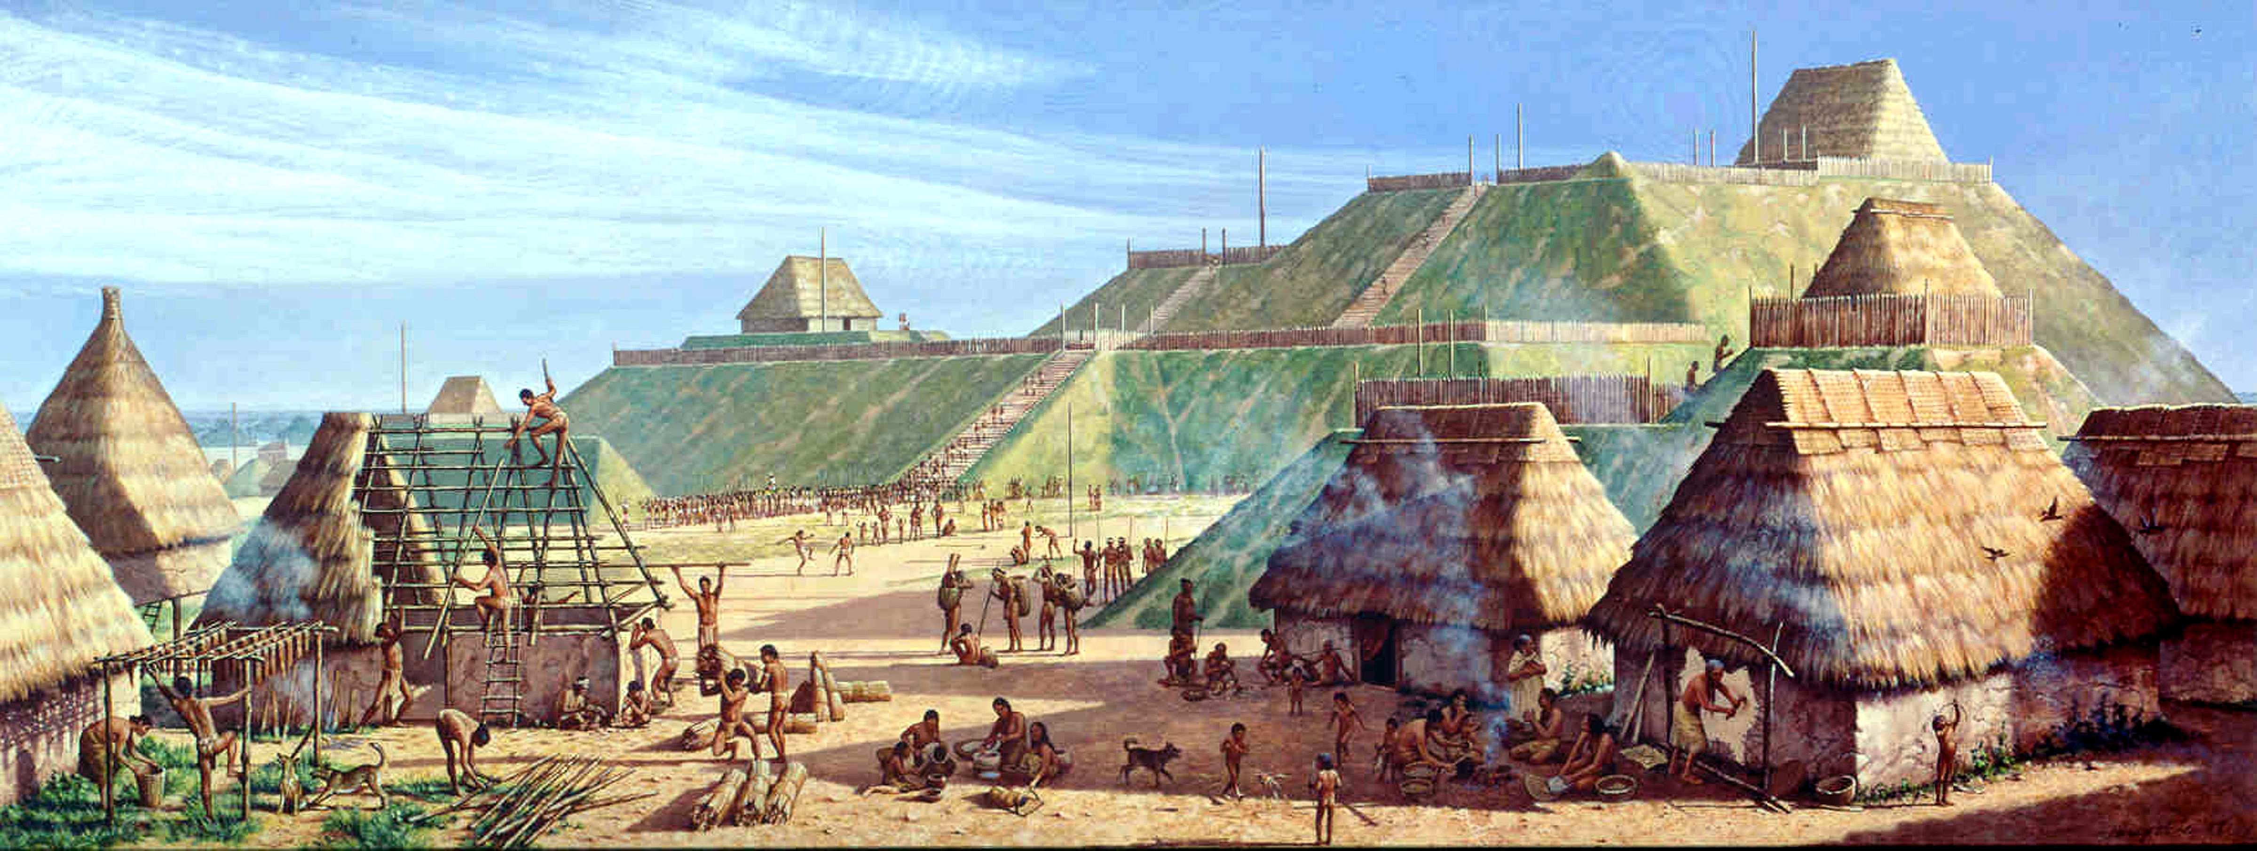
Cahokia
Notes:
Artist rendition of community life in Cahokia, permission from the Cahokia State Historical Museum.

Slide 6
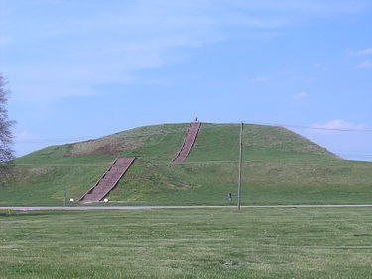
Monks Mound in Cahokia
Notes:
Monks Mound in Cahokia, Wikimedia Commons

Slide 7
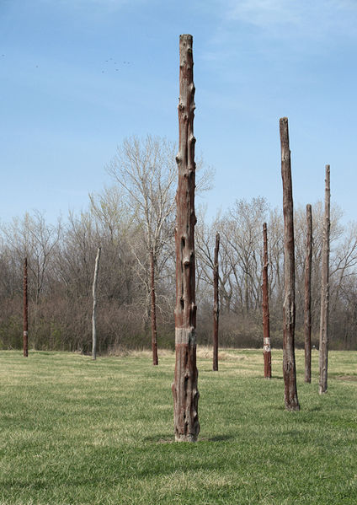
Reconstructed Woodhenge, Cahokia
Notes:
Reconstructed Woodhenge in Cahokia, Wikimedia Commons

Slide 8
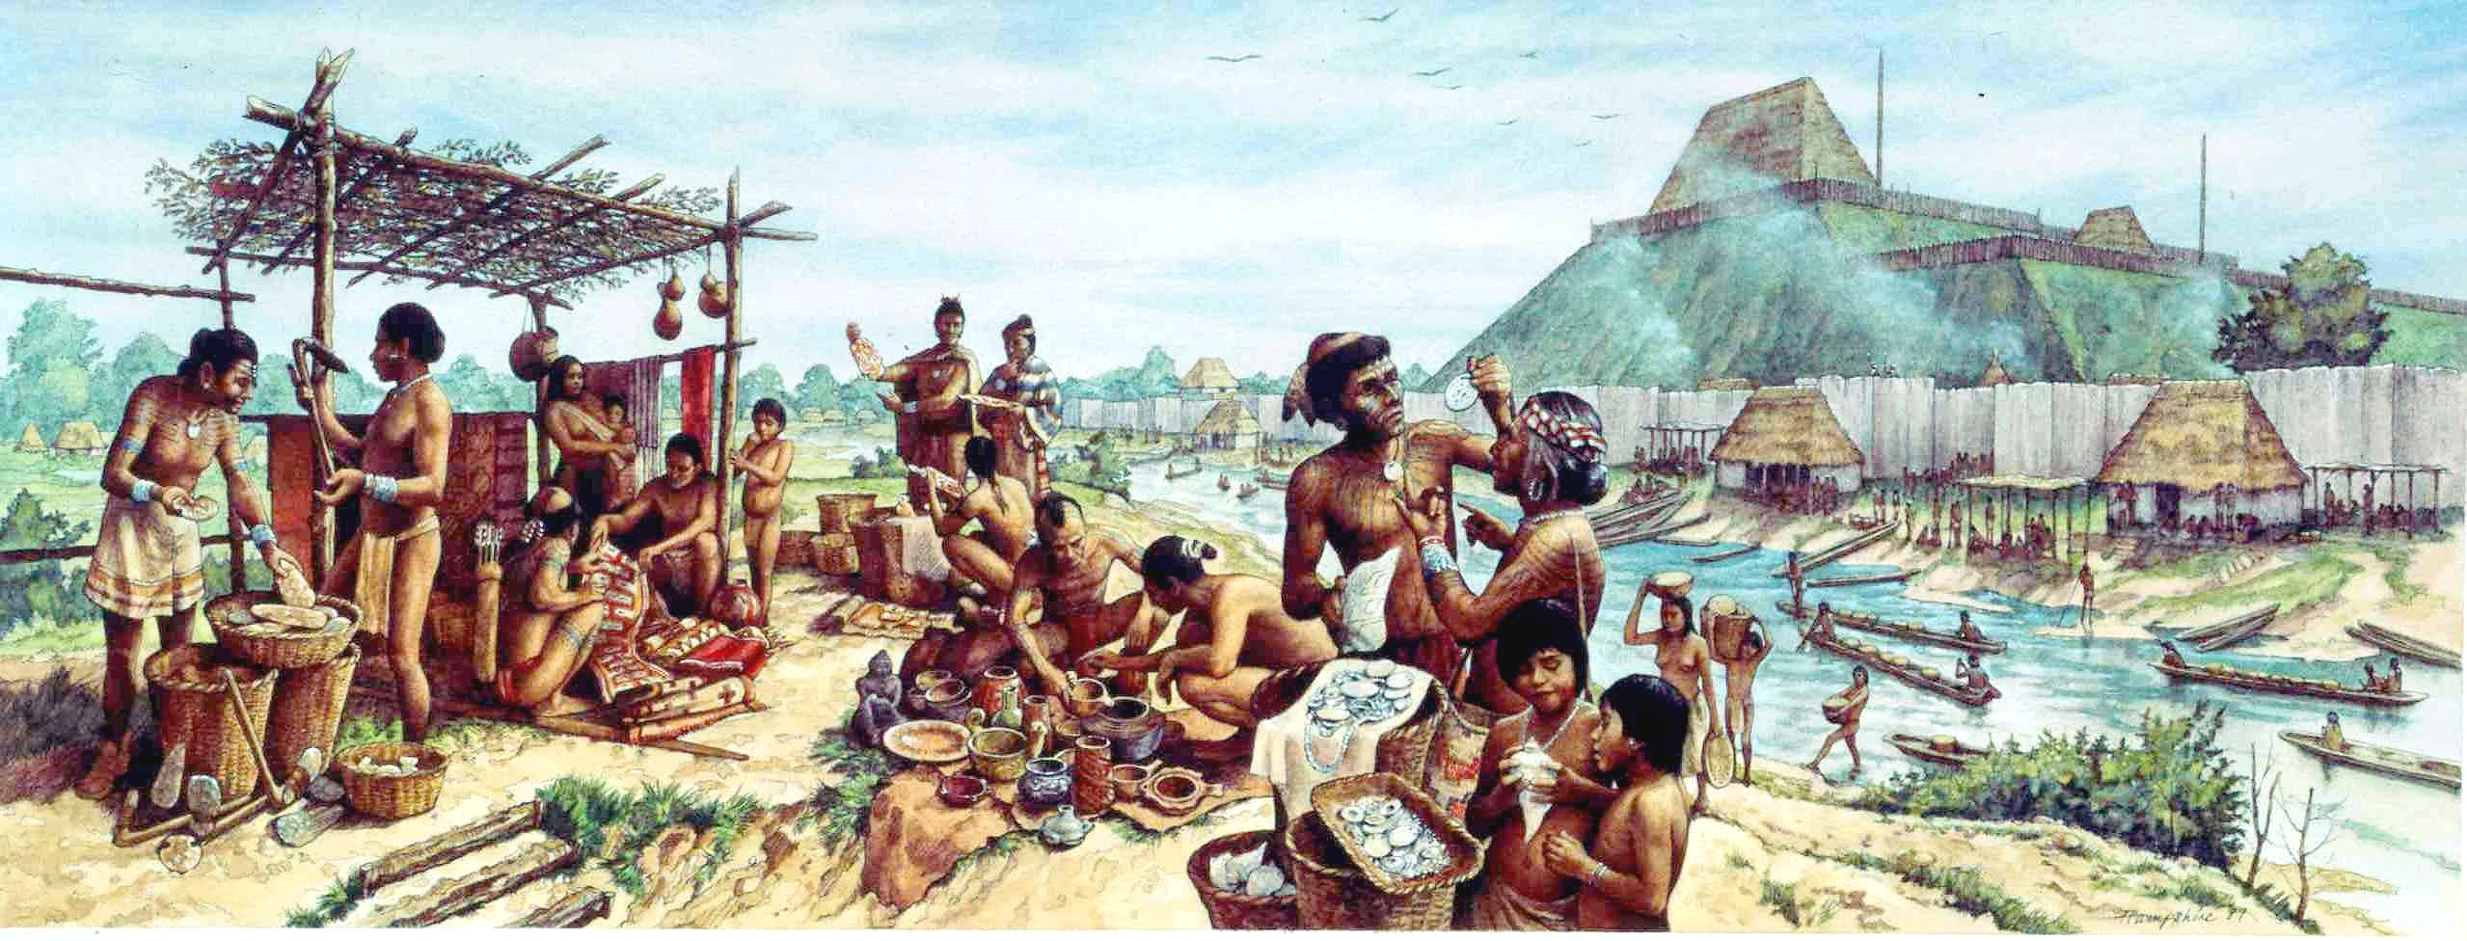
Trading, Cahokia
Notes:
Artist rendition of trading near Cahokia (permission from the Cahokia State Historical Museum)

Slide 9
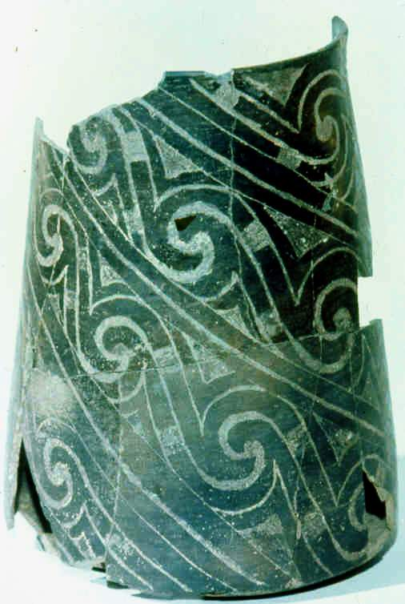
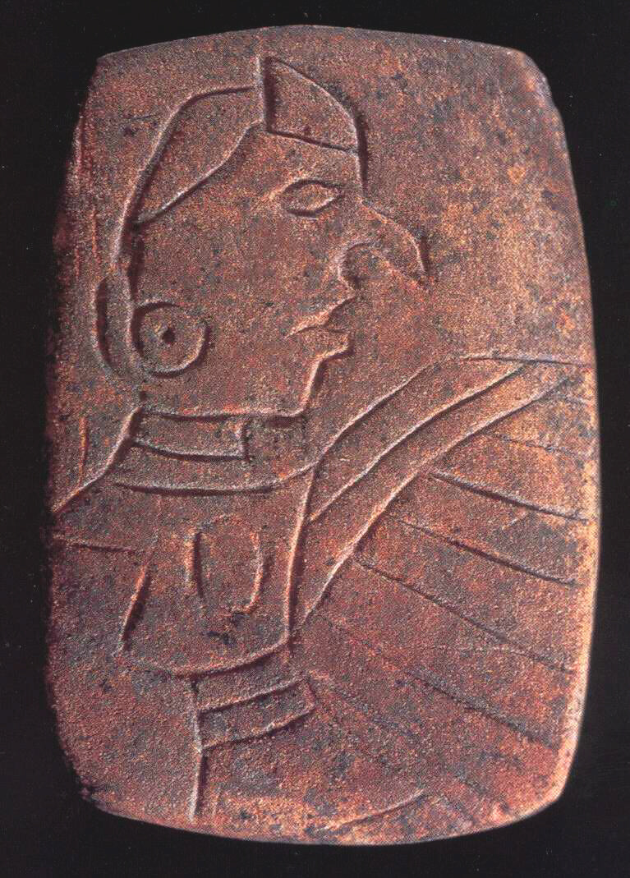
Cahokia
Notes:
Left: Engraved beaker, Cahokia, permission from the Cahokia State Historical Museum.
Right: Birdman Tablet, Cahokia, permission from the Cahokia State Historical Museum

Slide 10
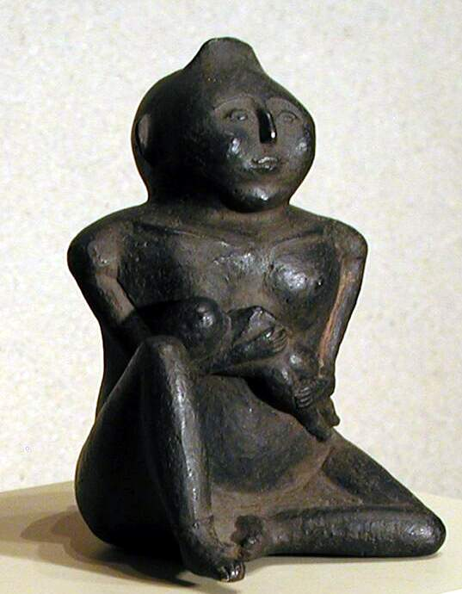

Cahokia
Notes:
Left: Mother and child, Cahokia, permission from the Cahokia State Historical Museum
Right: Chunkey Player, flint clay figurine, Wikimedia Commons

Slide 11
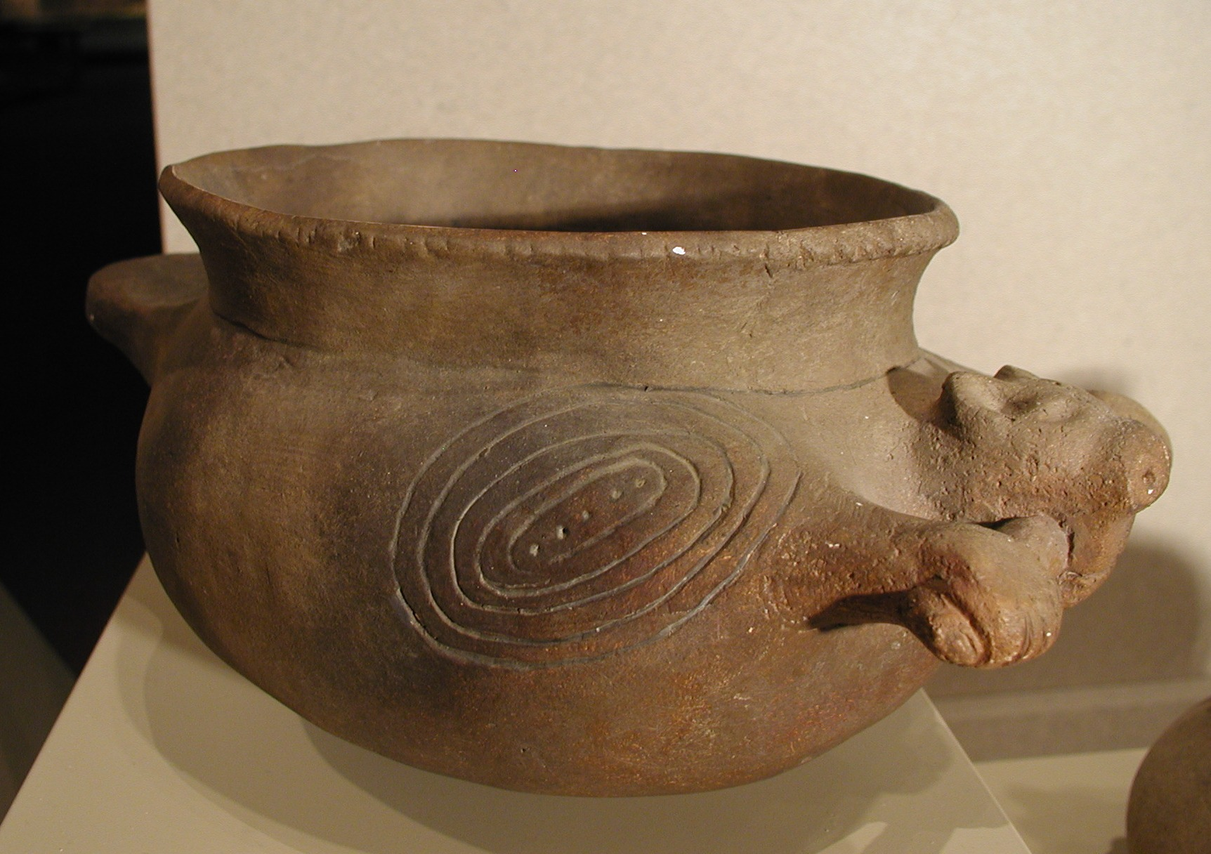
Cahokia Pottery
Notes:
Cahokia pottery, permission from the Cahokia State Historical Museum.

