Slide 1
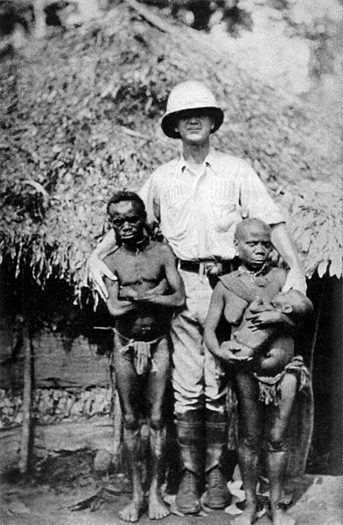
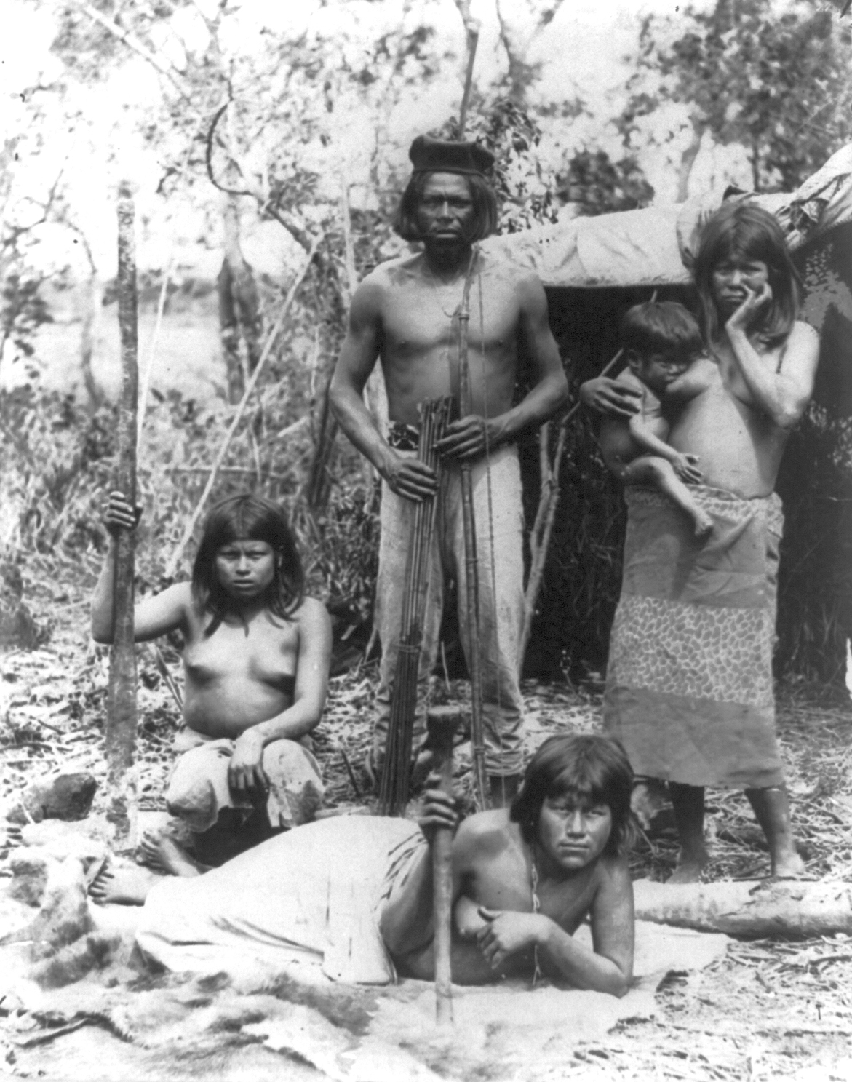
Foraging Societies
Notes:
Right: Indian family in Brazil posed in front of hut – 3 females, baby and man with bow and arrows.
Date between 1890(1890) and 1923(1923). Wikimedia Commons
Left: Pygmy is a term used for various ethnic groups worldwide whose average height is unusually short; anthropologists define pygmy as any group whose adult men grow to less than 150 cm (4 feet 11 inches) in average height. The term "pygmy" is sometimes considered pejorative. However, there is no single term to replace it.

Slide 2
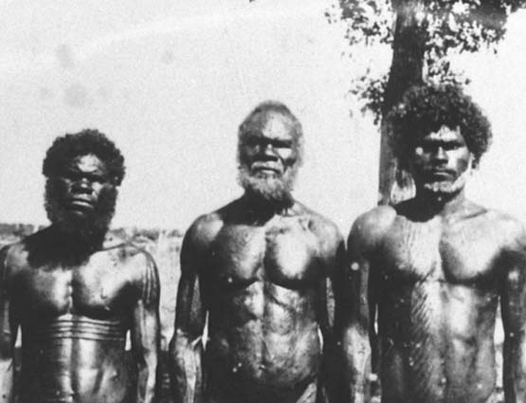
Communal Wave:
Australian Aborigines
Notes:
Aborigines are people who are indigenous to most of the Australian continent. These three indigenous Australians on Bathurst Island in 1939. Apparently the island’s population was isolated from modern society for 6,000 years until the 18th century. Today the population totals 517,000, 2.3% of Australia's population. Wikimedia Commons

Slide 3
Ecosystem Currents
Geography
Environment
Human Populations
Natural Populations
Human and Nature Interaction

Slide 4
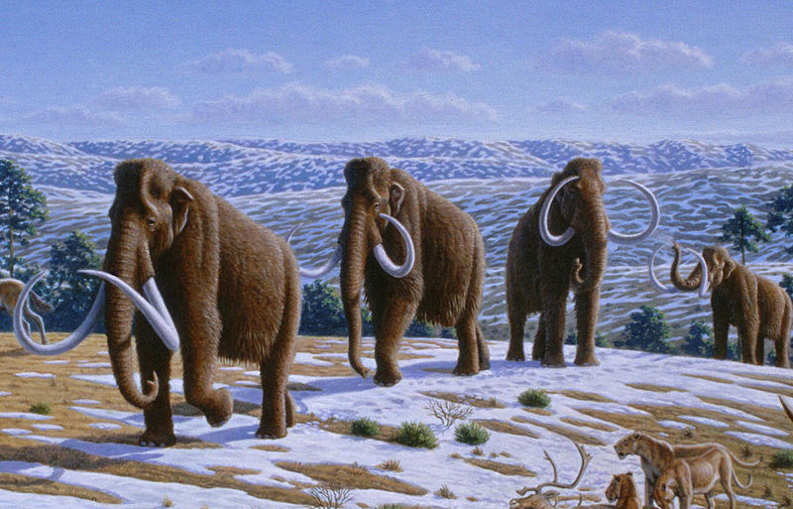
Upper Paleolithic Environment
Notes:
The wooly mammoth disappeared from most of its range about 10,000 years ago. Many great mammals such as wooly mammoths, wooly rhinoceros, and cave lions inhabited places like Siberia during the Pleistocene. Wikimedia Commons

Slide 5
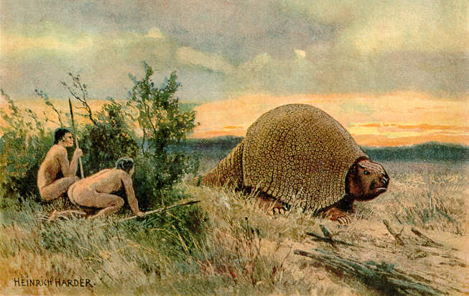
Upper Paleolithic
Notes:
Glyptodon hunters. Paleolithic recreation. Glyptodon originated in South America. Wikimedia Commons

Slide 6
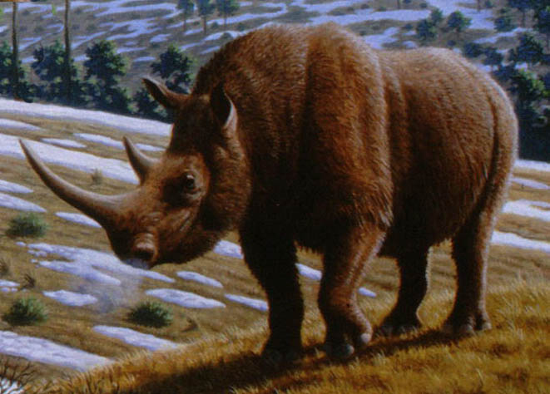
Upper Paleolithic
Notes:
Life restoration of the woolly rhinoceros used its horns for defensive purposes and to attract mates. It is believed that they migrated from there to northern Asia and Europe when the Ice Age began. Wikimedia Commons

Slide 7
Ways of Living:
Techno-Economic Currents
Daily Life
Economic Systems
Technology
Exchange and Trade
Patterns of Labor

Slide 8
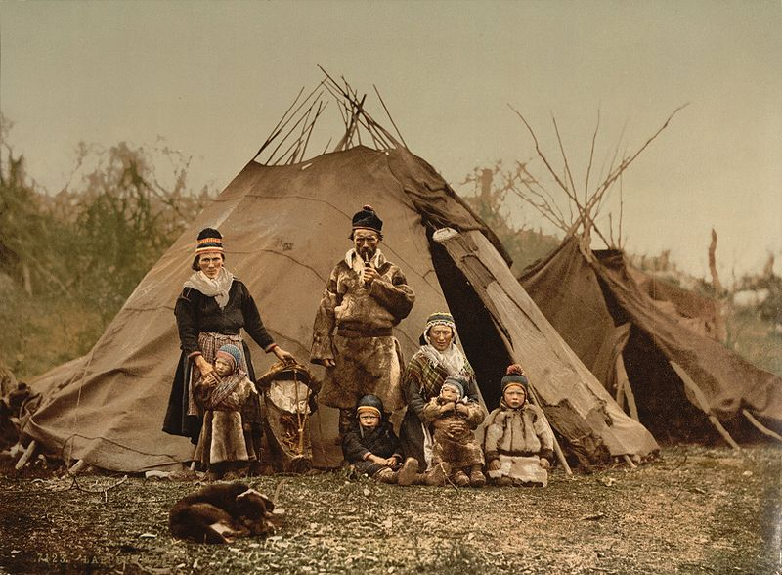
Daily Life: Housing, Sami (Lapp)
Notes:
A Sami (Lapp) family in Norway around 1900. Their subsistence is based on reindeer herding.

Slide 9
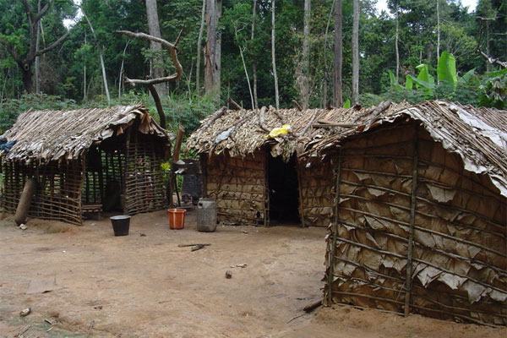
Daily Life: Housing
Notes:
Mbuti huts in the rainforest of central Africa

Slide 10
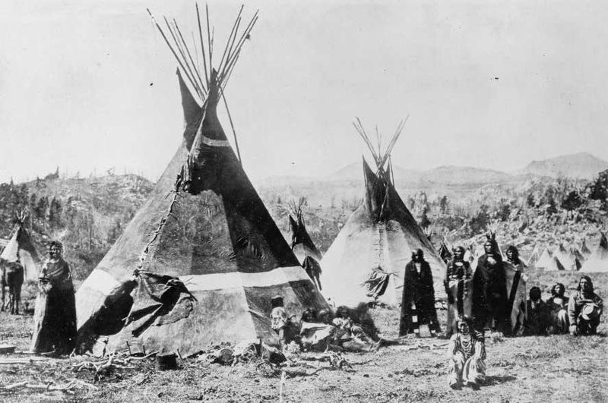
Daily Life: Housing
Notes:
The Shoshone or Shoshoni are a Native American tribe in the United States with three large divisions: the Northern, the Western and the Eastern. Tipis taken 1890, Wikimedia Commons

Slide 11
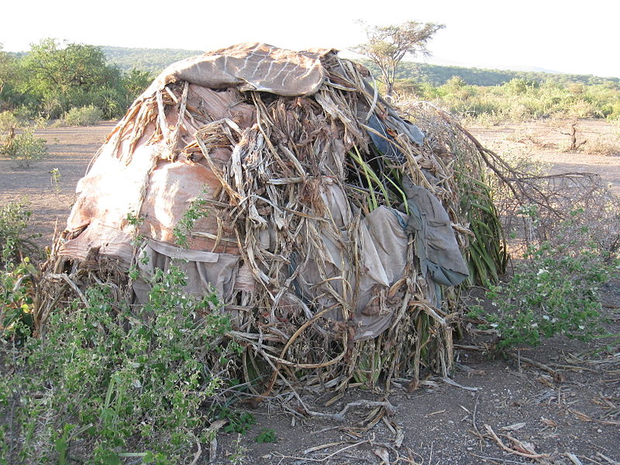
Daily Life: Housing
Notes:
The Hadza, or Hadzabe, are an ethnic group in north-central Tanzania The Hadza's way of life is highly conservative. Huts have been built in this style for as long as records have been kept. Some 300–400 Hadza live as hunter-gatherers, much as their ancestors have for thousands or even tens of thousands of years; they are the last full-time hunter-gatherers in Africa.

Slide 12
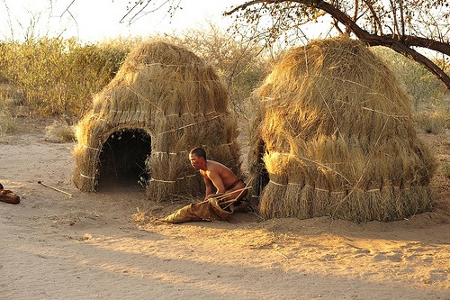
Daily Life: Housing
Notes:
Kung huts, flickr, educational purposes only, do not reproduce.

Slide 13
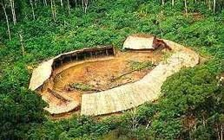
Daily Life: Village
Notes:
The Yanomami, also spelled Ya̧nomamö or Yanomama, are a group of approximately 20,000 indigenous people who live in some 200–250 villages in the Amazon rainforest on the border between Venezuela and Brazil.

Slide 14
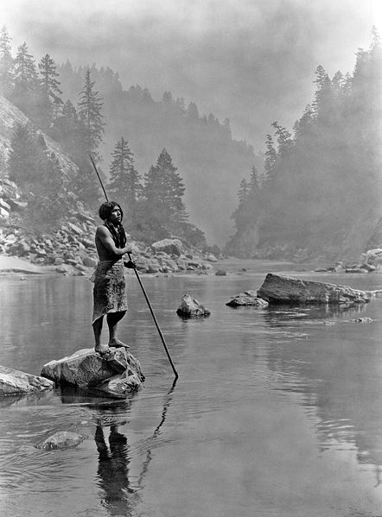
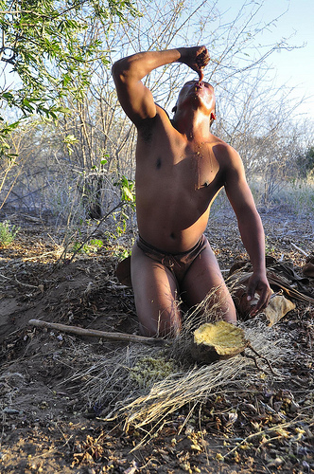
Daily Life
Notes:
Right: Kung man eating from a gourd.
Left: A Smoky Day at the Sugar Bowl, Hupa man spear fishing.

Slide 15


Daily Life: Food
Notes:
Right: Large game animals such as deer were an important source of protein in Middle and Upper Paleolithic diets
Left: People may have first fermented grapes in animal skin pouches to create wine during the Paleolithic. Wikimedia Commons

Slide 16
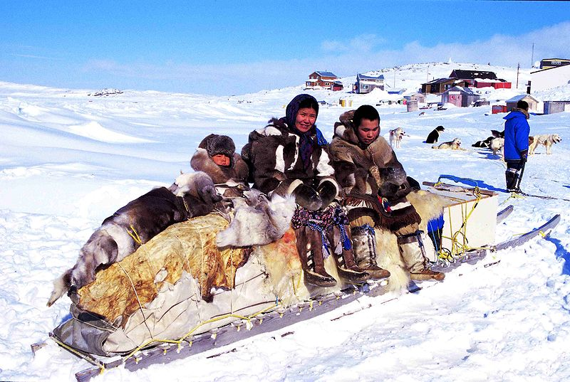
Daily Life: Transportation
Notes:
Inuit people, traditional qamuti (sled), Cape Dorset. The Inuit (also called Eskimo) are a group of culturally similar indigenous peoples inhabiting the Arctic regions of Canada, Denmark, (Greenland), Russia (Siberia) and the United States (Alaska). Total population is estimated at 150,000.

Slide 17
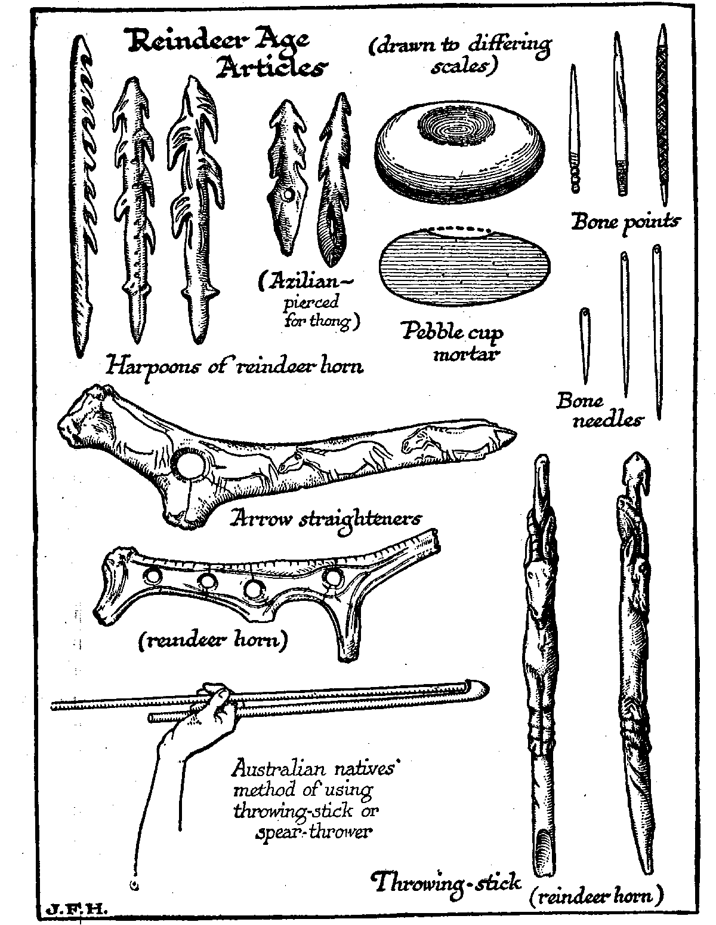
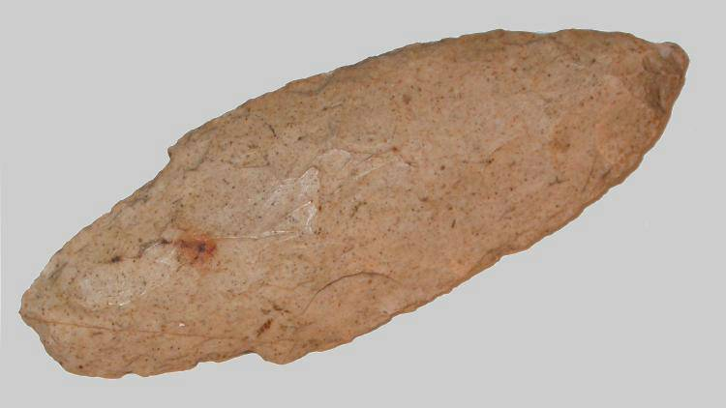
Technology: Tools
Notes:
Right: spearhead from the Upper Paleolithic
Left: Assorted reindeer bone tools

Slide 18
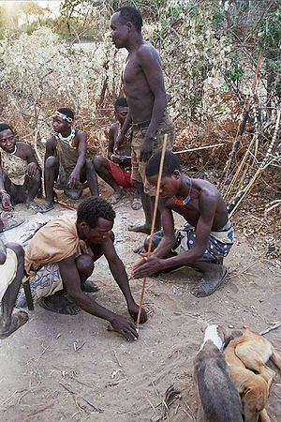
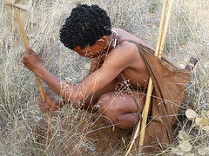
Patterns of Labor
Notes:
Right: Kung woman with digging stick, source flickr, copyrighted do not reproduce, educational purposes only.
Left: Hazda men lighting fire. Wikimedia Commons

Slide 19
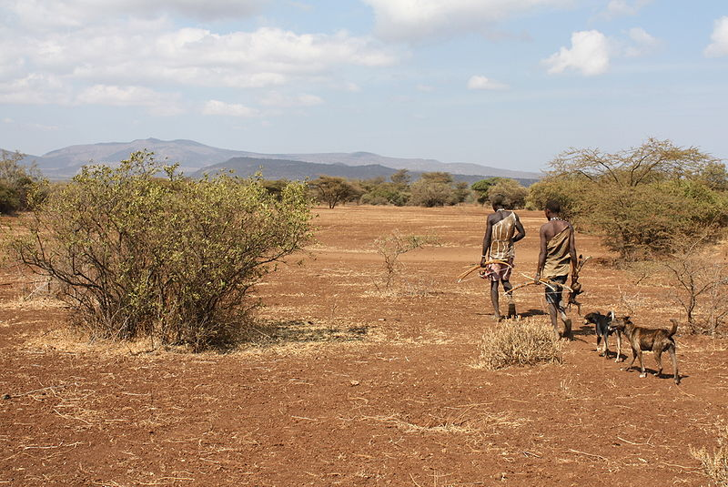
Patterns of Labor: Hunting
Notes:
Two Hadza men returning from a hunt on the Serengeti Plain of eastern Africa. The contribution of meat to the diet increases in the dry season, when game become concentrated around sources of water. During this time, men often hunt in pairs, and spend entire nights lying in wait by waterholes, hoping to shoot animals that approach for a night-time drink, with bows and arrows treated with poison.

Slide 20
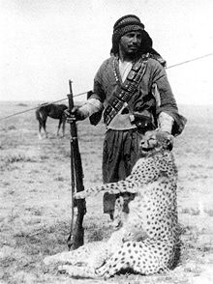
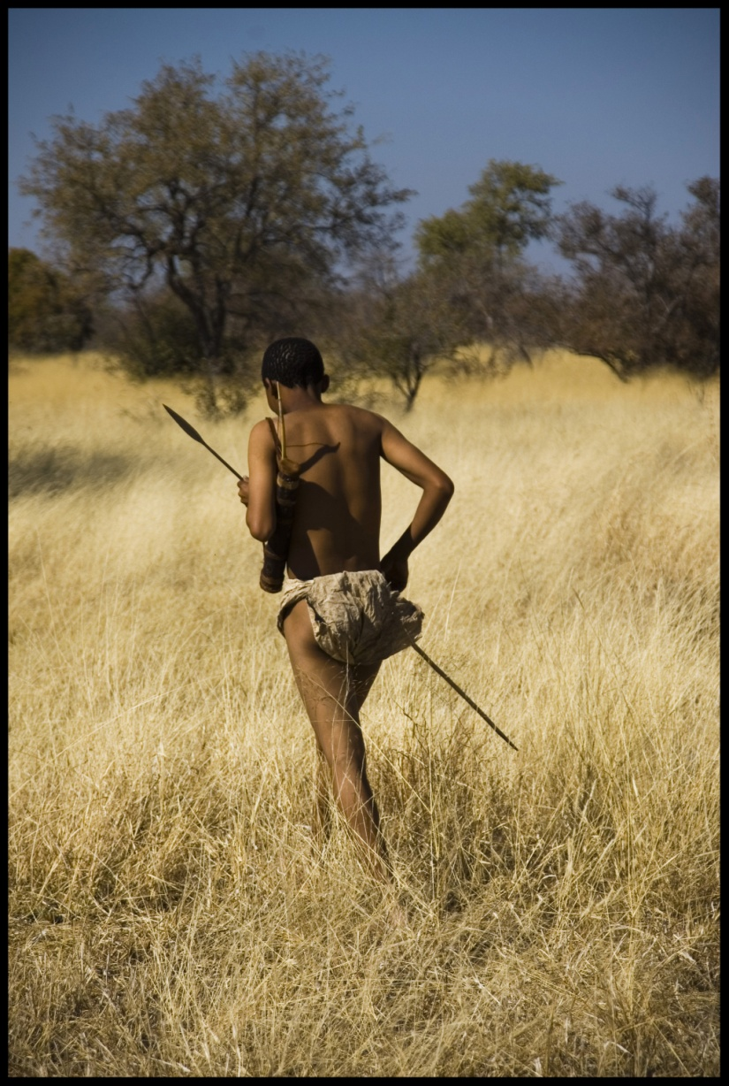
Daily Life: Hunting
Notes:
Left: A Bedouin hunter from Shammar tribe with a shot Asiatic Cheetah and cub from Southwestern Iraq poses with his new Lee-Enfield rifle in 1925.

Slide 21
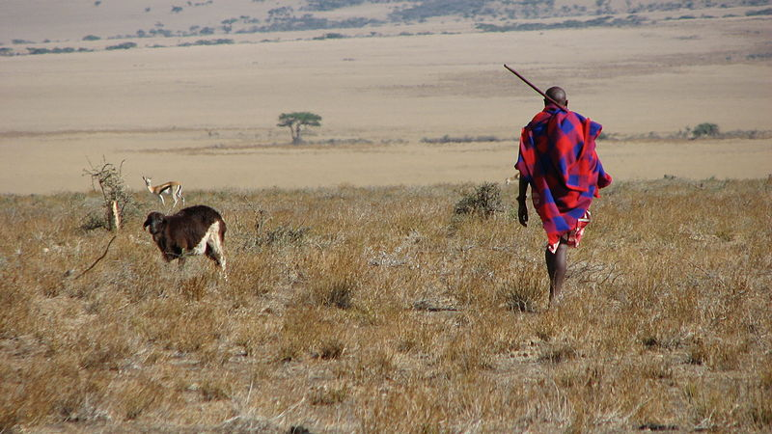
Daily Life: Hunting
Notes:
The Maasai (sometimes spelled "Masai") are a semi-nomadic people located in Kenya and northern Tanzania. Population 1.5 million.

Slide 22
Human Networks:
Social Currents
Groups
Family
Gender Roles
Prestige and Social Status
Socialization and Education

Slide 23
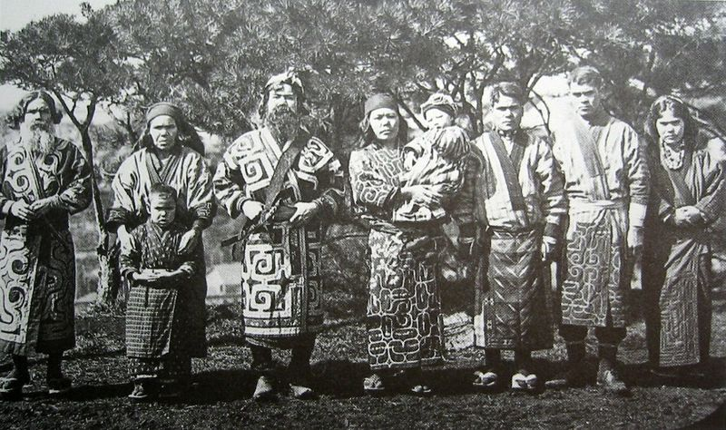
Groups
Notes:
Group of Ainu people, 1902 photograph. They are indigenous people or groups in Japan and Russia. The official Japanese government estimate is 25,000, though this number has been disputed with unofficial estimates of upwards of 200,000.

Slide 24
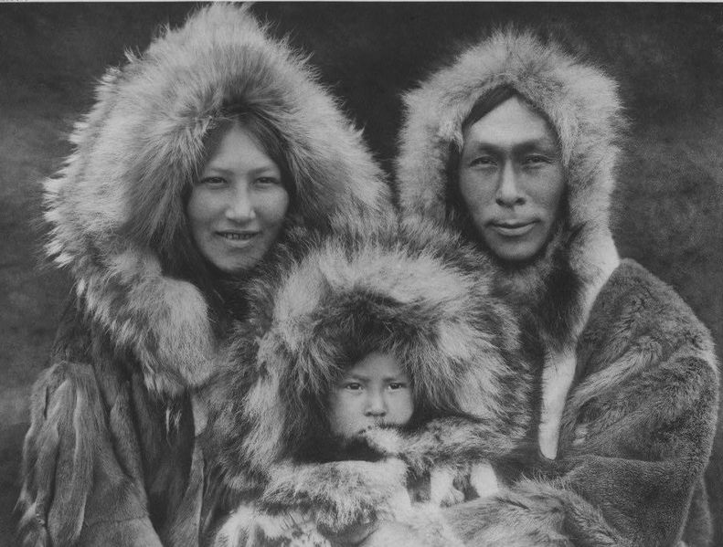
Family
Notes:
Inuit family, 1930

Slide 25
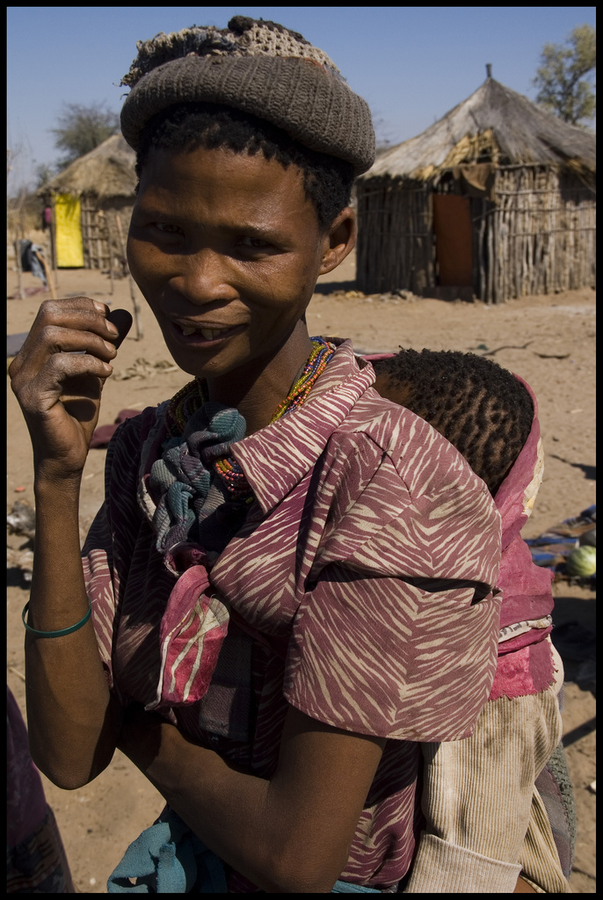
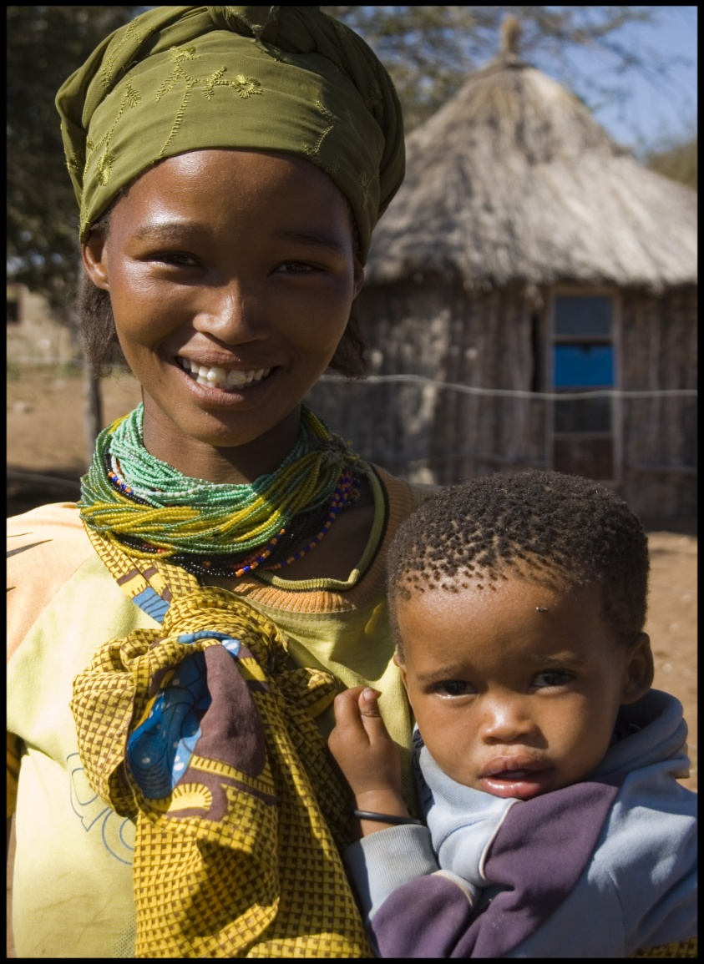
Family: Mother and Child
Notes:
Kung women with their children, photo Izla Kaya Bardavid

Slide 26
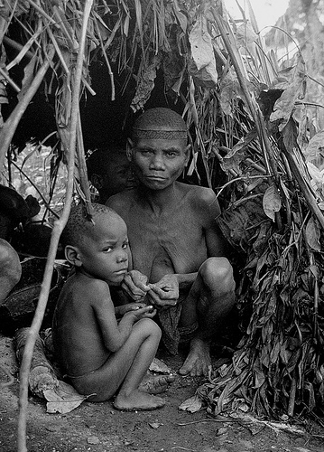
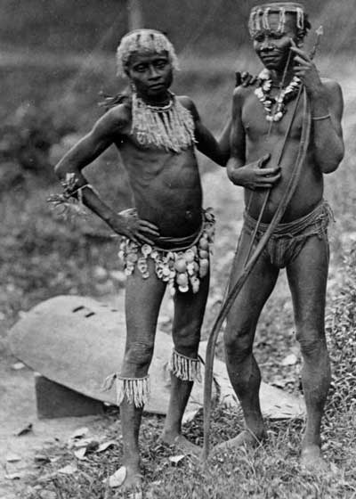
Gender
Notes:
Right: Two Great Andamanese men, in an 1875 photograph. The Andamanese people are the various aboriginal inhabitants of the Andaman Islands, which is the northern district of India, located in the southeastern part of the Bay of Bengal.
Left: Mbuti (pygmy) mother and child in hut. Flickr, educational purposes only, do not reproduce.

Slide 27
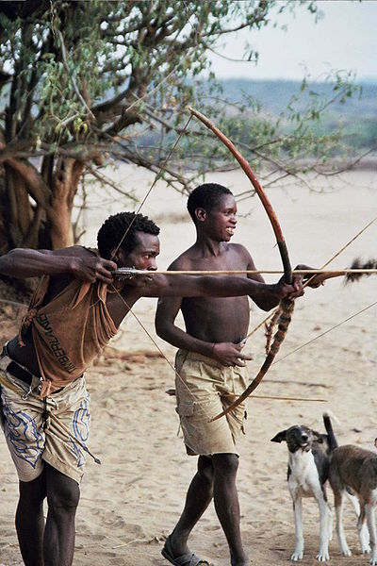
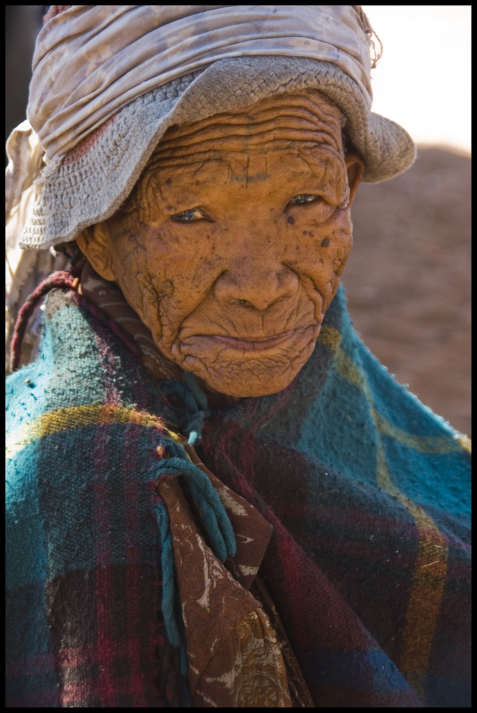
Socialization and Education
Notes:
Right: Elderly Kung woman, known for passing on their wisdom to younger generations. Photo by Izla Kaya Bardavid
Left: Hadza (Africa) man teaching young boy archery skills. Wikimedia Commons

Slide 28
Establishing Order:
Political Currents
Political Systems
Forms of Leadership
Customs and Rules
Migration and Interaction
Conflict, War and Cooperation

Slide 29
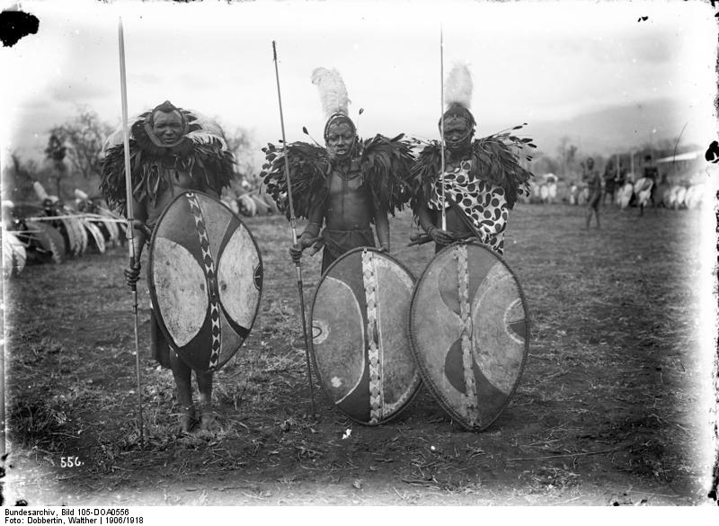
Warfare
Notes:
Massai warriors in eastern Africa c. 1908-1916.

Slide 30
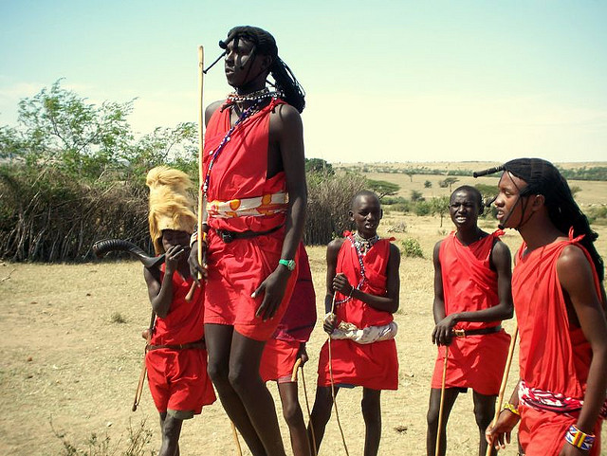
Warfare
Notes:
Massai warriors jumping

Slide 31
Human Expressions:
Cultural Currents
Worldview, Ideology
Religion and Spirituality
Communication
Identity and Belonging
Aesthetic Expression

Slide 32
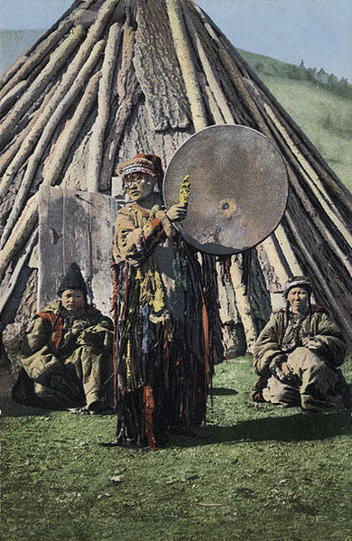
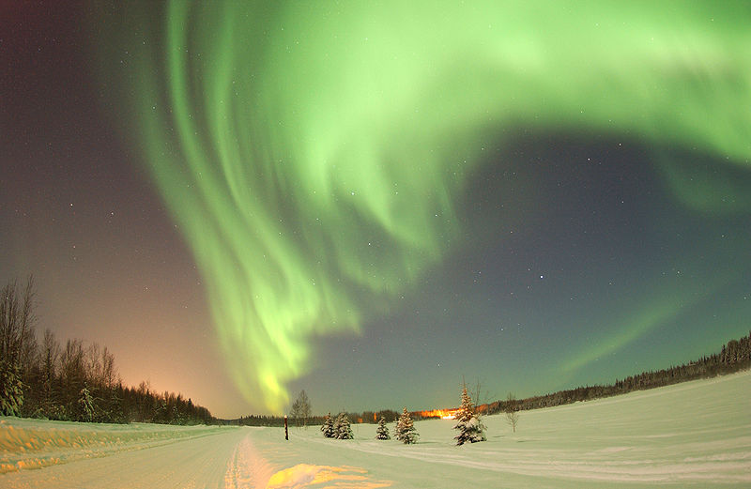
Spirituality
Notes:
Left: A 1908 photo showing a woman shaman likely of the Turki Khakas ethnicity in Russia.
Right : Some Inuit believe that the spirits of their ancestors could be seen in the northern lights.

Slide 33
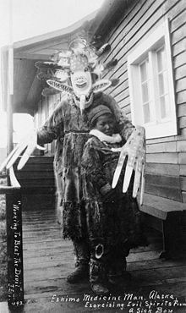
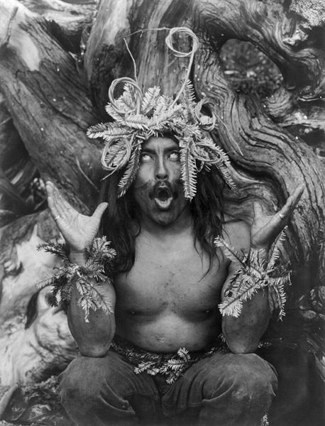
Spirituality: Shamans
Notes:
Left: Yup’ik shaman exorcising evil spirits from a a sick boy, Nushagak, southwest Alaska, 1890s.
Right: Hamatsa ritualist in British Columbia, Canada, 1914.

Slide 34
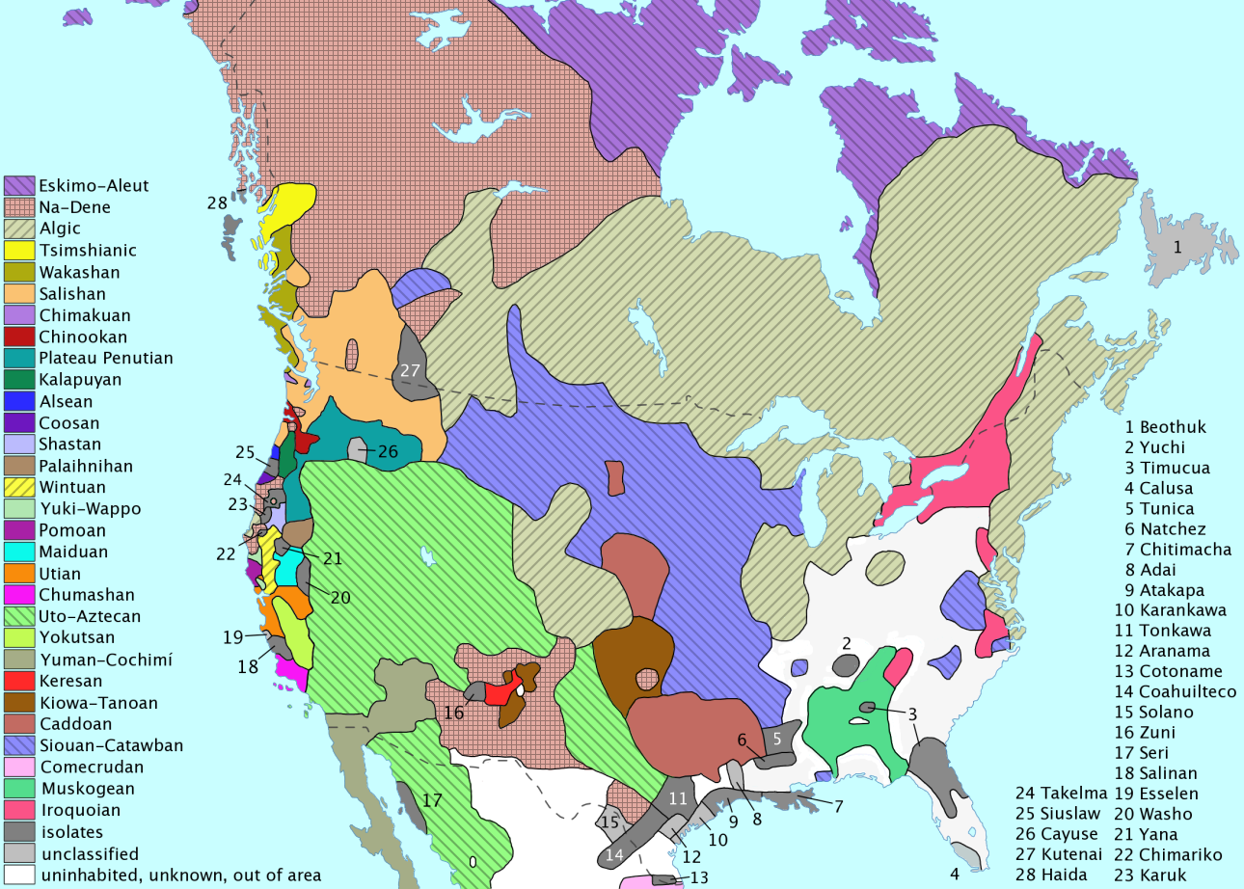
Communication/Language
Notes:
Language families of North American indigenous peoples. http://en.wikipedia.org/wiki/Indigenous_peoples_of_the_Americas Wikimedia Commons

Slide 35
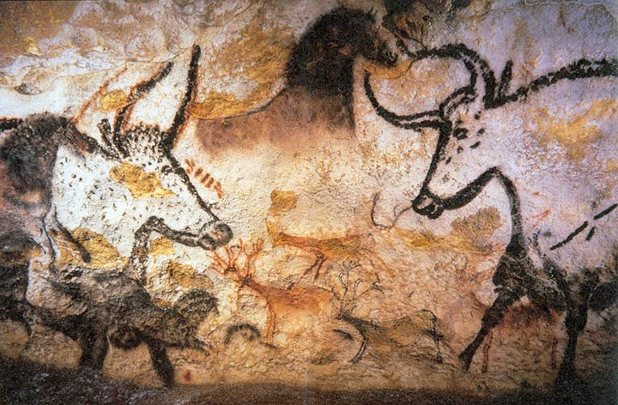
Aesthetic Expression: Art
Notes:
Lascaux is the setting of a complex of caves in southwestern France famous for its Paleolithic cave paintings. They contain some of the best-known Upper Paleolithic art. These paintings are estimated to be 17,300 years old.

Slide 36
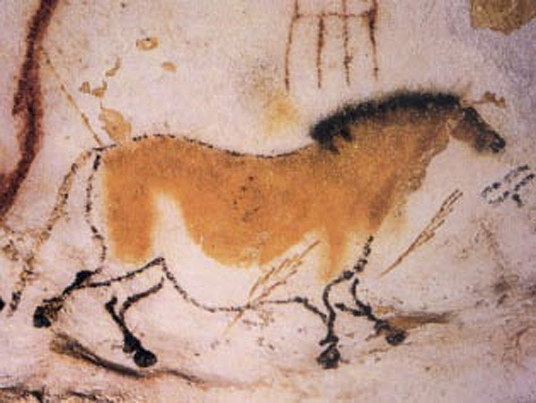
Aesthetic Expression: Art
Notes:
Cave painting of a dun horse at Lascaux.

Slide 37
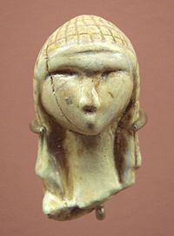
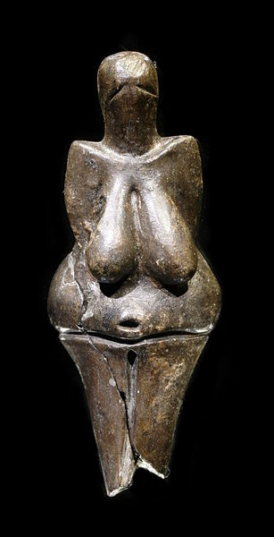
Aesthetic Expression: Sculpture
Notes:
Left: A fragmentary ivory figurine from the Upper Paleolithic. It was discovered in a cave at Brassempouy, France in 1892, About 25,000 years old. It is one of the earliest known realistic representations of a human face.
Right: The Venus of Dolní Věstonice is a Venus figurine, a ceramic statuette of a nude female figure dated to 29,000–25,000 BCE. Discovered in Moravia, present day Czech Republic in 1925

Slide 38
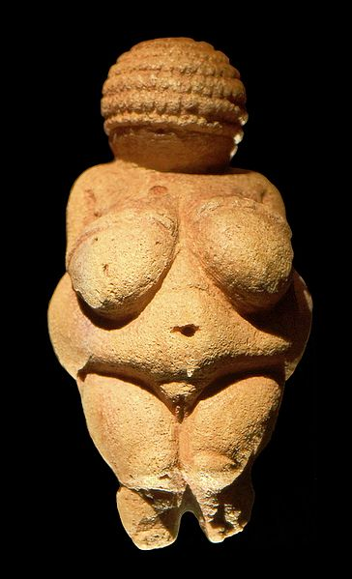
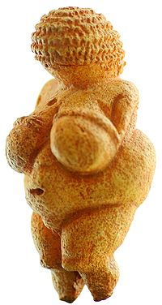
Aesthetic Expression: Sculpture
Notes:
Two views of the Venus of Willendorf, also known as the Woman of Willendorf, is an 11 cm (4.3 in) high statuette of a female figure estimated to have been made between 24,000 and 22,000 BCE. Found in present day Austria.

Slide 39
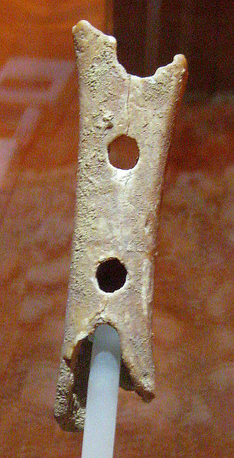
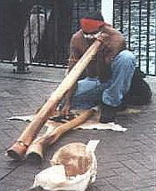
Aesthetic Expression: Music
Notes:
Left: The artifact known as the Divije Babe flute, discovered in Slovenia in 1995, has been claimed as the oldest flute. The artifact is a cave bear femur approximately 43,000 years old that has been pierced with spaced holes.
Right: An Aboriginal man playing the didgeridoo at Circular Quay in Australia. The didgeridoo is a wind instrument developed by Indigenous Australians of northern Australia around 1,500 years ago and still in widespread usage today both in Australia and around the world.

Slide 40
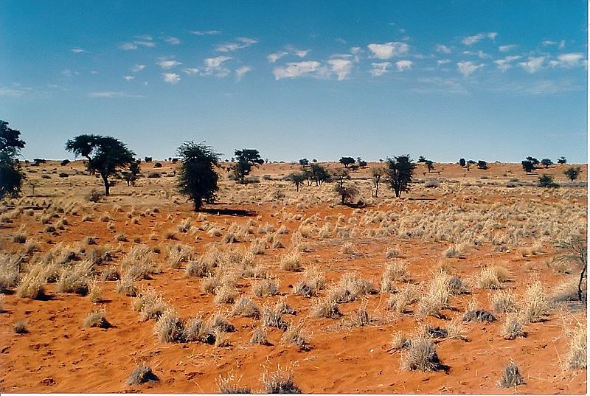
The !Kung:
Nomadic Foragers of the Kalahari Desert
Notes:
The Kalahari Desert is a large semi-arid sandy savannah in Southern Africa extending 900,000 square kilometres (350,000 sq mi). Wikimedia Commons

Slide 41
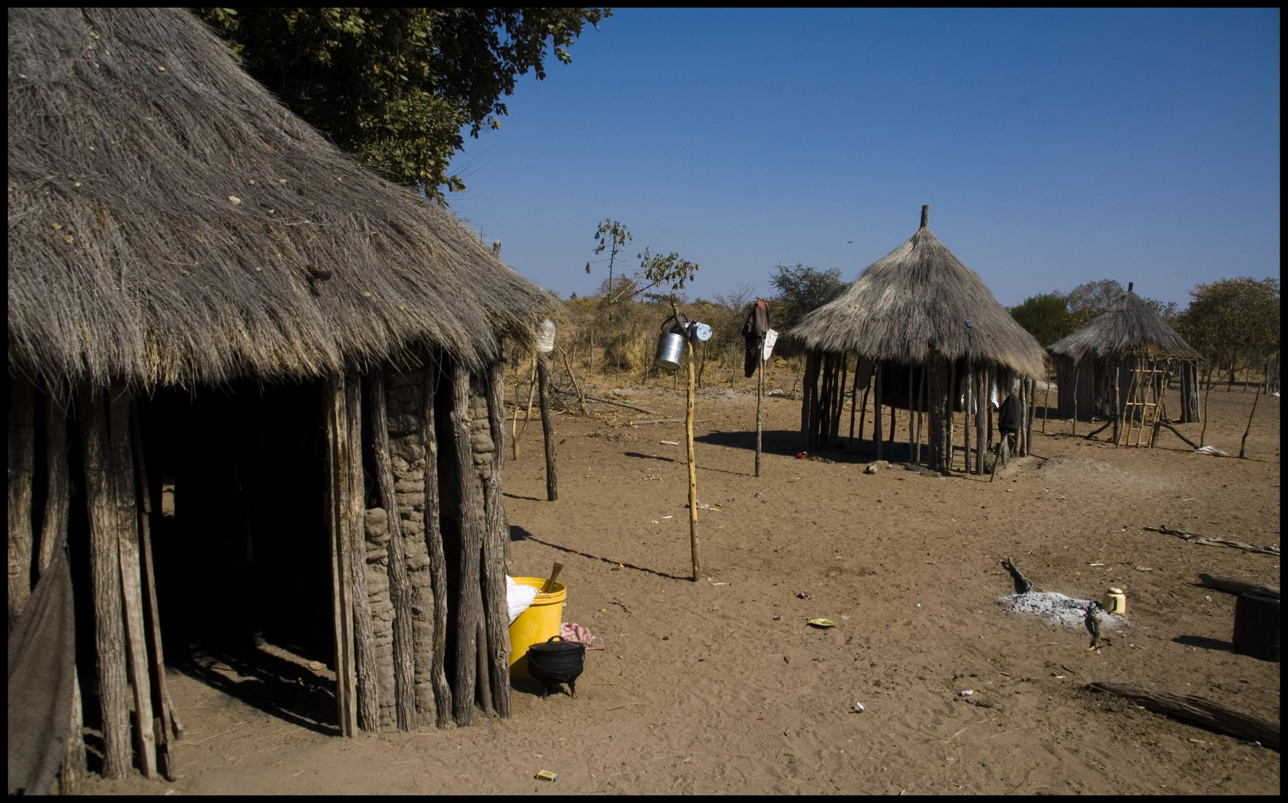
!Kung Village
Notes:
Photo Izla Kaya Bardavid

Slide 42
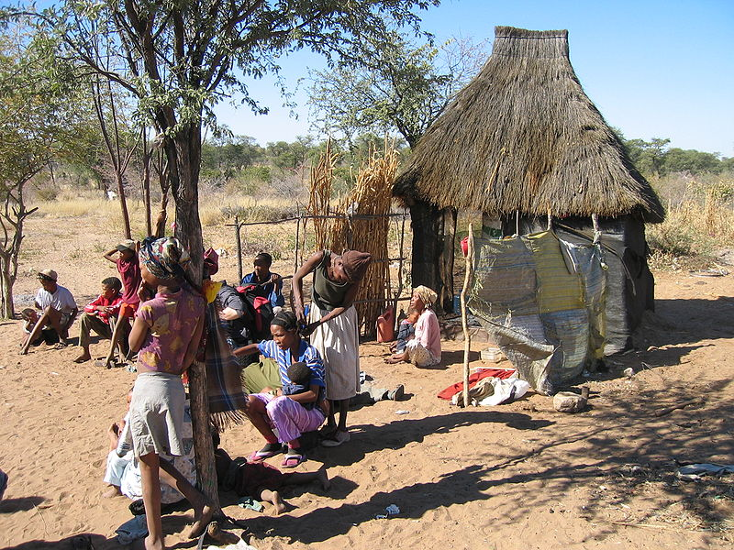
!Kung Village
Notes:
Kung village Namibia 2005, total population 90,000. Wikimedia Commons

Slide 43
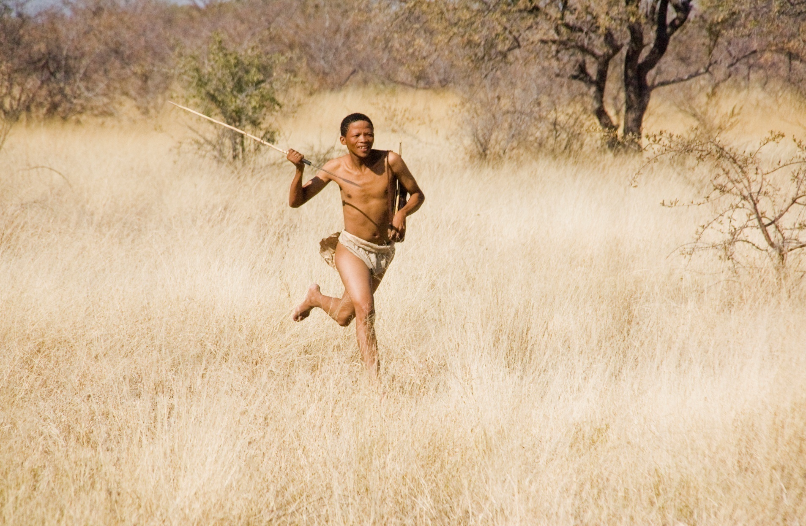
!Kung Hunter
Notes:
Photo Izla Kaya Bardavid

Slide 44

!Kung Hunting Expedition
Notes:
Photo Dan Massie, flickr, educational purposes only, no reproductions

Slide 45


!Kung Hunters
Notes:
Photos: Izla Kaya Bardavid

Slide 46

!Kung Men Starting Fire
Notes:
Wikimedia Commons

Slide 47


!Kung Men
Notes:
Left: Man preparing poison arrows
Right: Kung man

Slide 48

!Kung Women and Children
Notes:
Photos: Izla Kaya Bardavid

Slide 49

!Kung Children

Slide 50

!Kung Children
Notes:
Photo: Izla Kaya Bardavid

Slide 51


!Kung Elderly Women
Notes:
Photos: Izla Kaya Bardavid

Slide 52

!Kung Girl
Notes:
Smiling Sunshine in the Kalahari, photo Izla Kaya Bardavid

Slide 53

!Kung Girls
Notes:
Happy Girls Photo Izla Kaya Bardavid

Slide 54

!Kung Dancers
Notes:
Flickr photo, no reproductions, educational purposes only

Slide 55

!Kung Art
Notes:
1000- to 2000-year-old San-paintings near Murewa, Zimbabwe in Africa Wikimedia Commons

