Slide 1
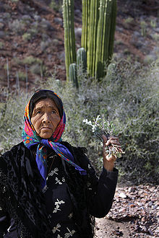
Imaginary figure, Toki Gawa
Notes:
Shaman woman. Source Wikimedia

Slide 2
Holistic
A society’s cultural traits reinforce each other
Political
Economic
Technological
Culture
Religious
Social
Environmental
Communication
Education
Laws
Art
Attitudes
Values
Trade

Slide 3
Transdisciplinary Approach
human-ities
psycho-logy
politics
religion
econo-mics
geo-graphy
anthro-pology
socio-logy
history
ecology
the sciences

Slide 4
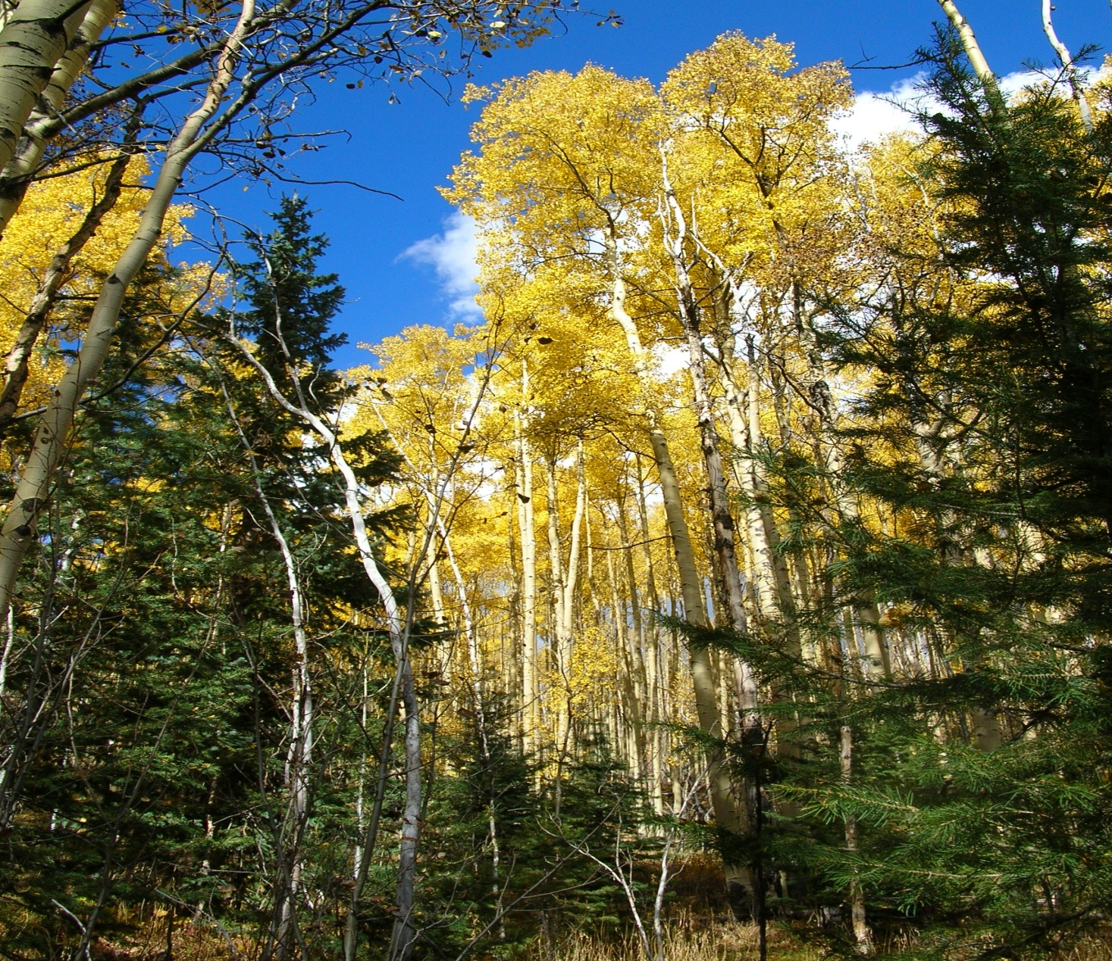
Aspen Trees the roots are all connected
Notes:
Photo Denise Ames

Slide 5
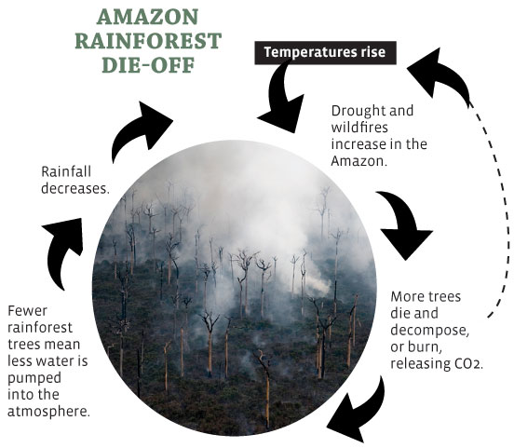
Reinforcing Feedback Loops
Notes:
Source: Yes, magazine

Slide 6
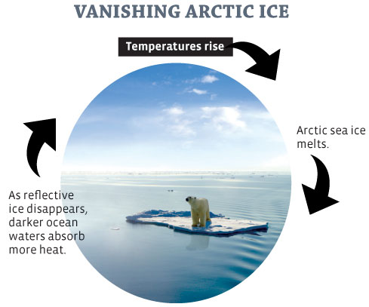
Feedback Loops
Notes:
Yes, magazine

Slide 7
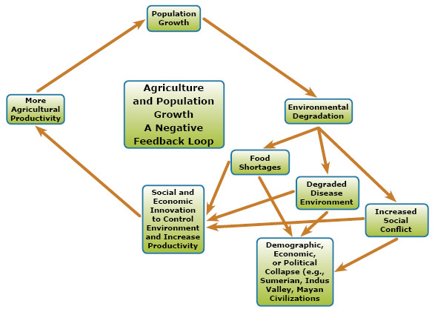
Feedback Loop Diagram
Notes:
http://www.bing.com/images/search?q=Feedback+Loop+Diagram&view=detail&id=31A1E55047DFF865B307F82763270BB5D3D107C7&first=0, found on this website page. Please site this reference, for education purposes only.

Slide 8
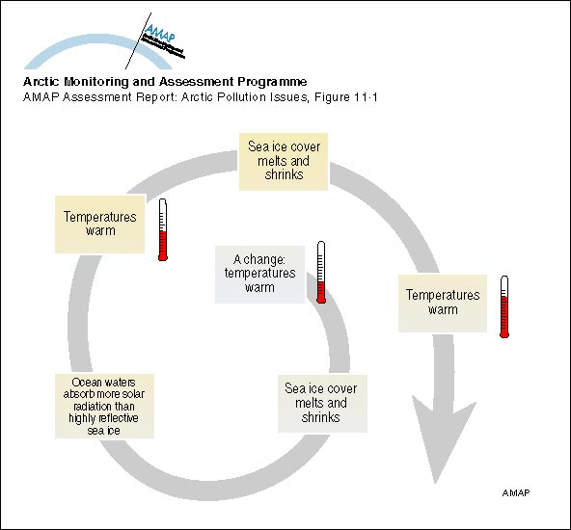
Positive Feedback Loop
Notes:
See above source

Slide 9
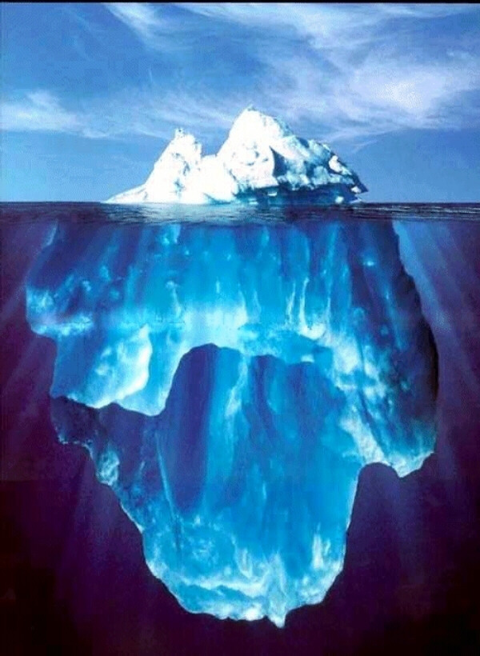
Iceberg
Notes:
http://www.bing.com/images/search?q=iceberg&view=detail&id=4C5AC94C42ABF352CCEB041A916491CA1FAF4C93&first=0 images on Bing, for education purposes only

Slide 10
Five Worldviews
Indigenous
Modern
Fundamentalist
Globalized
Transformative

Slide 11
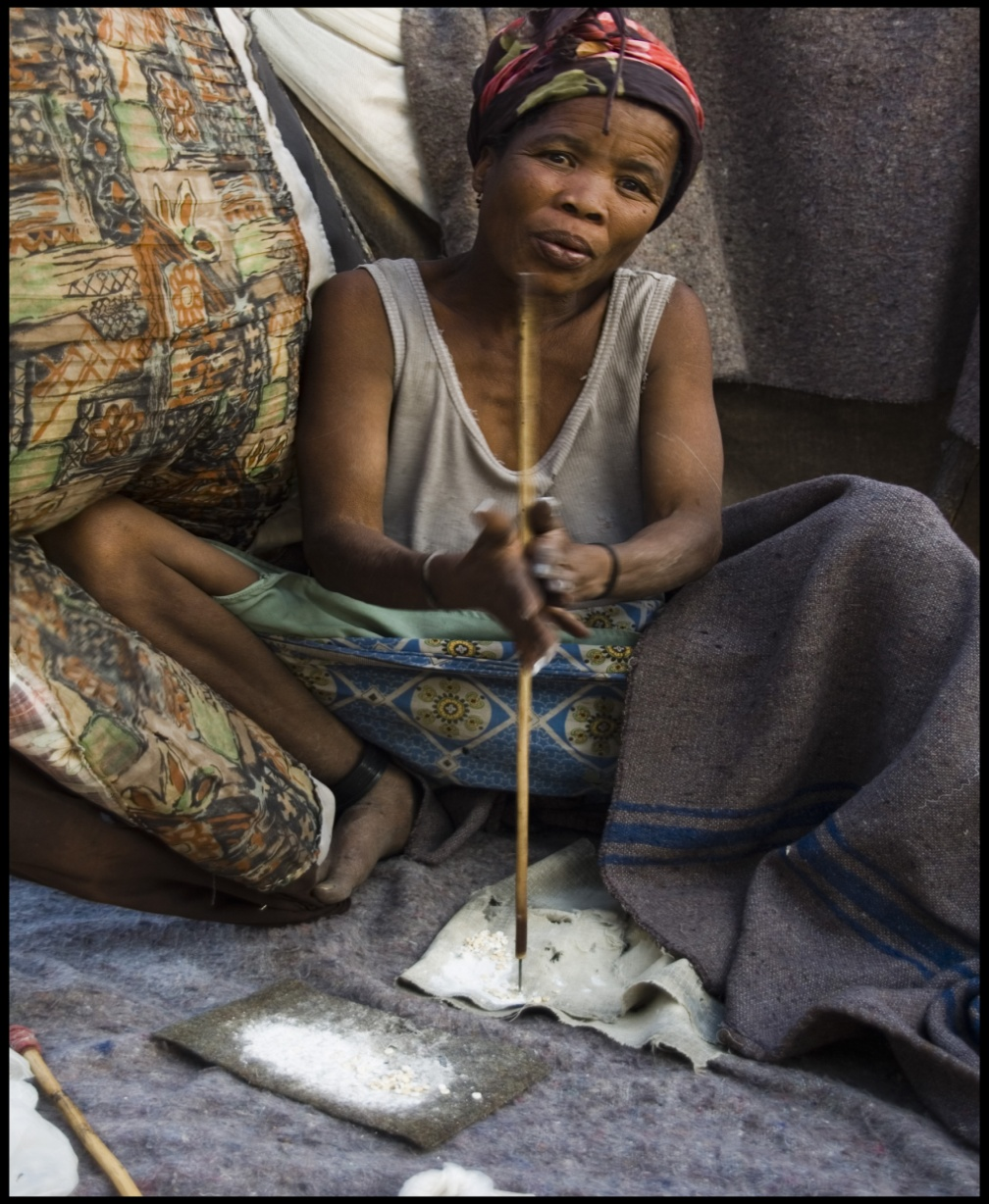
The Indigenous Worldview
!Kung woman making jewelry
Notes:
Photo: permission Izla K. Bardavid

Slide 12
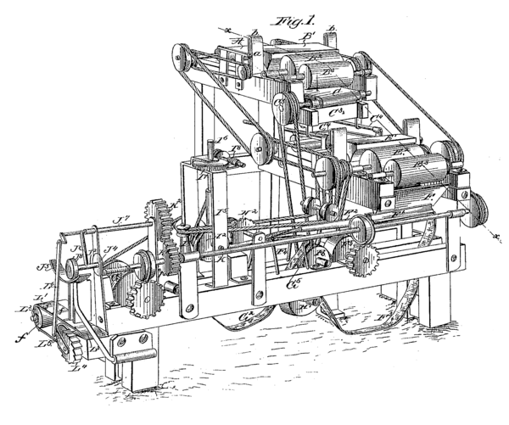
Modern Worldview
The World as a Machine
Notes:
Diagram, Wikimedia

Slide 13
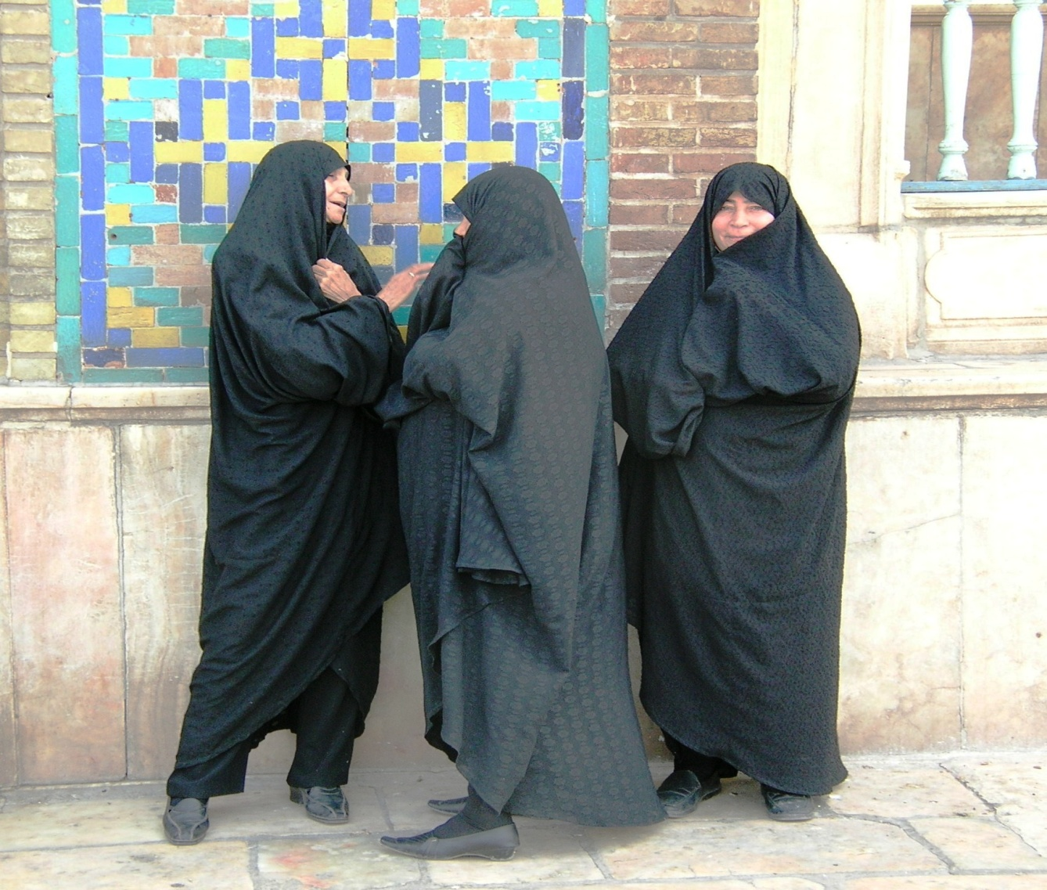
The Fundamentalist Worldview
Iranian women in chador
Notes:
Photo: Denise Ames

Slide 14

The Globalized Worldview sophisticated technology
Notes:
Photo, Wikimedia

Slide 15
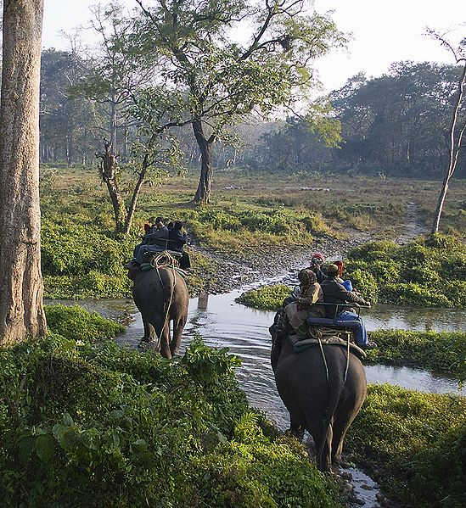
The Transformative Worldview
Ecotourism
An elephant safari through the Jaldapara Wildlife Sanctuary in West Bengal, India
Notes:
Photo, Wikimedia

Slide 16
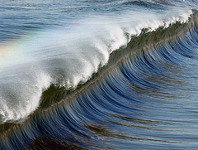
Waves of Global Change

Slide 17
World History
Periodization Plan
Human Development

Slide 18
Five Waves of Change
1. Communal Wave
2. The Agricultural Wave
3. The Urban Wave
4. The Modern Wave
5 The Global Wave

Slide 19
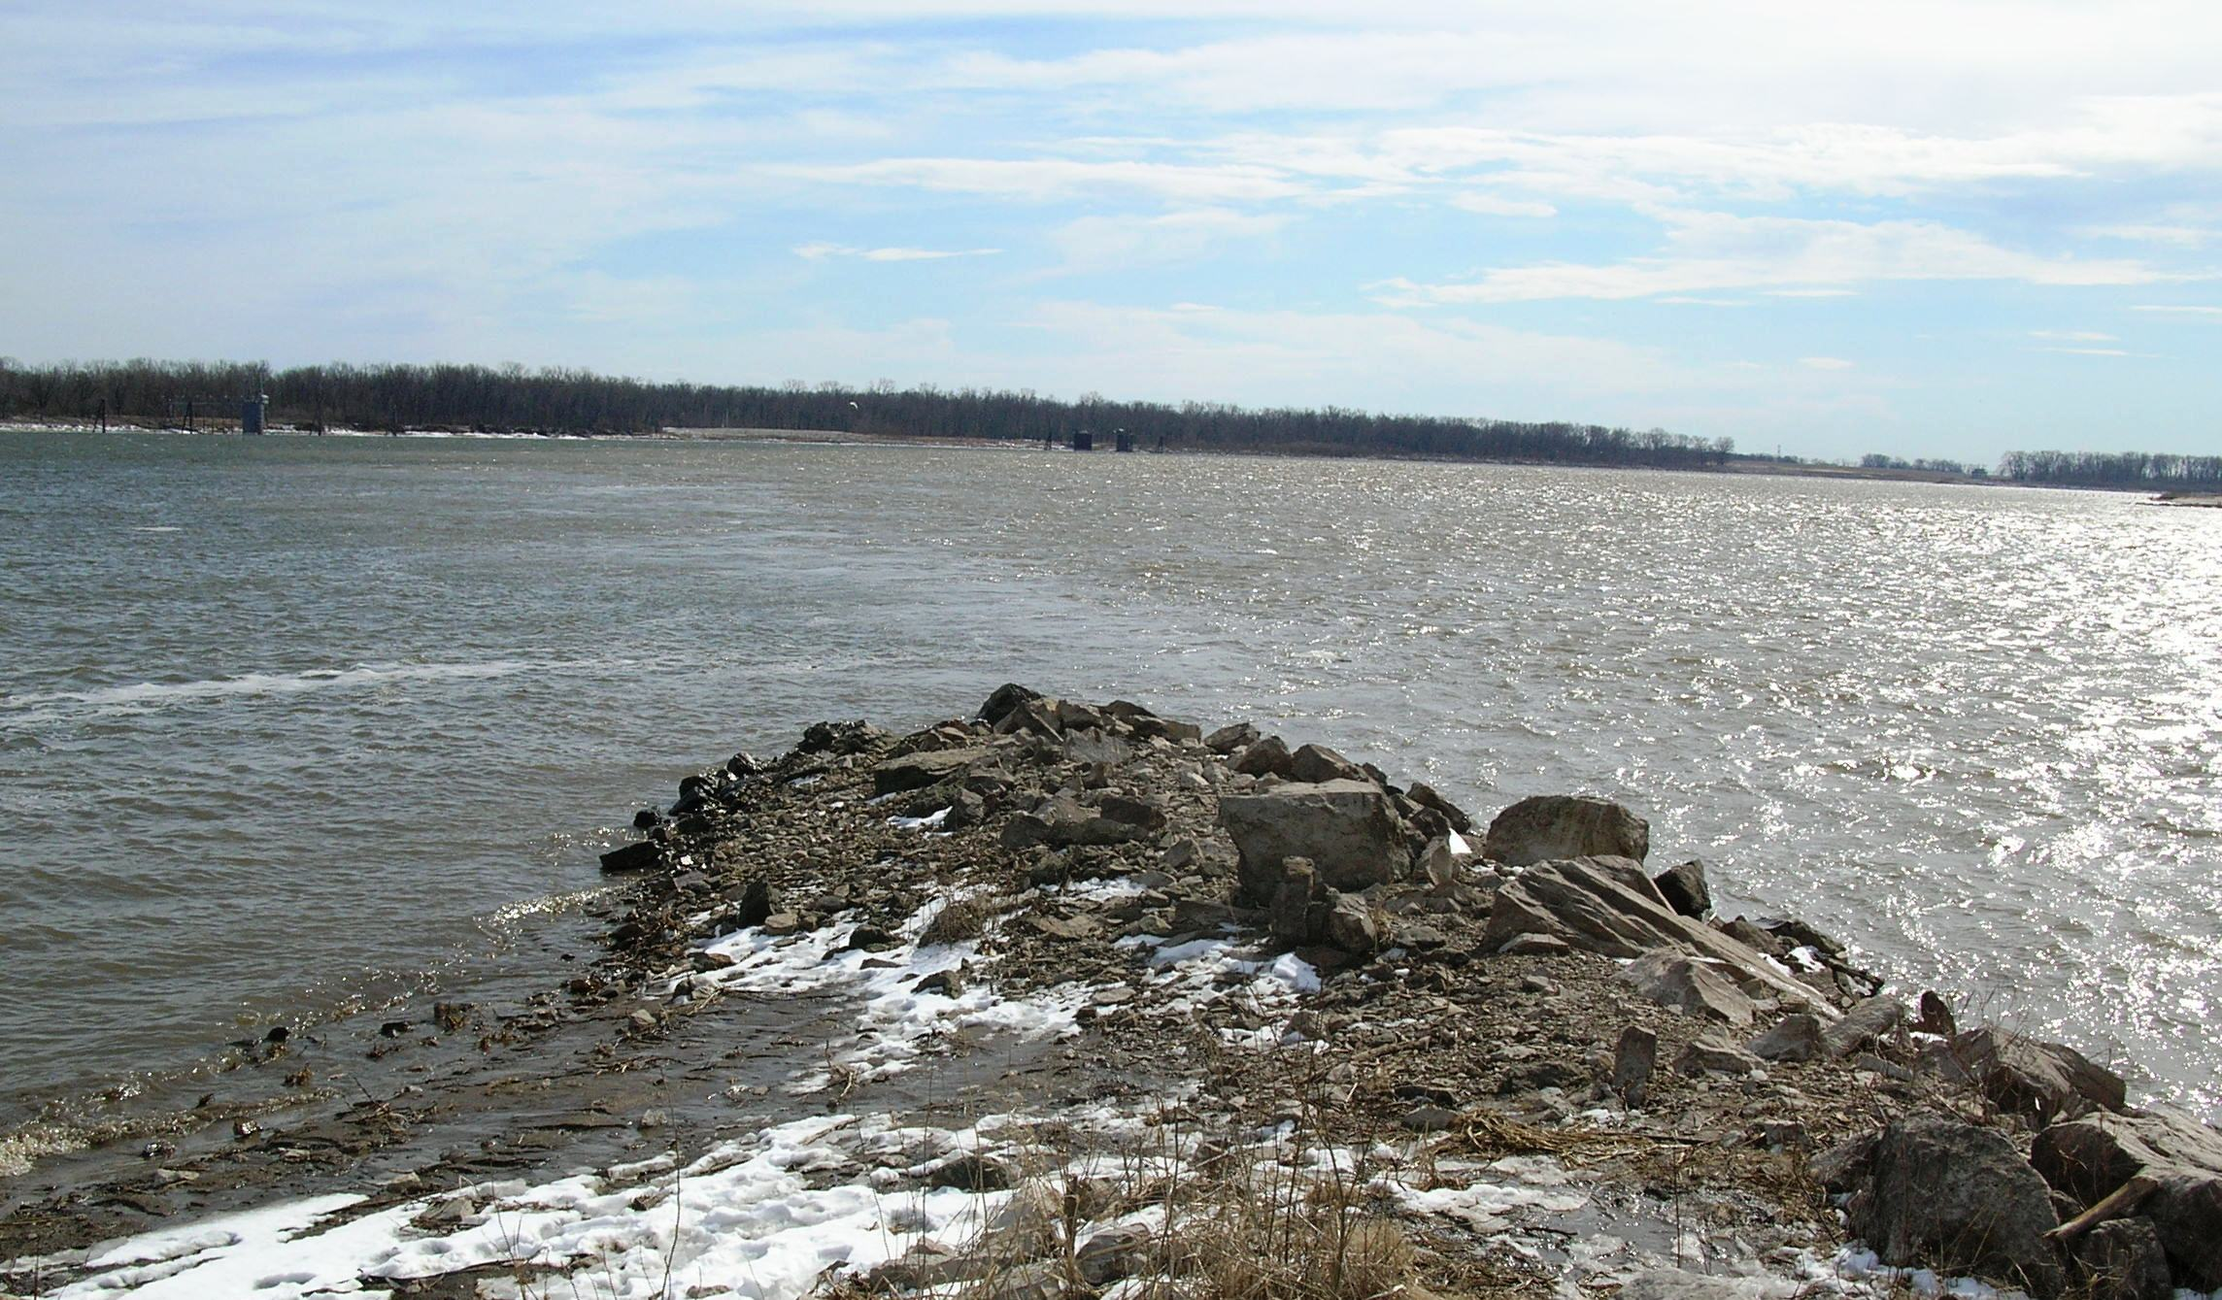
Currents
Notes:
The confluence of the Mississippi and Missouri Rivers, near St. Louis, MOPhoto Denise Ames

Slide 20

The Five Currents
1. Relationship with Nature: Ecosystem Currents
2. Ways of Living: Techno-Economic Currents
3. Human Networks: Social Currents
4. Establishing Order: Political Currents
5. Human Expression: Cultural Currents

Slide 21

Relationship with Nature:
Ecosystem Currents
Geography
Environment
Human populations
Natural populations
Human and nature interaction

Slide 22

Ways of Living
Techno-Economic Currents
Daily life
Economic systems
Technology
Exchange and trade
Patterns of labor

Slide 23

Human Networks
Social Currents
Human groups and institutions
The family
Gender
Prestige and social status
Socialization and education

Slide 24

Establishing Order:
Political Currents
Political systems
Forms of leadership
Customs, rules/laws and punishment
Migration and interaction
Conflict and cooperation, warfare

Slide 25

Human Expressions:
Cultural Currents
Worldview/beliefs
Spirituality/religion
Communication
Identity and belonging
Aesthetic expression

Slide 26
The Five Flows
Interdependence
Commonality and Diversity
Paradox
Creative and Destructive Energies
Change and Continuity

Slide 27
Six Types of Change
Random change or chance
Regional differentiation
Cultural change
Innovative or material change
Cumulative change
Human choice

Slide 28
Societal Response to Change
Assimilation
Synthesis
3. Systems breaks down

Slide 29
Features of a
Holistic World History
Big Picture periodization plan
Five universal flows
Recognition of human choice
Five Currents
Holistic/Systems Approach
Transdisciplinary perspective
Global format
Female voice
Non-state people
Insights: Learning from the Past

