Slide 1
Human Commonalities
psychology
anthropology
history
sociology
Notes:
Transdisciplinary approach to human commonalities

Slide 2
Common Human Features
Individual Commonalities
Group Commonalities

Slide 3
Individual Human Commonalities Model
Ten Dimensions
Physical and Physiological
Pleasure and Pain
Survival
Territorial
Power
Safety
Belonging
Consciousness
Self-actualization
Spiritual

Slide 4
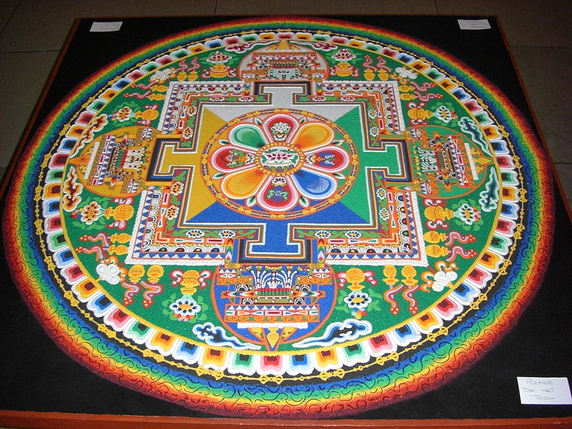
#10. The Spiritual Dimension
Notes:
Chenrezig sand mandala, which is Sanskrit for circle; a mandala is considered a sacred space by Hindus and Buddhists.

Slide 5

#10. The Spiritual Dimension
Notes:
The ba gua, a symbol commonly used to represent the Dao and its pursuit. Popular in China.

Slide 6
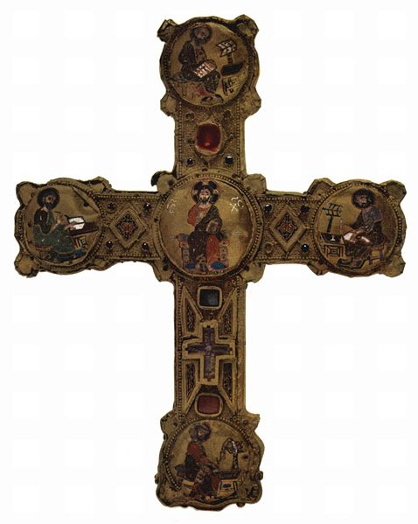
#10. Spiritual Dimension
Notes:
A reliquary in the form of an ornate Christian Cross. The Christian cross, seen as a representation of the instrument of the crucifixion of Jesus Christ, is the best-known religious symbol of Christianity. Wikimedia Commons

Slide 7
Group Commonalities and the Five Currents
Relationship with Nature:
Ecosystem Currents
2. Ways of Living:
Techno-Economic Currents
3. Human Networks: Social Currents
4. Establishing Order: Political Currents
5. Human Expressions: Cultural Currents

Slide 8
Human Commonalities and Ecosystem Currents
Ecosystem Currents
Geographic location
Environment
Human populations
Natural populations
Human and nature interaction
Human Commonalities
Survival needs
Need to grow food

Slide 9
Human Commonalities and Techno-Economic Currents
Techno-Economic Currents
Daily life
Economic systems
Technology
Exchange and trade
Patterns of labor
Human Commonalities
Need for food, shelter, sleep, and water
Horticulture sense
Need for comfort
Survival needs

Slide 10
Human Commonalities and Social Currents
Social Currents
Groups and institutions
Family
Gender roles
Prestige and social status
Socialization and education
Human Commonalities
Sexual /reproduce needs
Need to belong
Cooperative sense
Need to share/reciprocate
Compassion
Need for love
Friendship
Self respect
Kinship ties

Slide 11
Human Commonalities and Political Currents
Political Currents
Political systems
Forms of leadership
Customs, rules/laws and punishment
Migration and interaction
Conflict/cooperation and warfare
Human Commonalities
Drive for power, mastery, control
Conflict
Sense of territoriality
Needs for safety and security
Need for stability

Slide 12
Human Commonalities and Cultural Currents
Cultural Currents
Worldview and ideology
Spirituality and religion
Communication
Identity and belonging
Aesthetic expression
Human Commonalities
Sense of rhythm
Aesthetic sense
Identity
Need language and communication
Sense of belonging
Need self-actualization
Spiritual sense

Slide 13
Environment
Hot Regions
Wet Regions
High Regions
Cold Regions
Dry Regions
Low Regions

Slide 14
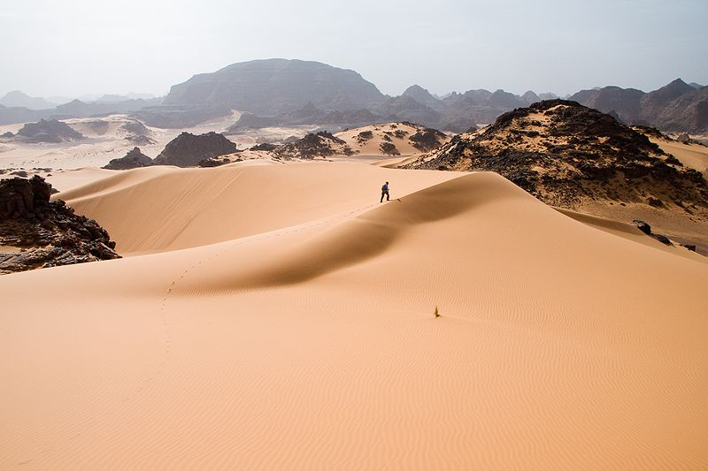
Eco-system Currents: Environment
Notes:
Sahara Desert in Libya, north Africa. Wikimedia Commons

Slide 15
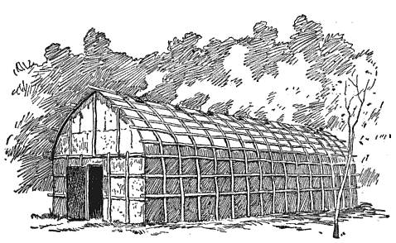
Techno-Economic Currents Daily Life
Notes:
Iroquois "People of the Longhouse are an association of several tribes of indigenous people of North America. A longhouse. Wikimedia Commons

Slide 16
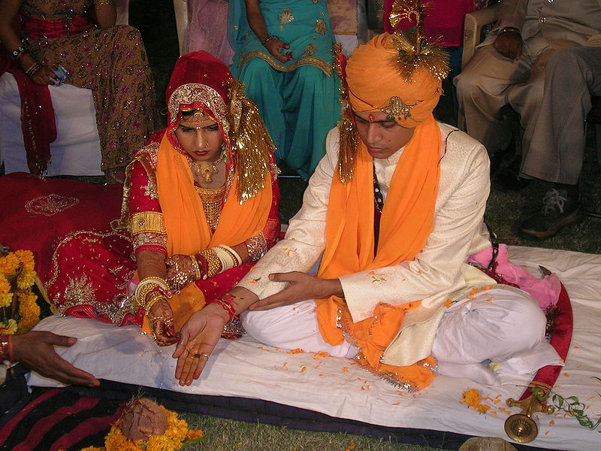
Social Currents: Family
Notes:
Hindu marriage ceremony, Wikimedia Commons

Slide 17
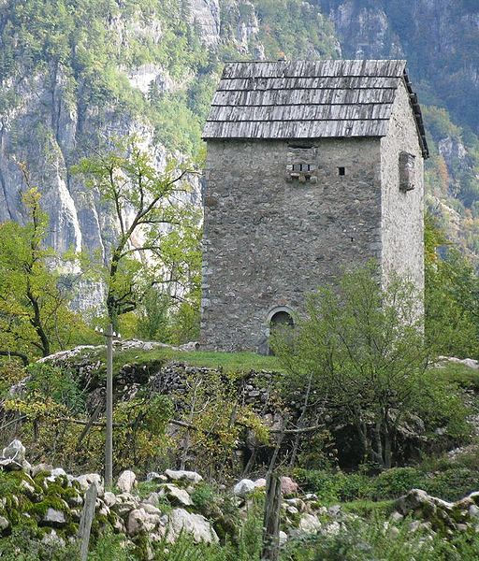
Political Currents: Conflict
Notes:
A fortified tower used as refuge for men involved in a blood feud that are vulnerable to attack. Thethi, northern Albania in eastern Europe. Wikimedia Commons

Slide 18
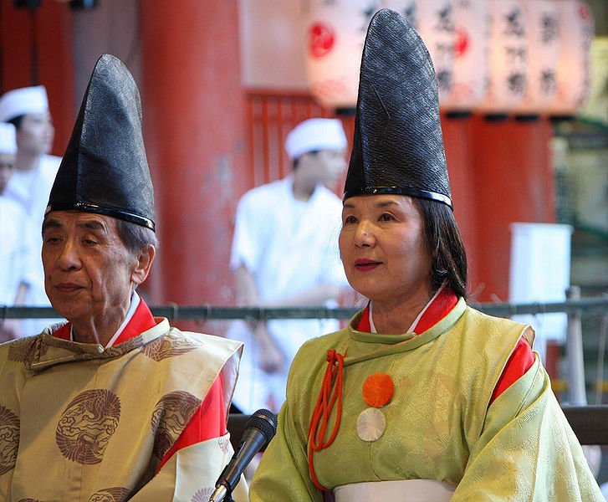
Cultural Currents: Religion
Notes:
Shinto priest and priestess in Japan

