Slide 1
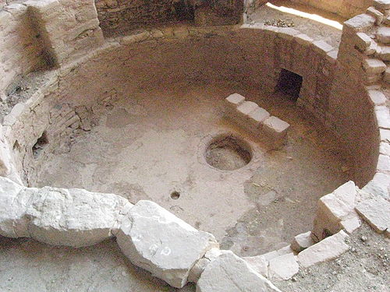
The Sipapu, A Hopi Creation Story
Notes:
Sipapu, a Hopi word, is a small hole or indentation in the floor of kivas used by the Ancient Pueblo Peoples and modern-day Puebloans. It symbolizes the portal through which their ancient ancestors first emerged to enter the present world. Beginning with this example of creation stories illustrates the fact that there are many different creation stories.
Illustrates the various of creation stories or narratives that have emerged through history.
Photo taken at Mesa Verde, four corners region, Photo from Wikipedia

Slide 2
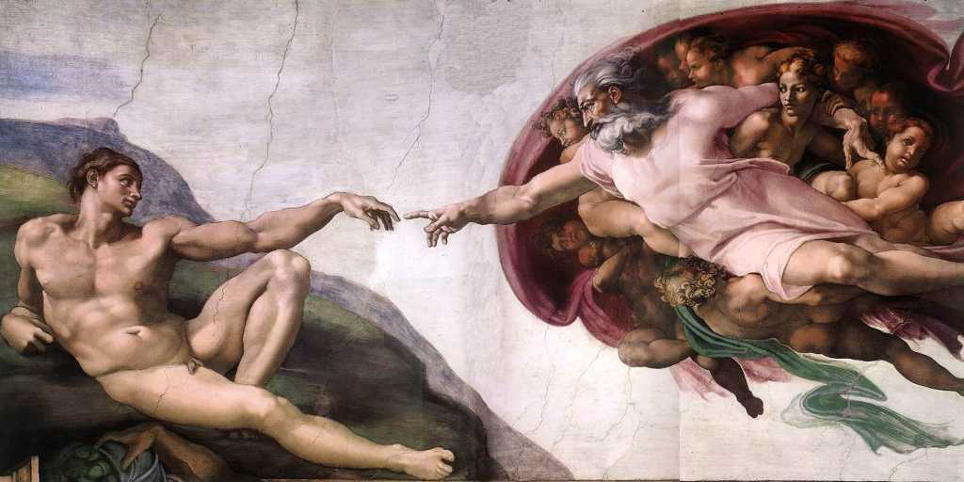
Genesis: A Creation Narrative
Notes:
The Genesis creation narrative is the creation myth contained in the first two chapters of the Book of Genesis, the first book of the Hebrew Bible (the Old Testament of the Christian Bible). With the touch, God transfers the spark of life to Adam. Wikimedia

Slide 3
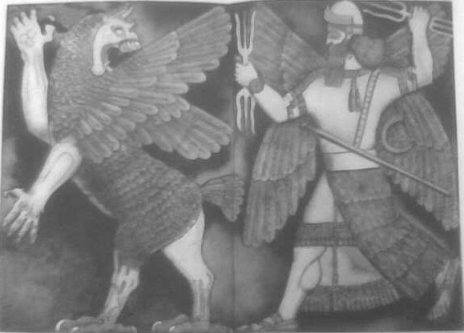
A Babylonian Creation Story
Notes:
Marduk, god of Babylon, destroying Tiamat, the dragon of primeval chaos, ancient Babylonian creation story, photo Wikimedia Commons.

Slide 4
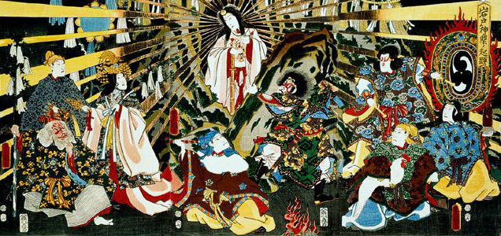
A Japanese Creation Story Sun goddess, Amaterasu
Notes:
The Sun goddess Amaterasu emerging out of a cave, bringing sunlight back to the universe. Japanese creation story, Wikimedia photo.

Slide 5
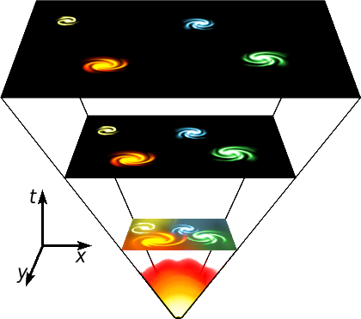
A Scientific Story The Creation of the Universe
Notes:
A scientific perspective of the creation of the universe. Universe expansion, Wikimedia Commons

Slide 6
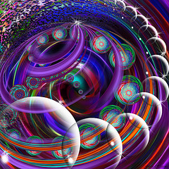
Imagining the Universe
Notes:
Copyrighted photo from Flickr, for educational purposes only, not to be reproduced.
3825906638_59e23cb629_m[1]

Slide 7
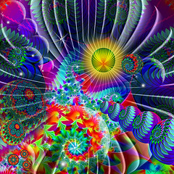
Imagining the Universe
Notes:
Imagining the Universe, copyrighted, Flickr, 738423688_8c7c113472_m[1], educational purposes only, not to be reproduced.

Slide 8
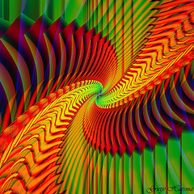
Imagining the Universe
Notes:
Copyrighted, Flickr, 3532373551_ee91305f64_m[1], educational purposes only, not to be reproduced.

Slide 9
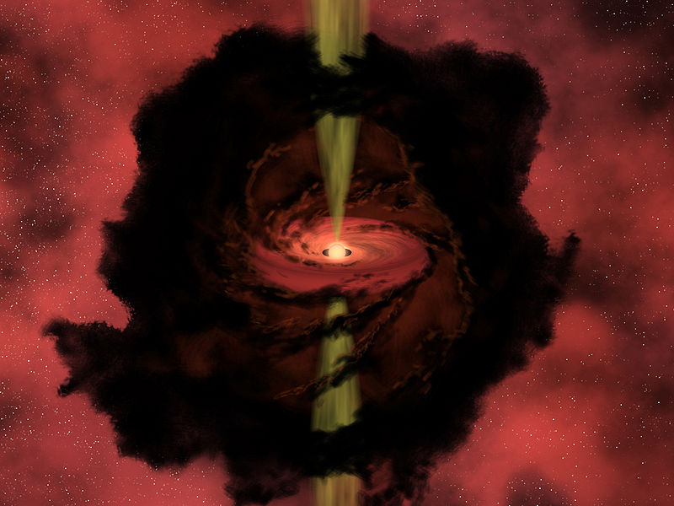
Birth of a Star
Notes:
Birth of a Star, artists rendition, NASA R. Hunt, public domain, Wikimedia Commons.

Slide 10
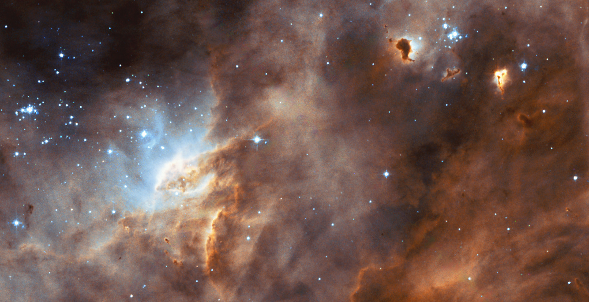
Star Formation
Notes:
Star formation is the process by which dense regions within molecular clouds collapse into spheres of plasma to form stars. The star formation region N11B in the LMC taken by WFPC2 on the NASA/ESA Hubble Space Telescope. Wikimedia Commons

Slide 11
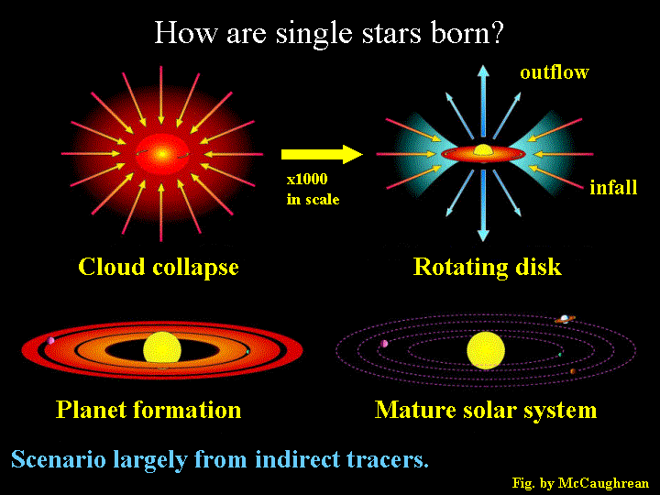
Notes:
Geoff Blake / Caltech / Molecular Astrophysics Research Page
Image Source Page: http://www.gps.caltech.edu/~gab/astrophysics/astrophysics.html

Slide 12
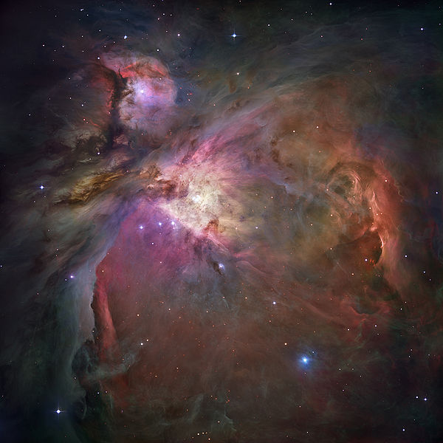
Orion Nebula, Star Formation
Notes:
The Orion Nebula is an archetypical example of star formation, from the massive, young stars that are shaping the nebula to the pillars of dense gas that may be the homes of budding star. Wikimedia Commons

Slide 13
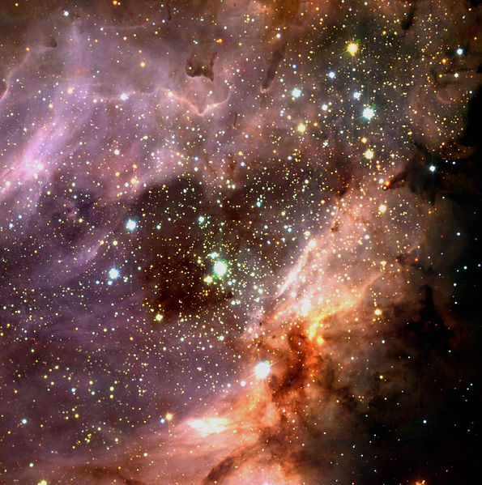
Star Formation
Notes:
Three-colour composite of the sky region of M 17, a H II region excited by a cluster of young, hot stars. A large silhouette disc has been found to the south-west of the cluster centre. The present image was obtained with the ISAAC near-infrared instrument at the 8.2-m VLT ANTU telescope at Paranal. Wikimedia Commons

Slide 14
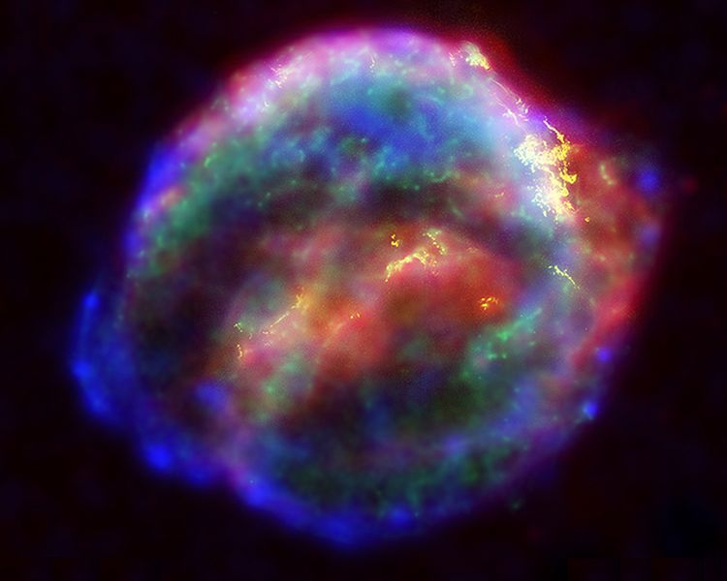
Supernova
Notes:
Multiwavelength X-ray, infrared, and optical compilation image of Kepleris supernova remnant, SN 1604. Wikimedia Commons

Slide 15
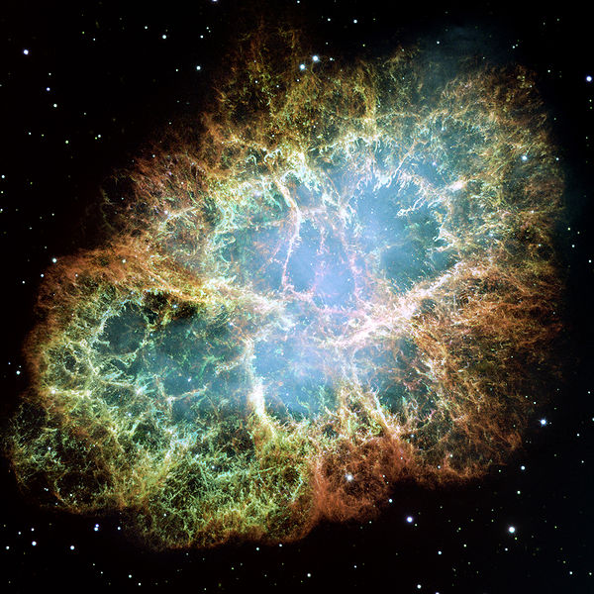
Crab Nebula, Supernova
Notes:
The Crab Nebula is a pulsar wind nebula associated with the 1054 supernova. Wikimedia Commons

Slide 16
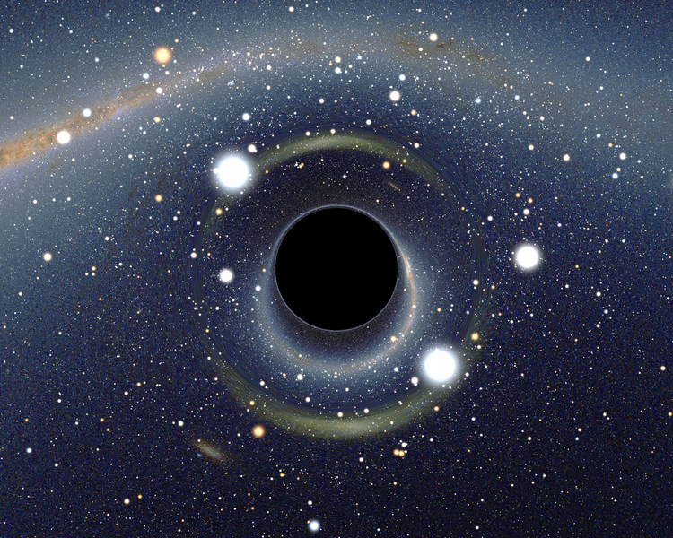
Black Hole
Notes:
A black hole is a region of spacetime from which nothing, not even light, can escape. Simulated view of a black hole (center). Note the gravitational lensing effect, which produces two enlarged but highly distorted views of the Cloud. Across the top, the Milky Way disk appears distorted into an arc. Wikimedia Commons

Slide 17
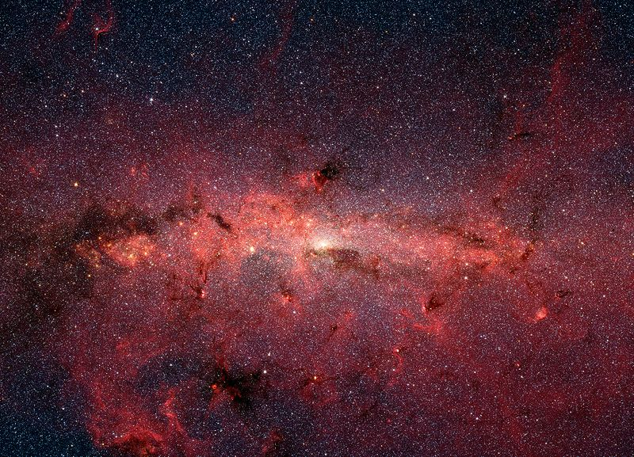
Milky Way Galaxy
Notes:
A false-color infrared image of the core of the Milky Way galaxy taken by NASA's Spitzer Space Telescope. Older cool stars are blue, dust features lit up by large hot stars are shown in a reddish hue, and the bright white spot in the middle marks the site of a super-massive black hole at the center of the galaxy. Wikimedia Commons

Slide 18
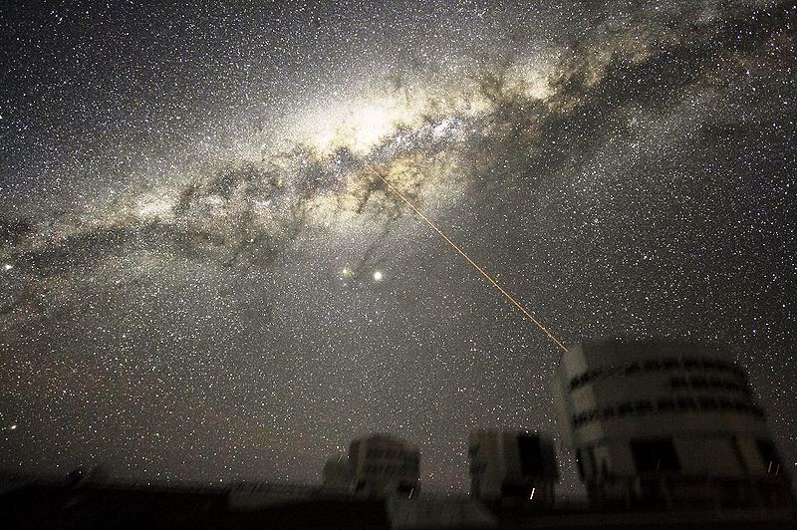
Milky Way Galaxy
Notes:
An image of the Milky Way's Galactic Center in the night sky above Paranal Observatory. Wikimedia Commons

Slide 19

Imagining the Solar System
Notes:
Copyrighted picture, Flickr, educational purposes only

Slide 20
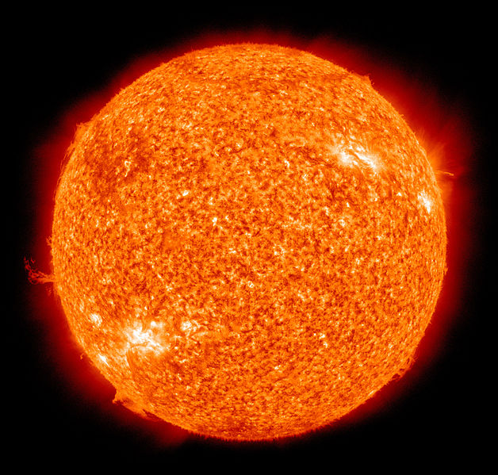
Our Sun
Notes:
The Sun is the star at the center of the solar system. Photographed by the Atmospheric Imaging Assembly (AIA 304) of NASA's Solar Dynamics Observatory (SDO). This is a false color image of the sun observed in the extreme ultraviolet region of the spectrum. Wikimedia Commons

Slide 21
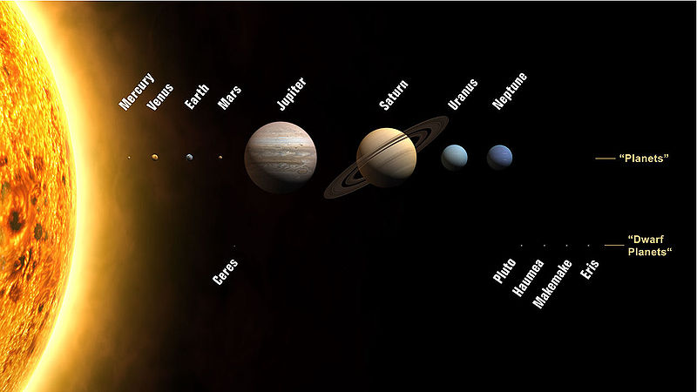
Our Solar System
Notes:
Wikimedia Commons

Slide 22
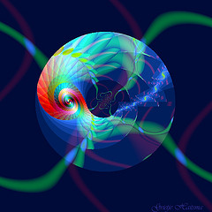
Imagining the Creation of our Earth
Notes:
Copyrighted image, educational purposes only

Slide 23
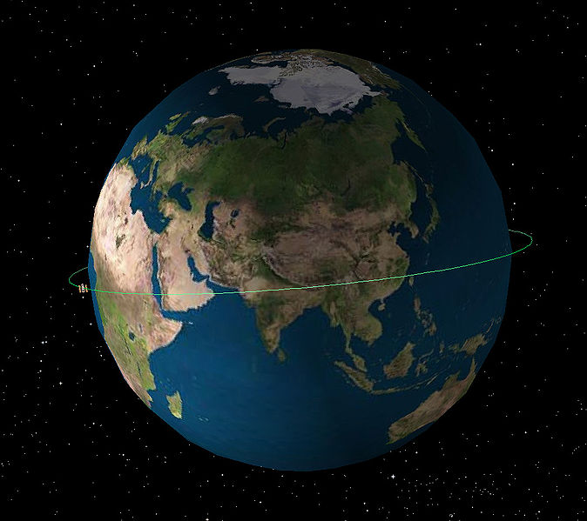
Rotation of the Earth
Notes:
Rotation of Hubble Telescope around the Earth. Wikimedia Commons
http://en.wikipedia.org/wiki/File:Diagram_of_Hubble%27s_orbit.jpg

Slide 24
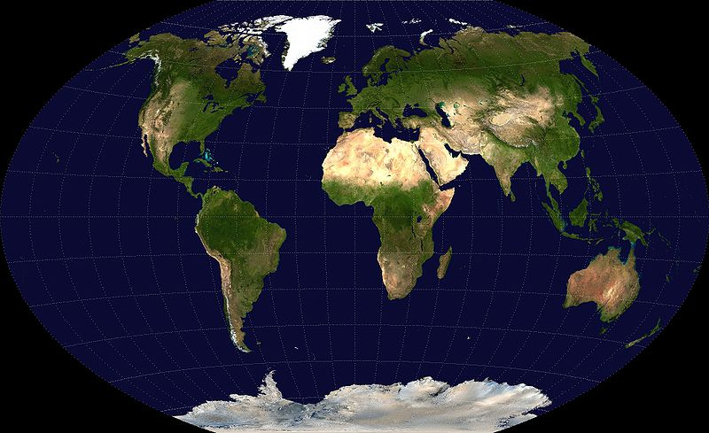
Our Earth
Notes:
NASA map, Wikimedia Commons

Slide 25
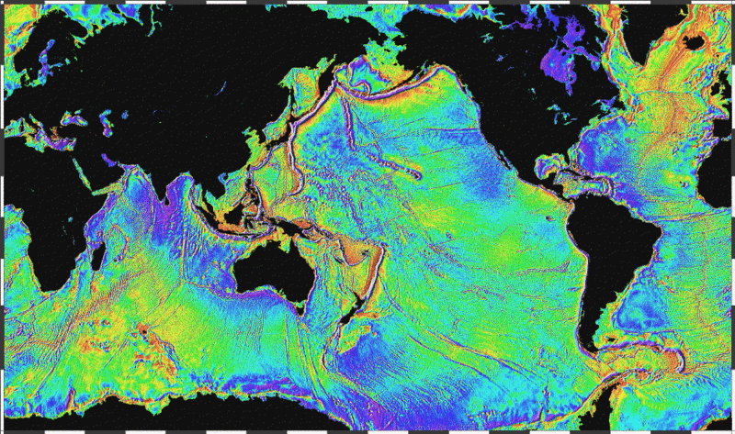
Oceans and Continents
Notes:
Oceans and continents, Wikimedia Commons

Slide 26
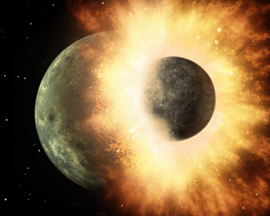
Impact Forming the Moon
Notes:
Artist's impression of the enormous collision that likely formed the moon. Wikimedia Commons

Slide 27
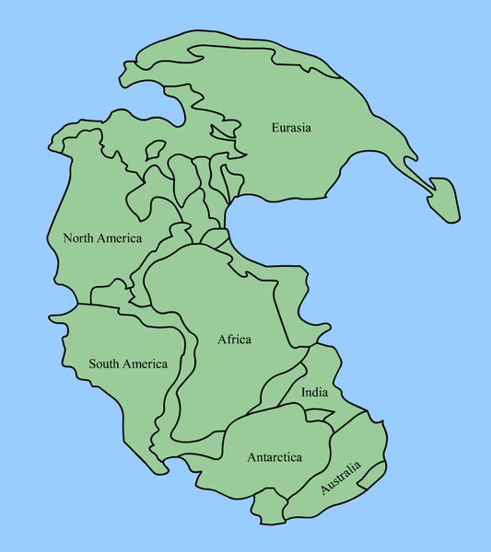
Pangaea
Notes:
Pangaea, the most recent supercontinent, existed from 300 to 180 Ma. The outlines of the modern continents and other land masses are indicated on this map. Wikimedia Commons

Slide 28
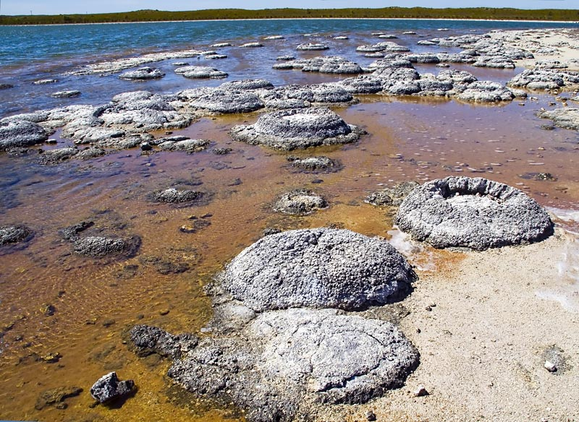
Early Life on Earth
Notes:
Stromatolites at Lake Thetis, Western Australia. Archean stromatolites are the first direct fossil traces of life on Earth. Perhaps an example of early life on Earth. Wikimedia Commons

Slide 29
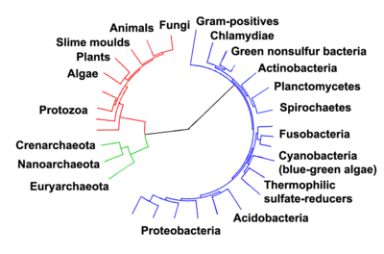
Evolution of Life
Notes:
Evolutionary tree showing the divergence of modern species from their common ancestor in the center. The three domains are colored, with bacteria blue, archaea green, and eukaryotes red. Wikimedia Commons

Slide 30
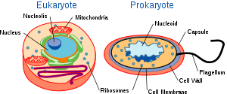
Cells
Notes:
There are two types of cells: eukaryotic and prokaryotic. Prokaryotic cells are usually independent, while eukaryotic cells are often found in multicellular organisms. Wikimedia Commons

Slide 31
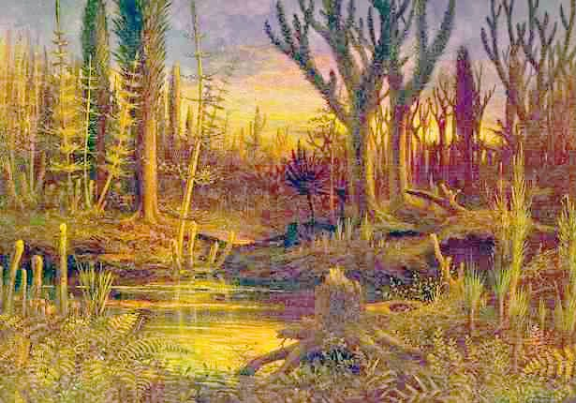
Early Plants
Notes:
Artist rendition. The Devonian period marks the beginning of extensive land colonization by plants, which through their effects on erosion and sedimentation brought about significant climatic change. Land plants evolved from chlorophyte algae, perhaps as early as 510 million years ago; some molecular estimates place their origin even earlier, as much as 630 million years ago. Wikimedia Commons

Slide 32
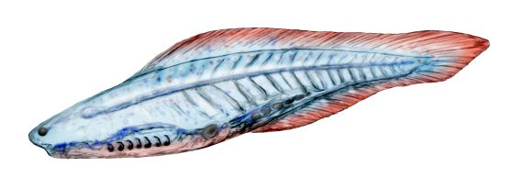
Early Vertebrates
Notes:
The early vertebrate Haikouichthys. Vertebrates originated about 525 million years ago during the Cambrian explosion, which saw the rise in organism diversity.

Slide 33
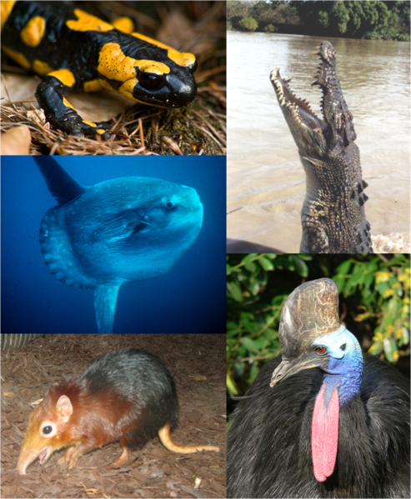
Vertebrates
Notes:
Vertebrates are the largest group of chordates, which have backbones, with currently about 58,000 species described. Vertebrates include five groups the jawless fishes, bony fishes, sharks and rays, amphibians, reptiles, mammals, and birds Vertebrates make up about 5% of all described animal species; the rest are invertebrates, which lack backbones. Wikimedia Commons
Individual organisms from each major vertebrate group. Clockwise, starting from top left: Fire Salamander, Saltwater Crocodile, Southern Cassowary, Black-and-rufous Giant Elephant Shrew, Ocean Sunfish

Slide 34
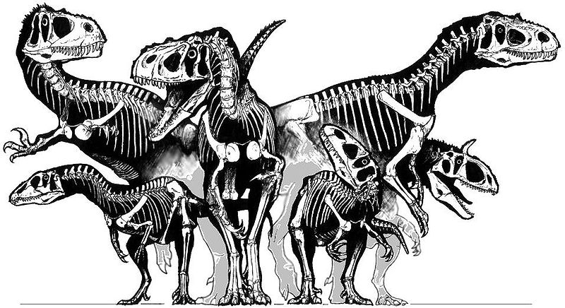
Dinosaurs
Notes:
Assemblage of dinosaurs, early reptiles. Wikimedia Commons

Slide 35
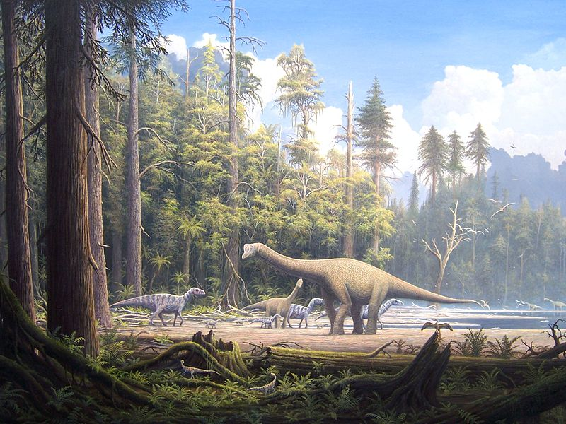
Dinosaurs
Notes:
Dinosaurs were the dominant terrestrial vertebrates throughout most of the Mesozoic. Wikimedia Commons

Slide 36
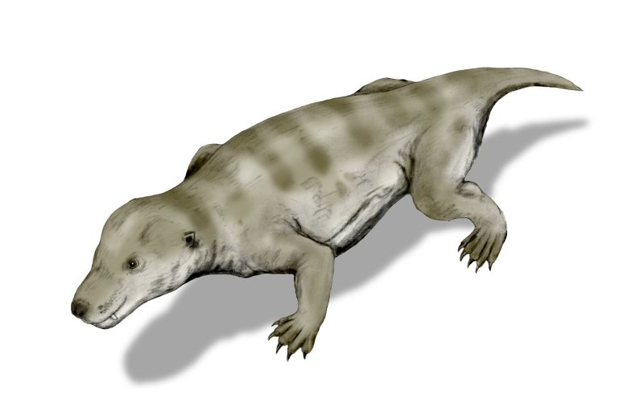
Early Mammals
Notes:
Restoration of Thrinaxodon, a member of the cynodont group, which includes the ancestors of mammals. There are suggestions that it was warm-blooded. Even so, Thrinaxodon still laid eggs, and there were many reptilian features in its skeleton. Wikimedia Commons
Its remains were found on South Africa and Antarctica, supporting the notion that the two continents were once joined together. This animal lived during the Triassic Period (248-245 million years ago). Wikimedia Commons

Slide 37
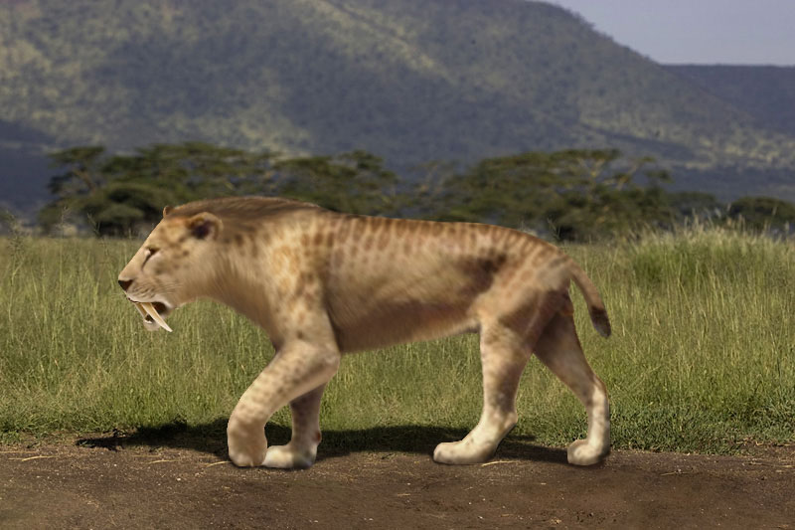
Extinct Saber Tooth Tiger
Notes:
Artist rendition, Wikimedia Commons, see book. p .62

Slide 38
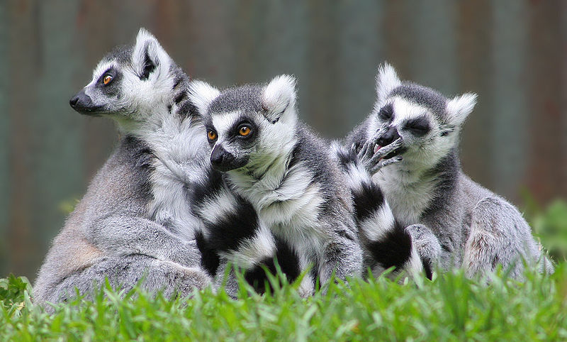
Ring Tailed Lemurs, Like Early Primates
Notes:
The primate lineage is thought to go back at least 65 mya (million years ago). Lemurs are in the line thought to be some of the earliest primates. See book p. 67. Wikimedia Commons

Slide 39
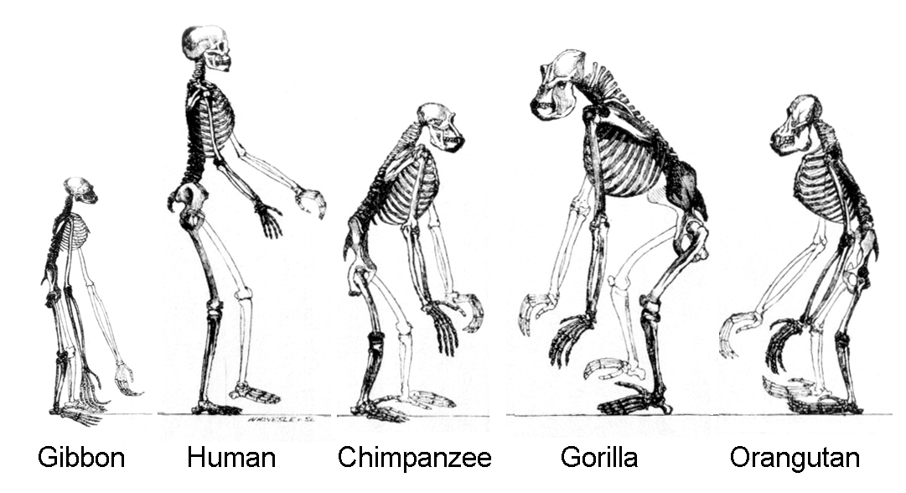
Primate Skeletons
Notes:
The hominoids are descendants of a common ancestor.
Wikimedia Commons

Slide 40
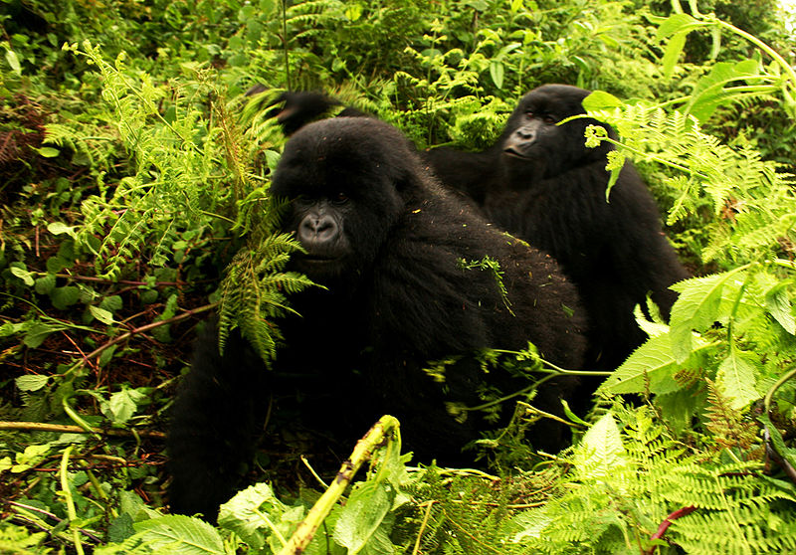
Gorillas
Notes:
Mountain gorillas, foraging in their habitat, Rwanda. Wikimedia Commons

Slide 41
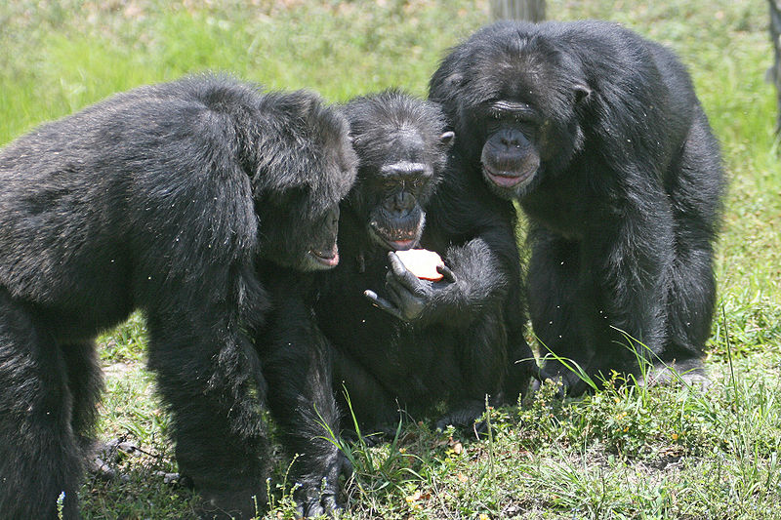
Our “Cousins,” the Chimpanzees
Notes:
Chimpanzees are social animals. We share DNA that is approximately 98.4% identical to that of chimpanzee,s when comparing single nucleotide polymorphisms. Wikimedia Commons

Slide 42
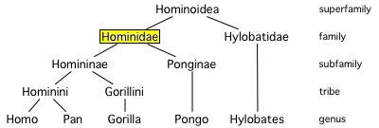
Family Tree
Notes:
Family tree showing the extant hominoids: humans (genus Homo), chimpanzees and bonobos (genus Pan), gorillas (genus Gorilla), orangutans (genus Pongo), and gibbons (four genera of the family Hylobatidae: Hylobates, Hoolock, Nomascus, and Symphalangs). All except gibbons are hominids. Wikimedia Commons

Slide 43
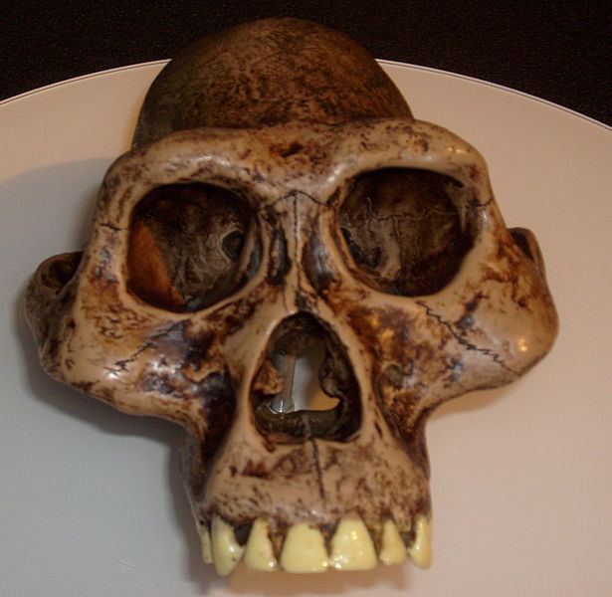
Australopithicus
Notes:
Australopithecus is a genus of hominids that is now extinct. From the evidence gathered by palaeontologists and archaeologists, it appears that the Australopithecus genus evolved in eastern Africa around 4 million years ago before spreading throughout the continent and eventually becoming extinct 2 million years ago. See book p. 68, Wikimedia Commons.

Slide 44
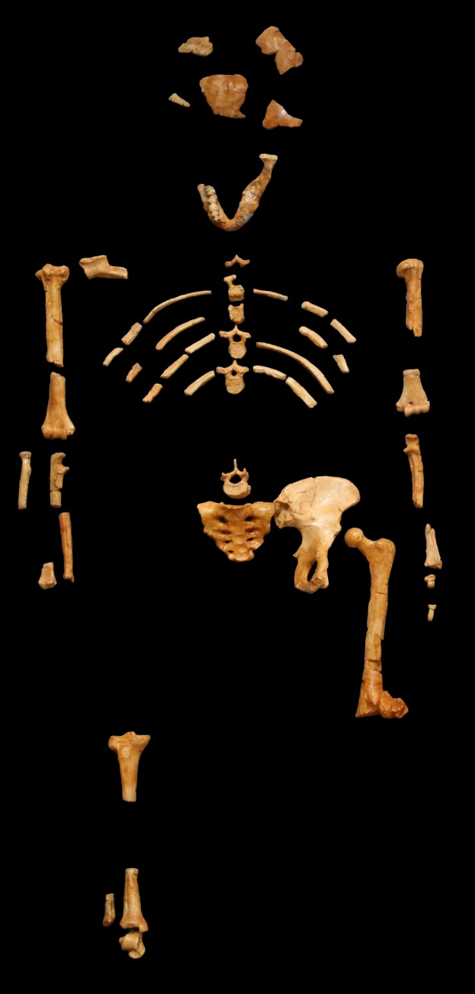
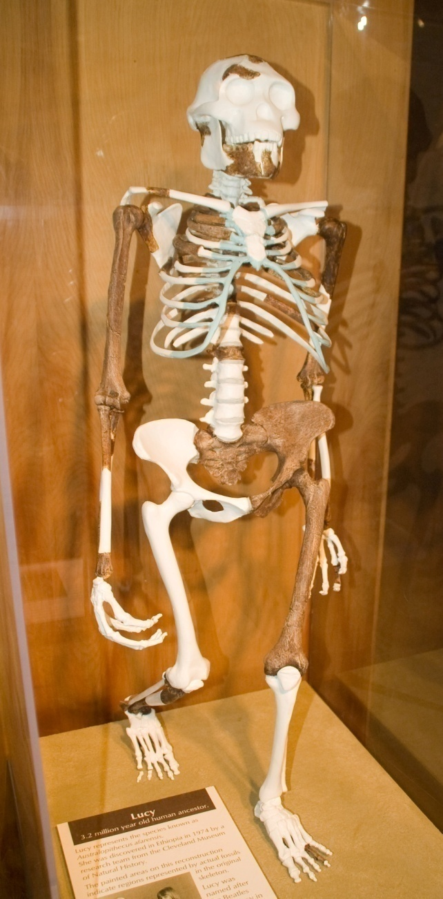
Lucy, original skeleton on l., reconstruction on r.
Notes:
Lucy is the common name of AL 288-1, several hundred pieces of bone representing about 40% of the skeleton of an individual Australopithecus afarensis. The specimen was discovered in 1974 at Hadr in the Awash Valley of Ethiopia’s Afar Depression. Lucy is estimated to have lived 3.2 million years ago. Wikimedia Commons

Slide 45
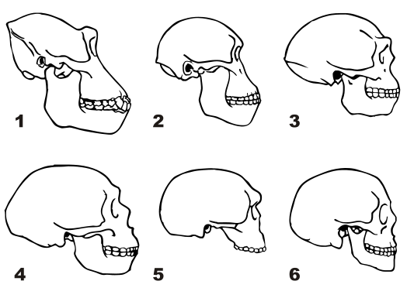
Skulls
Notes:
Skulls of 1. Gorilla 2. Australopithecine 3. Homo erectus 4. Neanderthal (La-Chapelle-au-Seine) 5. Steinheim Skull 6. Modern human Wikimedia Commons

Slide 46
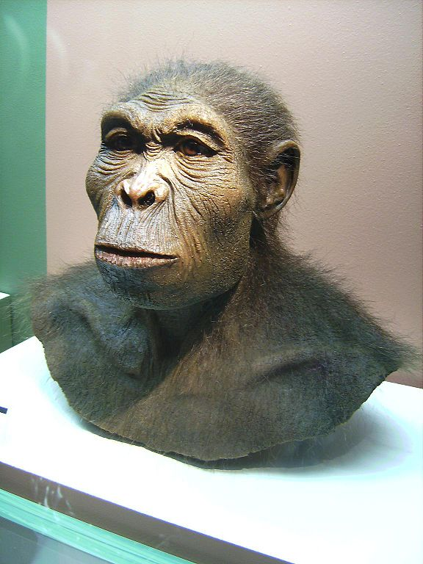
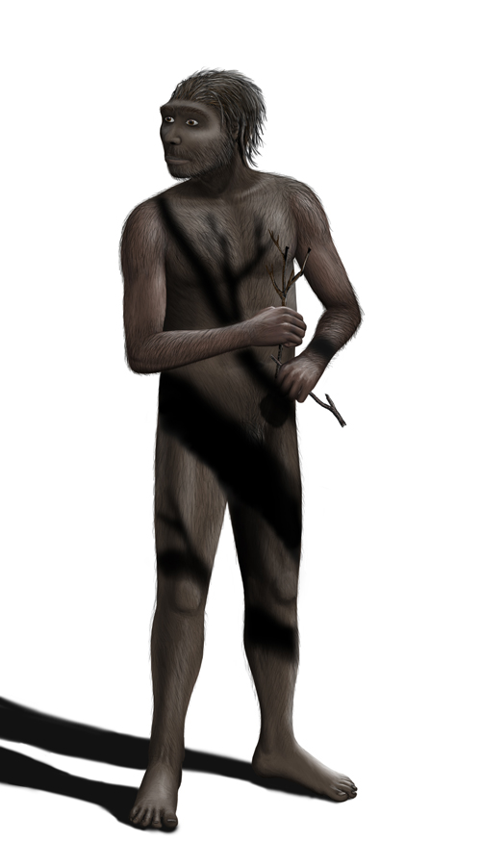
Homo Habilis l. Homo Erectus r.
Notes:
Homo habilis , "Handy-man") is a species of the genus Homo, which lived from approximately 2.33 to 1.7 Million years ago. Reconstruction of Homo habilis at the Westfälisches Museum für Archäologie, Herne. See book, p. 70, Wikimedia Commons
Homo erectus is an extinct species of hominid that lived about 1.3 to 1.8 million years ago. The species originated in Africa and spread as far as India, China and Java. Wikimedia Commons

Slide 47
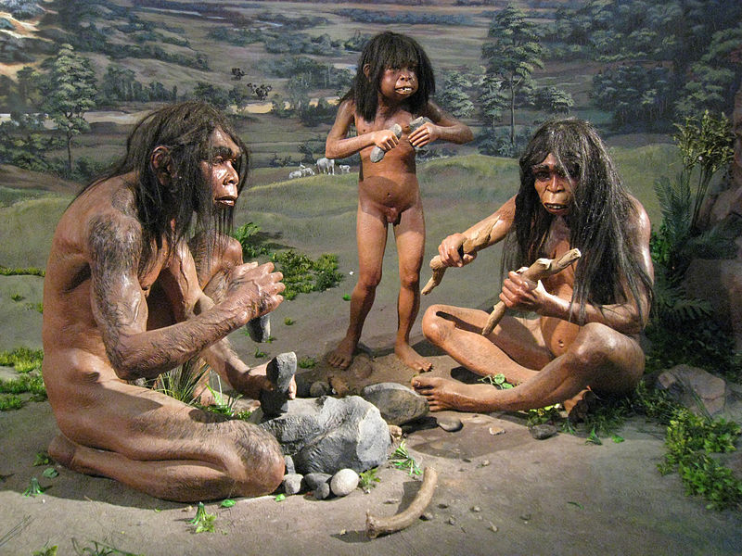
Reconstruction, Homo Erectus family
Notes:
A diorama in National Museum of Indonesia, Jakarta, depicting the life size model of stone equipped hunter, a Homo erectus family living in Sangiran about 900,000 years ago. Wikimedia Commons

Slide 48
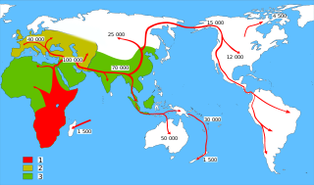
Early Human Migrations
Notes:
Map of early human migrations 1. Homo sapiens 2. Neanderthals 3. Early Hominids
Wikimedia Commons

Slide 49
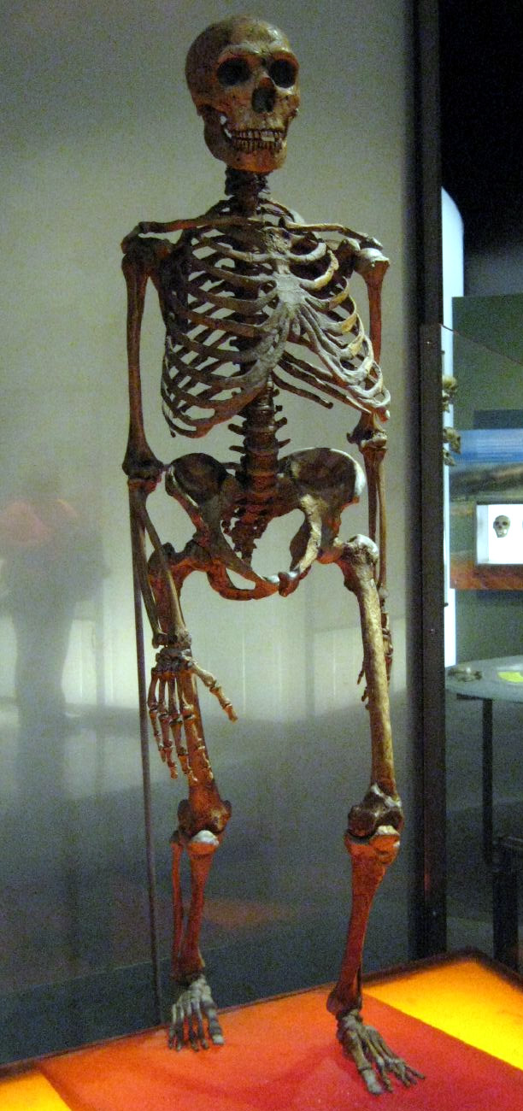

Neanderthals
Notes:
Mounted Neanderthal skeleton, American Museum of Natural History on right
Reconstruction on left. Wikimedia Commons
is an extinct member of the Homo genus known from Pleistocene specimens found in Europe and parts of western and central Asia. Neanderthals are classified either as a subspecis of Homo sapiens (Homo sapiens neanderthalensis) or as a separate human species (Homo neanderthalensis). Genetic evidence suggests interbreeding took place with anatomically modern humans between roughly 80,000 and 50,000 years ago in the Middle East, resulting in 1–4% of the genome of people from Eurasia having been contributed by Neanderthals.[

Slide 50

Sites of Neanderthal Fossils
Notes:
Sites where typical Neanderthal fossils have been found.

Slide 51

To Modern Humans
Notes:
For educational purposes only, do not reproduce.
Image Source Page: http://actividadoctavo.blogspot.com/

